Slide 1
Mass, Force and Gravity
Mass – Amount of stuff (atoms/molecules) in an object. Measured in kg.
Force – Measures the gravitational pull on something. Measured in N (newtons)
Earths Gravitational Field Strength – 10N/kg. (The gravitational field strength at the surface of the Earth produces a force of approximately 10 N on every mass of 1 kg)

Slide 2
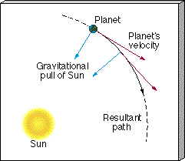
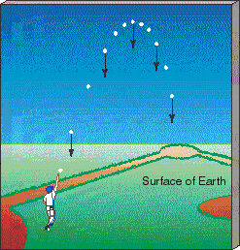
Gravitational field
Sun’s gravitational force makes the Earth move in an orbit around the Sun.
Earth’s gravitational force makes the ball move down towards the centre of the Earth.

Slide 3
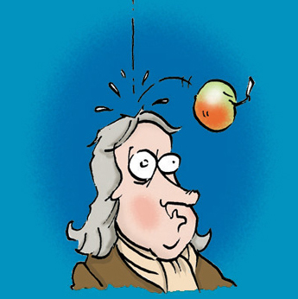
Putting it all together
The apple has mass (kg)
It gets pulled to the ground at a force (this can be measured in Newtons)
The earth’s gravitational field strength pulls the apple towards it

Slide 4
Now…
Weight – Is a measure of force pulling something to the ground due to gravity
Hang on a minute…that sounds very familiar…

Slide 5
Weight = Force
Weight is measured in N (newtons)

Slide 6
Putting it all together
The apple has mass (kg)
It gets pulled to the ground at a force (this can be measured in Newtons) = WEIGHT
The earth’s gravitational field strength pulls the apple towards it

Slide 7
How can we calculate weight?
We can use an equation we already know to help us:
g (gravitational field strength) = force / mass
If Force = Weight
Weight = Mass x g (gravitational field strength)
Memorise: W = m X g

Slide 8
This powerpoint was kindly donated to www.worldofteaching.com
http://www.worldofteaching.com is home to over a thousand powerpoints submitted by teachers. This is a completely free site and requires no registration. Please visit and I hope it will help in your teaching.

