Slide 1
Standard Grade Physics
Health Physics
Using Ionising Radiation in Medicine

Slide 2
By the end of this lesson, and for the exam, you should be able to:
Describe one medical use of radiation based on the fact that that it can destroy cells (instrument sterilisation, treatment of cancer) (General level).
Describe one medical use of radiation based on the fact that radiation is easy to detect (General level).
Notes:
It should be ionising radiation but the Standard Grade Arrangements in Physics does not state this.

Slide 3
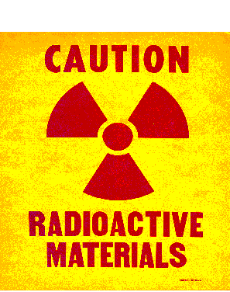
There are 3 main uses of ionising radiation in medicine:
Treatment
Diagnosis
Sterilisation
Notes:
Ask pupils: what would ionising radiation in medicine be used for?

Slide 4
What is Cancer?
Cancers are growths of cells (cancerous tumours) which are out of control. As a result of this, they do not perform their intended function.
Notes:
Ask pupils: what would ionising radiation be used to treat?
Ask pupils: what is cancer?

Slide 5
Treatment of Cancer
Cancerous tumours can be treated using the following main methods:
Chemotherapy (drugs).
Radiation therapy (radiotherapy and brachytherapy).
Surgery.

Slide 6
Factors Which Affect the Choice of Treatment for Cancer
The choice of treatment depends on a number of factors including:
The size of the tumour.
The position of the tumour.
Notes:
Ask pupils: what factors have to be considered when selecting the choice of treatment for cancer?

Slide 7
The Aims of Radiation Therapy
The aim of radiation therapy is to cause damage to the cancerous cells whilst minimising the risk to surrounding healthy tissue.
The damage inflicted by radiation therapy causes the cancerous cells to stop reproducing and thus the tumour shrinks.
Unfortunately, healthy cells can also be damaged by the radiation.
Notes:
Inform the class that they are going to concentrate on radiation therapy in the treatment of cancer.

Slide 8
Why does the amount of radiation given to the patient have to be accurately calculated?
The amount of radiation given to the patient has to be accurately calculated so that the damage is limited to the cancerous cells only.

Slide 9
Radiation Therapy
Radiation therapy uses ionising radiation to treat cancer i.e. to destroy cancerous cells.
There are two techniques in radiation therapy that are used to treat cancer using ionising radiation:
Radiotherapy
Brachytherapy
Notes:
Stress to pupils that they only need to know about radiotherapy.

Slide 10
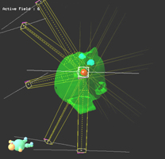
Radiotherapy Treatment Planning
Every treatment using radiotherapy has to be rigorously planned. The planning process consists of three phases:
Planning
Simulation
Treatment

Slide 11
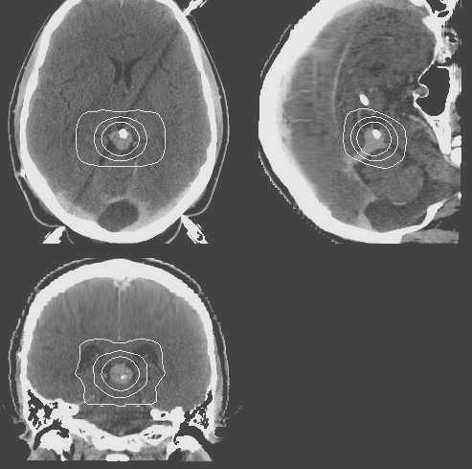
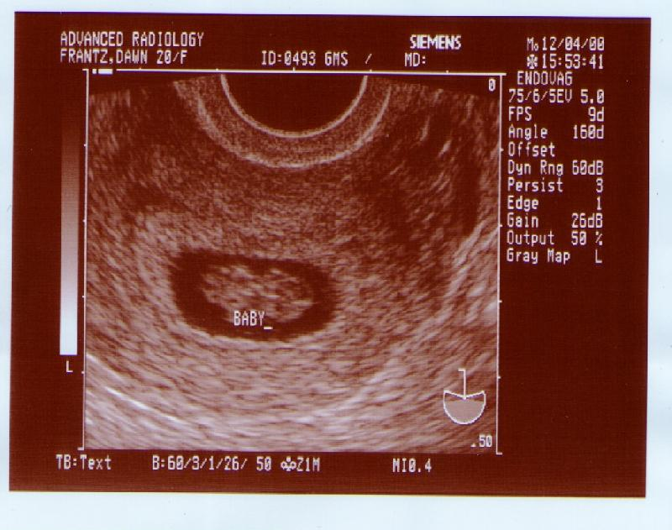
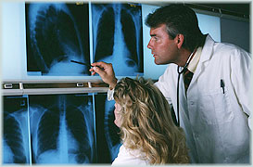
Radiotherapy Treatment Planning Planning
The cancerous tumour has to be located so that its size and position can be analysed. This information can be obtained from:
X-rays
CT scans
MRI scans
Ultrasound images

Slide 12
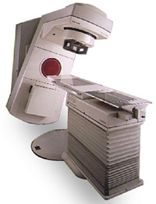
Radiotherapy Treatment Planning Simulation
Once the amount of radiation to be given has been accurately calculated, the patient then goes to the simulator to determine what settings are to be selected for the actual treatment using a linear accelerator.
The settings are determined by taking a series of x-rays to make sure that the tumour is in the correct position ready to receive the ionising radiation.

Slide 13
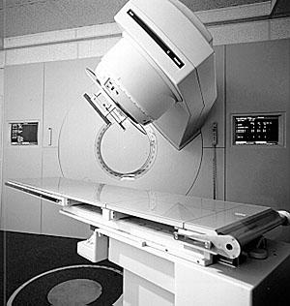
Radiotherapy Treatment Planning Treatment
Cancerous tumours can be treated using radiotherapy as follows:
Irradiation using high energy gamma rays.
Irradiation using high energy x-rays.

Slide 14
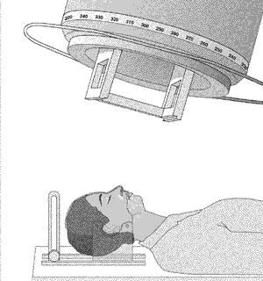
Radiotherapy Treatment Irradiation Using High Energy Gamma Rays
Gamma rays are emitted from a cobalt-60 source – a radioactive form of cobalt.
The cobalt source is kept within a thick, heavy metal container.
This container has a slit in it to allow a narrow beam of gamma rays to emerge.

Slide 15
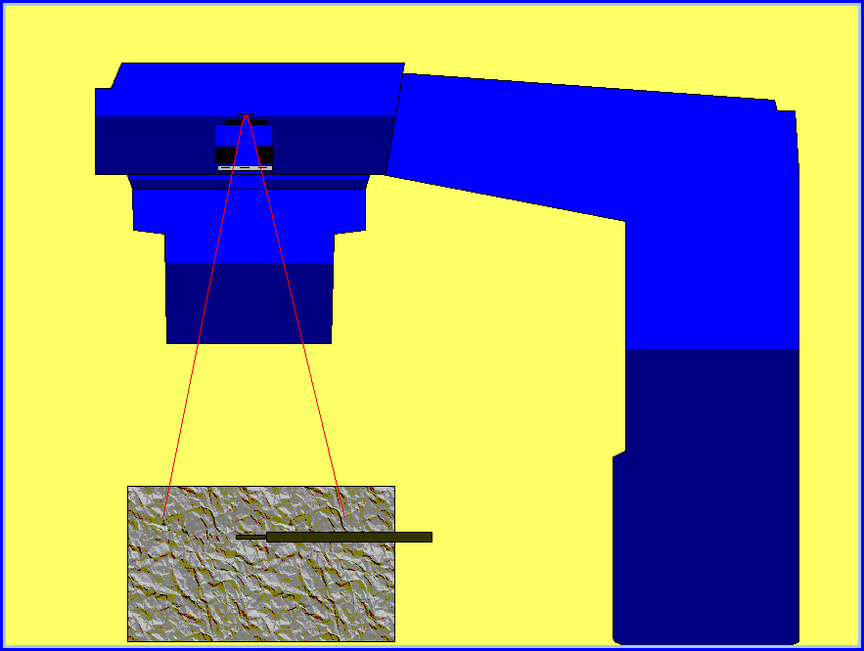
Radiotherapy Treatment Irradiation Using High Energy X-rays
The x-rays are generated by a linear accelerator (linac).
The linac fires high energy electrons at a metal target and when the electrons strike the target, x-rays are produced.
The x-rays produced are shaped into a narrow beam by movable metal shutters.
Notes:
Stress to the class that Cobalt-60 machines are no longer used in hospitals but it is still in Standard Grade Physics Textbooks.

Slide 16
Treatment of Cancer Radiotherapy
The apparatus is arranged so that it can rotate around the couch on which the patient lies.
This allows the patient to receive radiation from different directions.
The diseased tissue receives radiation all of the time but the healthy tissue receives the minimum amount of radiation possible.
Treatments are given as a series of small doses because cancerous cells are killed more easily when they are dividing, and not all cells divide at the same time – this reduces some of the side effects which come with radiotherapy.
Notes:
Inform the class of what types of cancer are treated using radiotherapy.

Slide 17
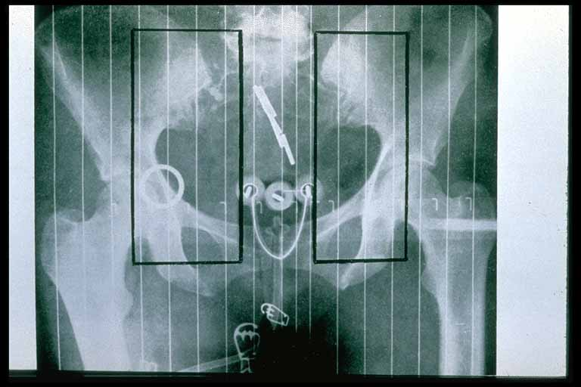
Radiation Therapy Brachytherapy
This involves placing implants in the form of seeds, wires or pellets directly into the tumour.
Such implants may be temporary or permenant depending on the implant and the tumour itself.
The benefit of such a method is that the tumour receives nearly all of the dose whilst healthy tissue hardly receives any.

Slide 18
Radiation Therapy Brachytherapy
Brachytherapy is used to treat the following cancers:
Uterus
Cervix
Prostate
Intraocular
Skin
Thyroid
Bone

Slide 19
Tracers
There are many uses of ionising radiation based on the fact that it is easy to detect. In such applications, the radioactive material is used in the form of a tracer.
In nuclear medicine, a tracer is a radioactive substance which is taken into the body either, as an injection, or as a drink. Such a substance is normally a gamma emitter which is detected and monitored.
This gives an indication of any problems that may be present in body organs or tissues by how much, or how little, of the substance has been absorbed.
Notes:
Stress to the class that most tracers come in the form of an injection.

Slide 20
Nuclear Medicine Tracers
It is important to be able to study internal organs, or tissues, without the need for surgery. In such cases, radioactive tracers can be injected into the body so such studies can take place. The path of these tracers can be detected using a gamma camera because of their radioactivity.
Such tracers consist of two parts:
A drug which is chosen for the particular organ that is being studied.
A radioactive substance which is a gamma emitter.
Notes:
Give the class examples: asprin, paracetamol, ibuprofen – pain, antibiotics – immune system, etc.

Slide 21
Tracers Used in Nuclear Medicine
Pharmaceutical | Source | Activity (MBq) | Medical Use
Pertechnetate | ^{99m}Tc | 550 - 1200 | Brain Imaging
Pyrophosphate | ^{99m}Tc | 400 - 600 | Acute Cardiac Infarct Imaging
Diethylene Triamine Pentaacetic Acid (DTPA) | ^{99m}Tc | 20 - 40 | Lung Ventilation Imaging
Benzoylmercaptoacetyltriglycerine (MAG3) | ^{99m}Tc | 50 - 400 | Renogram Imaging
Methylene Diphosphonate (MDP) | ^{99m}Tc | 350 - 750 | Bone Scans

Slide 22
Factors Which Affect the Choice of Tracer
Such tracers are chosen so that:
They will concentrate in the organ, or tissue, which is to be examined.
They will lose their radioactivity (short t).
They emit gamma rays which will be detected outside the body.

Slide 23
Factors Which Affect the Choice of Tracer
Gamma rays are chosen since alpha and beta particles would be absorbed by tissues and not be detected outside the body.
Technitium-99m is most widely used because it has a half-life of 6 hours.
Notes:
Ask pupils: why are gamma rays chosen?
Ask pupils: what would be an appropriate half-life?

Slide 24
Why is a half-life of 6 hours important?
A half-life of 6 hours is important because:
A shorter half-life would not allow sufficient measurements or images to be obtained.
A longer half-life would increase the amount of radiation the body organs or tissues receive.
Notes:
Ask pupils: why is a half-life of 6 hours important? What happens if it is longer or shorter?

Slide 25
The Gamma Camera
The tracer is injected into the patient. The radiation emitted from the patient is detected using a gamma camera.
A typical gamma camera is 40 cm in diameter – large enough to examine body tissues or specific organs. The gamma rays are given off in all directions but only the ones which travel towards the gamma camera will be detected.

Slide 26
The Gamma Camera
A gamma camera consists of three main parts:
A collimator.
A detector.
Electronic systems.
electronic systems
detector
collimator

Slide 27
The Gamma Camera
The Collimator
The collimator is usually made of lead and it contains thousands of tiny holes.
Only gamma rays which travel through the holes in the collimator will be detected.

Slide 28
The Gamma Camera
The Detector
The detector is a scintillation crystal and is usually made of Sodium Iodide with traces of Thallium added.
The detector is a scintillation crystal and it converts the gamma rays that reach it into light energy.

Slide 29
The Gamma Camera
The Electronic Systems
The electronic systems detect the light energy received from the detector and converts it into electrical signals.

Slide 30
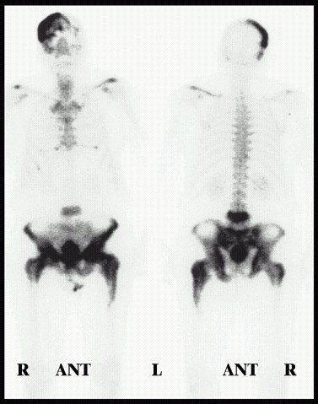
Diagnosis Static Imaging
There is a time delay between injecting the tracer and the build-up of radiation in the organ.
Static studies are performed on the brain, bone or lungs scans.

Slide 31
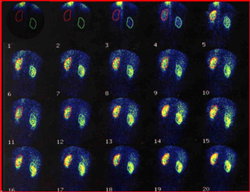
Diagnosis Dynamic Imaging
The amount of radioactive build-up is measured over time.
Dynamic studies are performed on the kidneys and heart.

Slide 32
Dynamic Imaging The Renogram
Renograms are dynamic images of the kidneys and they are performed for the following reasons:
To assess individual kidney and/or bladder function.
To detect urinary tract infections.
To detect and assess obstructed kidney(s).
To detect and assess vesico-ureteric reflux.
To assess kidney transplant(s).

Slide 33
Performing the Renogram
The tracer is injected into the patient.
The radioactive material is removed from the bloodstream by the kidneys.
Within a few minutes of the injection, the radiation is concentrated in the kidneys.
After 10 – 15 minutes, almost all of the radiation should be in the bladder.
The gamma camera takes readings every few seconds for 20 minutes.

Slide 35
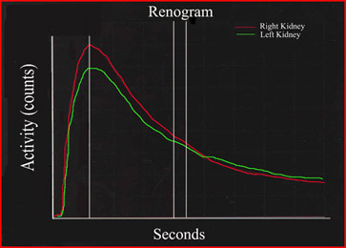
Diagnosis The Renogram
The computer adds up the radioactivity in each kidney and the bladder.
This can be shown as a graph of activity versus time – a time-activity curve.

Slide 36
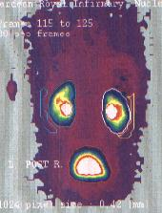
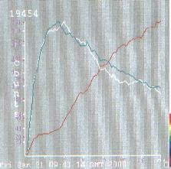
A Normal Renogram

Slide 37
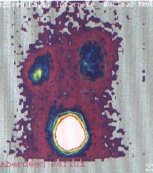
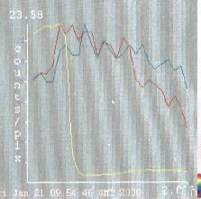
An Abnormal Renogram

Slide 38
Sterilisation
Radiation not only kills cells, it can also kill germs or bacteria.
Nowadays, medical instruments (e.g. syringes) are prepacked and then irradiation using an intense gamma ray source.
This kills any germs or bacteria but does not damage the syringe, nor make it radioactive.

Slide 39
Summary
Ionising radiation is used in radiotherapy to treat cancer and to sterilise medical equipment because it destroys cells.
Radioactive tracers are used in nuclear medicine because the ionising radiation it emits is easy to detect.
Notes:
Ask pupils: why is the ionising radiation emitted from radioactive tracers easy to detect?

Slide 40
Summary
There are 3 main uses of ionising radiation in medicine: treatment, diagnosis and sterilisation.
Radiotherapy is used to treat cancers by irradiating them with ionising radiation.
Radioactive tracers are used to diagnose and investigate several medical conditions.
Ionising radiation is used to sterilise medical equipment as it kills germs and/or bacteria.
Notes:
Stress to pupils: ionising radiation is used to treat cancer and to sterilise medical equipment because it destroys cells and that radioactive tracers are used because the ionising radiation it emits is easy to detect.

Slide 41
Careers
Oncologist.
Medical Physicist.
Radiographer.
Radiation Protection.
Environmental Protection.
Dosimetrist.
Research.

Slide 42
Any questions?

