Slide 1
Microwave
Telescopes
Parvaneh, Shelby & Marleena
Visit www.worldofteaching.com
For 100’s of free powerpoints

Slide 2
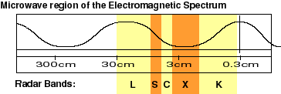
Discovery (domestic use)
Microwaves have wavelengths range from centimeters to those closer to a foot in length.
Longer are for heating food.
Shorter waves Doppler radar
Microwaves were first utilized by British the 1940s during WWII.
Sir John Randall and Dr. H. A. Boot, invented a device called a magnetron (Radar) using microwaves to detect Nazi warplanes.
1945, examining the magnetron, Percy Spencer’s candy bar melted
Product was marketed, thank goodness Percy was a chocolate lover!
www.sabers.org/STELLA%20CANDY%20BAR.JPG

Slide 3
Cosmic Microwave Background (CMB)
1960's at scientists at Bell Laboratories detected background noise using a special “low noise” antenna.
This static noise came from every direction and did not vary in intensity.
The scientists soon realized they had discovered the cosmic microwave background radiation.
“This radiation, which fills the entire Universe, is believed to be a clue to it's beginning, something known as the Big Bang.”

Slide 4
Big Bang Model
Universe was once much smaller, hotter, and denser
Based off of Einstein’s theory of general relativity
Expansion of the universe – 1929
Lightest elements
Deuterium, helium, lithium
CMB
oldwww.internet2.edu/apps/html/archives.html

Slide 5
What the CMB tells us about the Universe
The geometry of the universe
Whether the universe will expand or collapse
How much matter there is in the universe
Amount and nature of dark matter and energy
Expansion rate of the universe
Age of the universe
The origins of galaxies and galaxy clusters

Slide 6
Origins of the CMB
Universe cooled as expanded – became less dense
Density variations affected temp. of photons
Dense regions = hot spots in CMB
300,000 years – cooled enough to form atoms
Photons traveled through – form relic radiation
Gravitational collapse – 1 billion years
Created galaxies

Slide 7
Brief History and COBE
“The cosmic microwave background radiation is a remnant of the Big Bang and the fluctuations are the imprint of density contrast in the early universe.”
COBE (November 18, 1989- 1993)
Frequent observations were made over 6 mo. periods for 4 years.
DIRBE (Diffuse InfraRed Experiment)
FIRAS (Far-InfaRed Absolute Spectrophotometer)
DMR (Differential Microwave Radiometers)
DMR Receiver

Slide 8
Differential Microwave Radiometer
COBE’s findings at different levels of contrast:
Variations in intensity of the cosmic microwave background, show the post-Big Bang matter and energy distribution.
Uniformity / Isotropic CMB (top)
temperature of CMB
Black body curve (middle)
One hot and cold spot in the sky coming from our Solar System's motion through the galaxy.
Density Ripples (bottom)
Further contrast “with our local motion removed.” hot red stripe through the center marks the galactic plane and above and below are variations in microwaves of the CMB!
2.728 K
3.353 mK
18µK

Slide 10
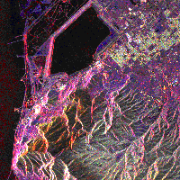
What are Microwaves used for?
Heating, transmitting information, remote sensing
Shorter microwaves used for remote sensing
Doppler radar
Active remote sensing system
Microwaves pierce through all cloud covering of earth
Satellite images
http://imagers.gsfc.nasa.gov/ems/micro.html

Slide 11
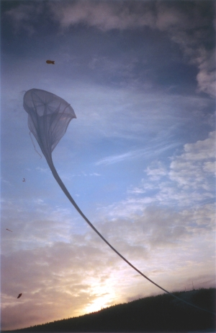
Archeops
Balloon Born Telescope
Aims
High quality CMB data with unmatched sky coverage
Competitive results on CMB anisotropy measurements
Testbed for data analysis to be used in PLANCK
http://journal.archeops.org/First_results/index.html

Slide 12
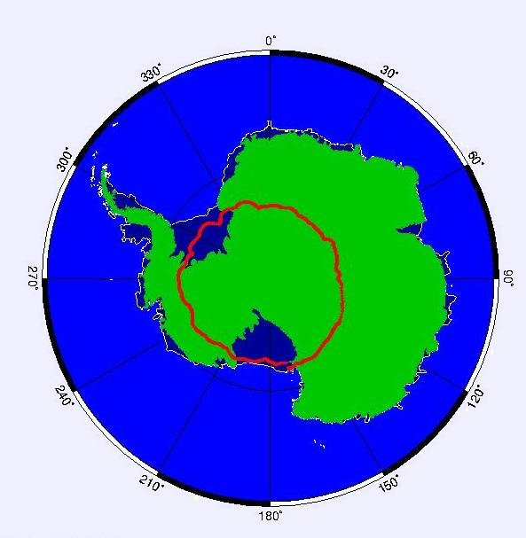
Boomerang
Balloon born telescope
Dec. 29, 1998 – Jan. 9, 1999
10.5 days around antarctica
120,000 ft
1.2 m primary mirror
Measured sky at 4 frequencies
90, 150, 240, 400
Covered 1800 square degrees (3% of sky)
http://cmb.phys.cwru.edu/boomerang/press_images/cmbfacts/cmbfacts.html

Slide 13
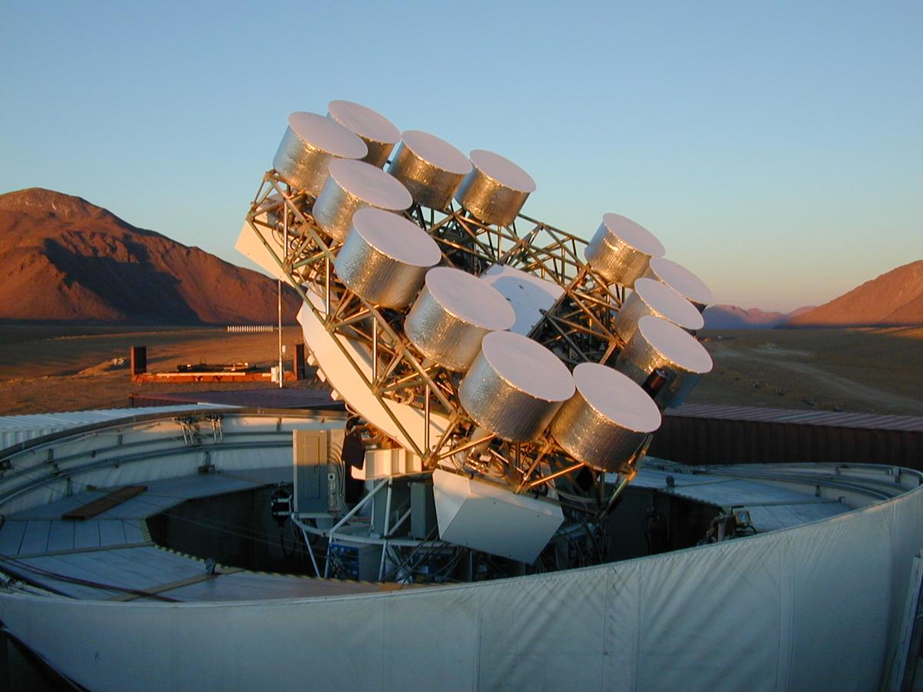
Cosmic background Imager
radio telescope to study CMB radiation
Measure the statistical properties on angular scales from 5 arc minutes to one degree
13 element interferometer
Field of view – 44 arcmin
Resolution – 4.5-10 arcmin
Looks at foreground
Unresolved sources measured by 40 m telescope in Owens Valley Radio Observatory
http://www.astro.caltech.edu/~tjp/CBI/pictures/cbi-frontview.html

Slide 14
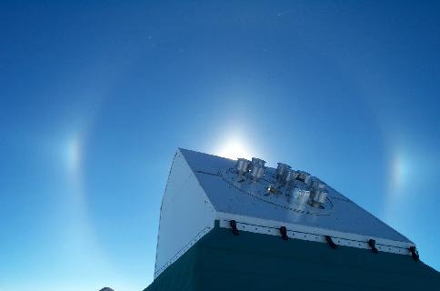
DASI
Degree Angular Scale Interferometer
13 elemental interferometer
Measure temp and angular power spectrum
http://astro.uchicago.edu/dasi/
Sampled over l range of 160-170 or .25-1.15 degrees
Mount includes rotation of aperture plane along line of sight

Slide 15
WMAP
Wilkinson Microwave Anisotropy Probe
Launched 2001 to map CMB radiation with higher resolution, sensitivity, and accuracy than COBE
http://map.gsfc.nasa.gov/m_mm/sg_earlyuniv.html

Slide 16
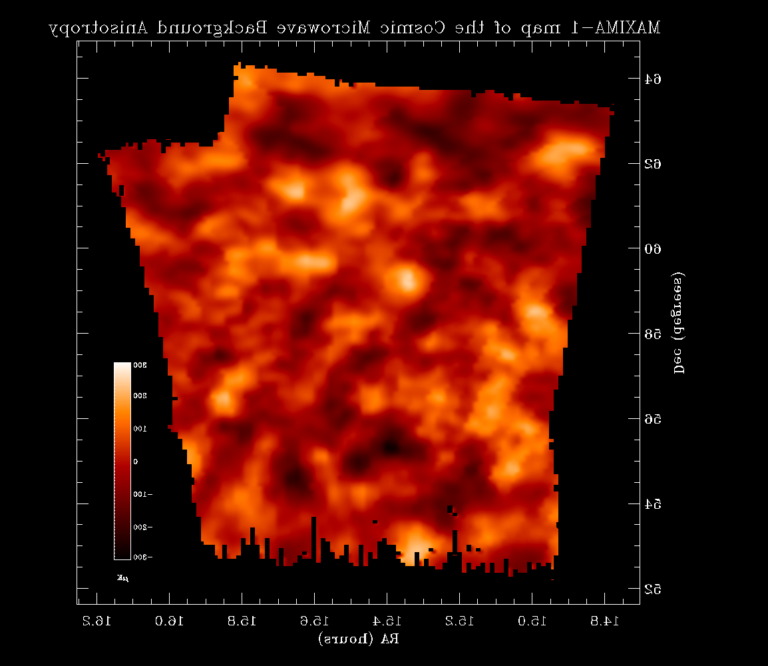
MAXIMA
Millimeter Anisotropy eXperiment Imaging Array
angular power spectrum with a unique set of "acoustic peaks" between the angular scales of 2 degrees and 10'
can provide precise estimates of cosmological constants
http://cosmology.berkeley.edu/group/cmb/image/maxima_map.gif

Slide 17
Plank
Part of the first European mission to study the “birth” of the Universe
Construction to be finished in 2005
Launched in the same rocket with Herschel in 2007
Will observe the Cosmic Microwave Background (left over radiation from the Big Bang)

Slide 18
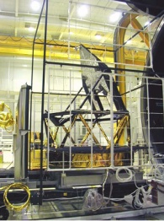
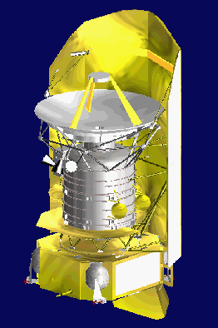
PLANK
http://spaceflightnow.com/news/n0006/13planck/
http://sci.esa.int/science-e/www/object/index.cfm?fobjectid=34875
http://www.dsri.dk/planck/

Slide 19
The South Pole Telescope (SPT)
An 8-meter precision submillimeter-wave telescope
Distant galaxy clusters through detection of their Sunyaev-Zel’dovich effect (SZE)
Dark Energy will be observed in great detail
1,000 Bolometers (heat detectors) measure the temperature differences up to 10 millionths of a degree
Mapping large areas of the sky will be very beneficial to modern astronomers

Slide 20
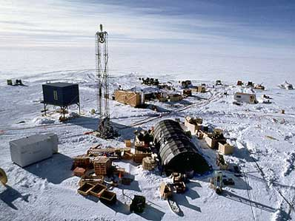
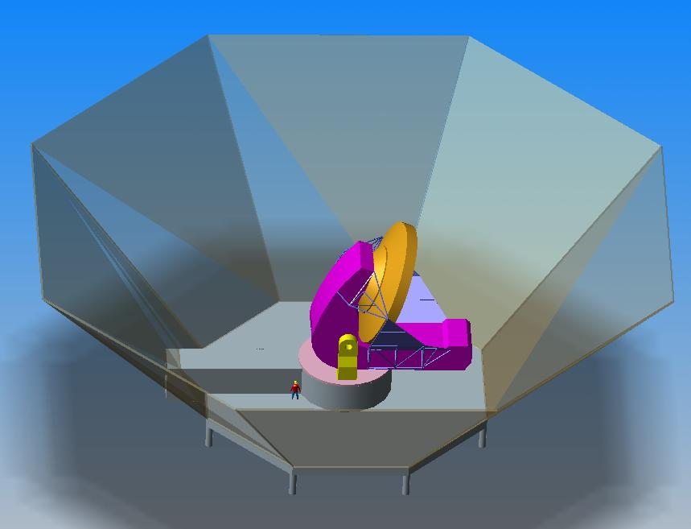
The South Pole Telescope
http://astro.uchicago.edu/spt/
http://www.spaceflightnow.com/news/n0301/29polescope/

Slide 21
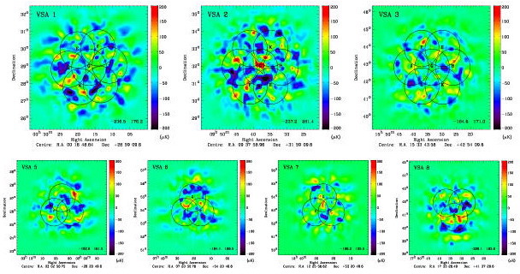
The Very Small Array (VSA)
Will be built as an Inferometer, due to the changing weather patterns and the basic noise of the instruments that are experienced
Uses radio signals received by each antenna
Construction finished in 1999→ now in Tenerife
http://www.mrao.cam.ac.uk/telescopes/vsa/

Slide 22
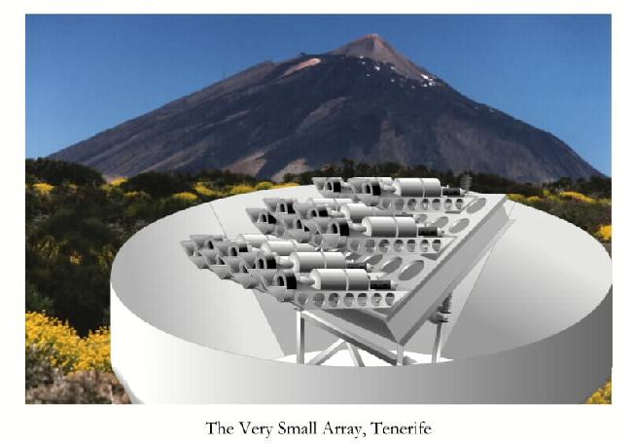
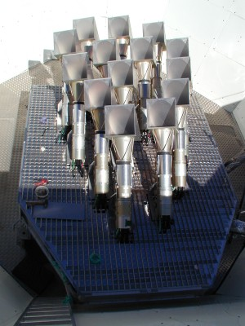
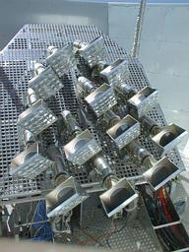
Very Small Array
www.mpifr-bonn.mpg.de/.../ teleskope/vsa_art1.jpg
www.jb.man.ac.uk/tech/ technology/array-top.jpg
www.mrao.cam.ac.uk/ telescopes/vsa/ext-array.jpg

Slide 23
Bibliography
http://www.archeops.org/
http://cmb.phys.cwru.edu/boomerang/
http://www.astro.caltech.edu/~tjp/CBI/
http://astro.uchicago.edu/dasi/
http://map.gsfc.nasa.gov/
http://cosmology.berkeley.edu/group/cmb/index.html
http://imagers.gsfc.nasa.gov/ems/micro.html
Comins & Kaufmann III, Discovering the Universe; 2003
http://aether.lbl.gov/www/projects/cobe/COBE_Home/DMR_Images.html
http://map.gsfc.nasa.gov/m_uni/uni_101bbtest3.html
http://nacho.princeton.edu/fowler/Talks/Brazosport_2001/slide30.html
http://www.ideafinder.com/history/inventions/story068.htm

