Slide 1
Mutation
Higher Biology

Slide 2
Mutation
Change in structure or amount of an organism’s genetic material
Change in genotype produces change in phenotype = mutant
2 types of mutation
Chromosome mutation
Change in structure of one chromosome

Slide 3
Chromosome mutations
Change in chromosome number
Non-disjunction in meiosis
Non-disjunction of sex chromosomes
Complete non-disjunction and polyploidy

Slide 4
Non-disjunction during meiosis
Spindle fibre fails during meiosis
Members of one pair of homologous chromosomes fail to become separated
2 gametes receive extra copy of affected chromosome
2 gametes lack that chromosome

Slide 5
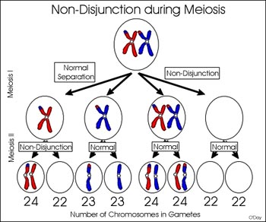

Slide 6
Down’s Syndrome
Non-disjunction in chromosome 21
Occurs in human egg mother cell
One or more abnormal eggs formed (n = 24)
Fertilised by normal sperm (n = 23)
Formation of abnormal zygote (2n = 47)

Slide 7
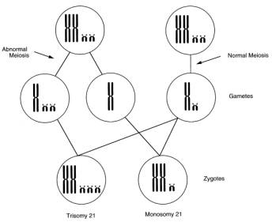

Slide 8
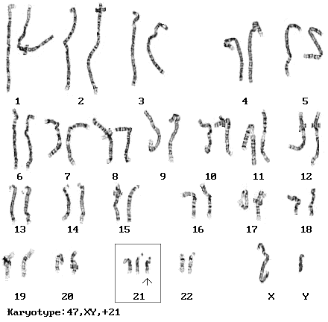

Slide 9
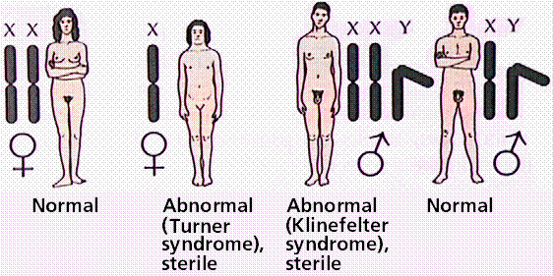
Non dis-junction of sex chromosomes

Slide 10
Turner’s syndrome
Gamete with no sex chromosomes fuses with normal X gamete
Zygote has chromosome complement 2n = 45
Individuals are female and short in stature
Infertile because ovaries haven’t developed normally

Slide 11
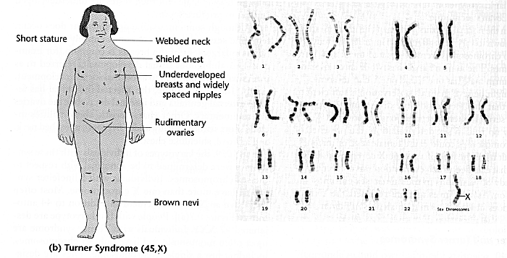

Slide 12
Klinefelter’s syndrome
XX egg fertilised by normal Y sperm
or
Normal X egg is fertilised by an XY sperm
Zygote has chromosome complement 2n = 47 (44 + XXY)

Slide 13
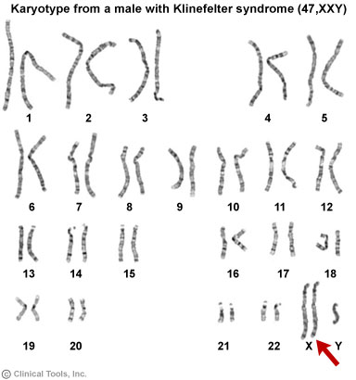

Slide 14
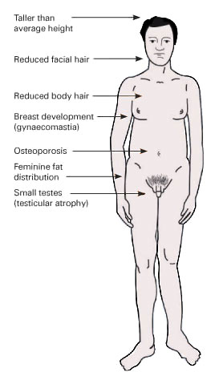
Always male
Normally infertile
Cannot produce sperm

Slide 15
Complete non-disjunction and polyploidy
All the spindle fibres in a gamete mother cell fail
All homologous pairs fail to become separated
Production of abnormal diploid gametes
Each contains 2 complete sets of chromosomes instead of one

Slide 16
Polyploidy
Fertilisation of abnormal gametes
Formation of mutant plants which possess complete extra sets of chromosomes
This type of chromosome mutation is called polyploidy

Slide 17
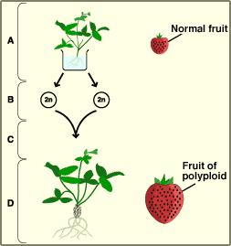
A: the strawberry plant is exposed to a chemical
B: due to the effect of chemical, total non-disjunction at meiosis produces diploid gametes(2n)
C: two diploid gametes fuse at fertilisation
D: a new plant develops which has four sets of chromosomes (4n)

Slide 18
Economic significance
Polyploid plants are larger than diploid relatives
Increased seed and fruit size
Many commercially developed crop plants are polyploid
-apples -strawberries
-tomatoes -wheat
Give greater yields

Slide 19
Effects of polyploidy
Uneven sets of chromosome
-polyploidy plants are sterile
Produce seedless fruit
Increase in vigour
Resistance to disease

Slide 20
This powerpoint was kindly donated to www.worldofteaching.com
http://www.worldofteaching.com is home to over a thousand powerpoints submitted by teachers. This is a completely free site and requires no registration. Please visit and I hope it will help in your teaching.

