Slide 1
Natural Selection in Action
Higher Biology

Slide 2
Natural Selection in Action
Most mutations produce inferior versions of original gene
Some mutations allow adaption to a changing environment
Mutant allele gives mutant form of organism a selective advantage
Change in environment
-abiotic factor (e.g. pollution)
-biotic factor (e.g. disease)

Slide 3
Sickle cell anaemia
Genetically transmitted disease of the blood
Caused by presence of abnormal haemoglobin S
Abnormality occurs as result of mutation

Slide 4
Haemoglobin S
H – allele for normal haemoglobin
S – allele for haemoglobin S
People homozygous for mutant allele (SS)
-sickle-shaped red blood cells
-inefficient at carrying oxygen
-cells clump together interfering with circulation

Slide 5
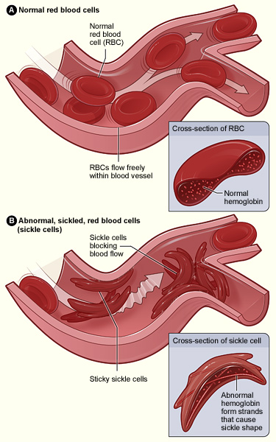

Slide 6
Symptoms of Sickle Cell Anaemia
Fatigue
Breathlessness
rapid heart rate
delayed growth and puberty
susceptibility to infections
ulcers on the lower legs (in adolescents and adults)
jaundice
attacks of abdominal pain
weakness
joint pain
fever
Vomiting
bloody (hematuria) urination
excessive thirst
excessive penis pain
Priapism
chest pain
decreased fertility

Slide 7
Incomplete dominance
Allele H incompletely dominant to allele S
Heterozygotes – HS
Allele S partially expressed
Sickle Cell Trait
-a third of the haemoglobin is S

Slide 8
Sickle Cell Anemia in Africa
Allele S rare in populations as semi-lethal
Some parts of Africa up to 40% of population is HS
People with Sickle Cell Trait resistant to malaria

Slide 9
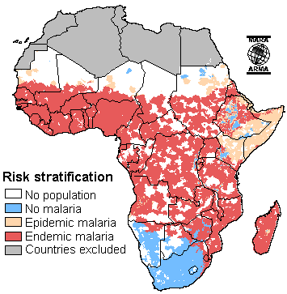
Distribution of malaria
Distribution of sickle cell trait

Slide 10
Sickle Cell Trait and Malaria
In malarial regions
-natural selection favours people with genotype HS
People that are HH will die during serious outbreaks of the disease
Hs loses selective advantage in non-malarial sites

Slide 11
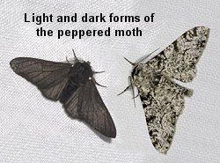
Industrial Melanism in Peppered Moth
Two forms of Biston betularia (peppered moth)
(melanic)

Slide 12
Biston betularia
Differ by only one allele of the gene forming dark pigment (melanin)
Both forms fly by night
Both forms rest on trees during the day

Slide 13
Prior to Industrial revolution
Pre 1800s
Light form common throughout Britain
Dark arose by mutation
-very rare

Slide 14
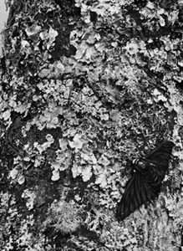
Light peppered moths
In non-polluted areas
-tree trunks covered with pale coloured lichens
Moth well camouflaged against pale background
Dark form easily seen and eaten by predators

Slide 15
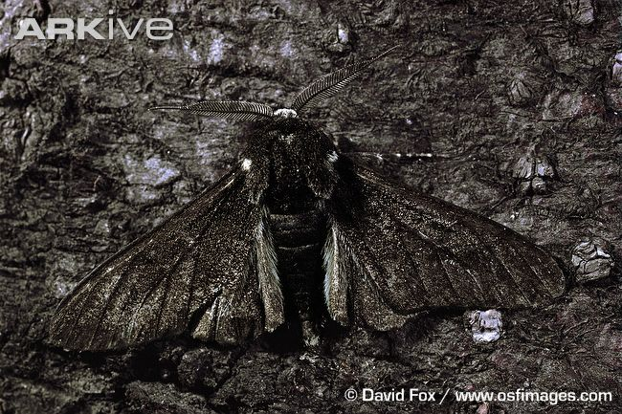
Survey in the 1950s
Pale form most abundant in non-industrial areas
Dark forms most abundant in areas suffering from heavy air-pollution

Slide 16
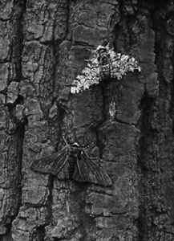
Reason for change?
In polluted areas
-toxic gases kill lichen
-soot particles darken tree trunks
Dark coloured well hidden and favoured by natural selection
Light coloured moth easily seen

Slide 17
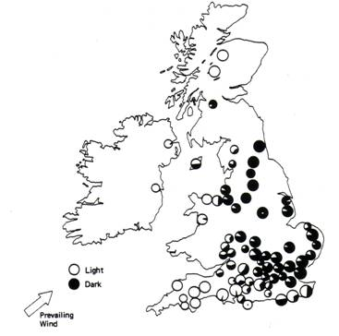
Frequencies of two forms of peppered moths in the 1950s

Slide 18
This powerpoint was kindly donated to www.worldofteaching.com
http://www.worldofteaching.com is home to over a thousand powerpoints submitted by teachers. This is a completely free site and requires no registration. Please visit and I hope it will help in your teaching.

