Slide 1
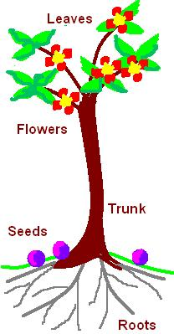
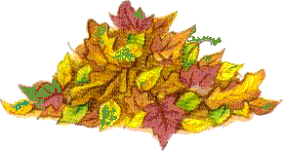
Nitrogen in
the air
nitrogen fixing plant
eg pea, clover
animal protein
plant made
protein
dead plants & animals
urine & faeces
root nodules
(containing nitrogen
fixing bacteria)
denitrifying
bacteria
decomposition by bacteria & fungi
nitrates absorbed
nitrates
ammonia
bacteria
nitrites
bacteria
(nitrifying bacteria)

Slide 2
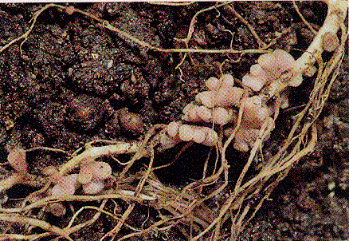
The nitrogen fixing bacteria are found inlumps on the roots called root nodules. The bacteria and the plant have a symbiotic relationship: the bacteria benefits by having food and shelter from the plant and the plant benefits by having nitrates produced by the bacteria.
Roots of a legume plant (peas, beans and clover).

Slide 3
This powerpoint was kindly donated to www.worldofteaching.com
http://www.worldofteaching.com is home to over a thousand powerpoints submitted by teachers. This is a completely free site and requires no registration. Please visit and I hope it will help in your teaching.

