Slide 1
Nutritional Requirements by SG Bhuvan kumar

Slide 2
Nutritional Requirements
Nutrition means either preparation of food or Supply of nutrients for the release of energy.
The chemical substances required for the production of energy, for the growth and for body building are called Nutrients
The procurement of nutrients is called Nutrition
The important nutrients required for the body are carbohydrates, fats, proteins , vitamins and minerals
Some nutrients like carbohydrates, proteins, fats and mineral like sodium are required in large quantities and they are known as Macro-nutrients.
Some nutrients like vitamins and minerals like iron, zinc molybdenum etc are required in very minute doses, (even in micrograms), are known as micro-nutrients.

Slide 3
CARBOHYDRATES
Carbohydrates are a group of compounds with Carbon, Hydrogen and Oxygen.
They are classified into two groups – Simple Carbohydrates and Complex Carbohydrates.
Simple Carbohydrates are sugars like Glucose, Fructose etc.,
Complex Carbohydrates are Sucrose, Maltose, Lactose etc.,
Cellulose is present in plant cells and it is not digested in the human digestive system.
It has no nutritive value in man but the presence of cellulose in food helps to avoid constipation.
Excess glucose is converted into
non-essential amino acids,
glycogen and
Fats.
One gram of Carbohydrates gives 4 kilo calories of energy

Slide 4
Glycogen is called Animal Starch
Lactose is called Milk sugar
Sucrose is called cane sugar.
Sports persons take glucose to get instant energy
If we eat only rice, only carbohydrates are supplied to the body and body building materials (proteins) will be deficient.
If we eat only proteins, body will be built up but for daily metabolic activities, energy will not be supplied.
Hence for healthy growth, all type of nutrients are required for the body.
Food having all the nutrients in required quantity for the body is called Balanced diet.

Slide 5
PROTEINS
Proteins are body building substances with Carbon, Hydrogen, Oxygen, Nitrogen. and Sulphur in small amounts.
Proteins have 24 types of amino acids, out of these 20 are present in most of the proteins
Based on our requirement, amino acids are classified into
Essential amino acids and
Non-essential amino acids.
Examples of essential amino acids are Isoleucine, Leucine, Lysine etc.,
Examples of Non-essential amino acids are Alanine, Arginine, Aspartic acid etc.
Histidine is the essential amino acid only for infants but not for adults.

Slide 6
The proteins from animal sources like Milk, Meat, Eggs, Fish etc., are rich sources of proteins and are called as Biologically complete proteins.
Proteins from vegetable sources like Pulses, Beans, Legumes etc, contain lesser amount of amino acids when compared to animal sources. Hence they are called as Biologically incomplete proteins.
Function of proteins
Proteins are used in -
various metabolic pathways as enzymes.
Chemical coordination as hormones.
body building.
repair and maintenance of tissues.
maintenance of osmotic pressure.
the production of energy

Slide 7
FATS
Fats are the organic compounds with Carbon, Hydrogen and Oxygen and are made up of fatty acids and Glycerol.
Fatty acids are divided into:-
Saturated fatty acids.
Unsaturated fatty acids.
The fatty acids required for our body and not present in our body are called as Essential fatty acids.
Ex:- Linoleic acid, Linolenic acid.
Fats are present in both plant and animal foods like Milk, Ghee, Butter, Cheese, Eggs etc.,
Plant sources are usually in the form of Oils like Groundnut oil, Mustard, Sesame, Coconut, Palm etc.,
Fats are solids at 20ºC. Liquid fats are called oils.
It is easy to store fats in the body as fats are insoluble in water and can be easily stored in solid form.

Slide 8
Cholesterol is saturated fatty acid. When excess cholesterol is consumed, it is deposited along the walls of the arteries and interferes with the blood flow. This may lead to Heart attacks
Vanaspathi is prepared by converting unsaturated fatty acids present in vegetable oils to saturated fatty acids.
FUNCTIONS
One gram of fats yield 9.45 Kilo calories of energy
The fats under the skin helps in preserving the body heat.
Fats are used in the body to generate energy.
It is required for the formation of membranes in all the cells.
Growth and development will not be normal if the required amounts of unsaturated fatty acids are not provided in the diet

Slide 9
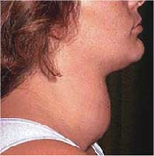
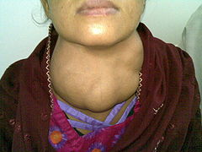
MINERALS
SODIUM :
Sodium ions maintain the osmotic balance in the body and also for the activity of the nervous system.
Sodium ion s maintian salts in plasma.
Pottasium maintains salts in cytoplasm of a cell.
IODINE
Iodine is component of thyroxine, a hormone of thyroid gland, iodine is required for the production of thyroid hormone.
Deficiency of iodine results in Hypothyroidism and enlargement of the thyroid gland (a condition is known as goiter) and reduction in metabolic rate and physical growth.
To prevent the Iodine deficiency, now-a-days iodine is added to the common salt (Iodised salt).
Naturally iodine is found in
vegetables and sea food.

Slide 10
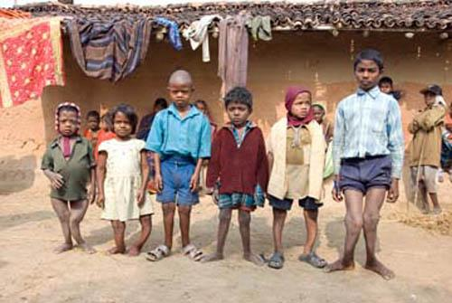
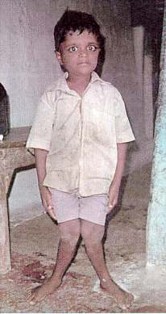
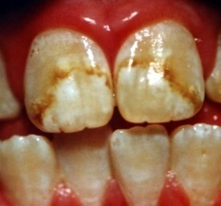
FLUORINE
Fluorine is require for proper formation of
Bone and enamel on the teeth and prevents dental caries.
Fluorine present in the soil get dissolved in the ground water and is major sources for fluorine for the body.
Fluorosis is a disease caused due to excess fluorine in water.
In people affected with fluorosis the teeth become yellow and bone deformations are seen.
So they can’t stand erect and walk properly.

Slide 11
CALCIUM
Calcium is the major element required for the body.
It forms about 1.5 to 2% of the body weight in an adult.
It is required for the formation of bones, teeth, coagulation of blood, for muscle contraction, for production of milk in lactating females.
We require about 400 – 500 mg. of calcium per day.

Slide 12
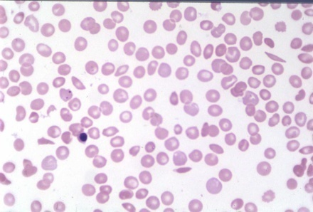
IRON
Iron is major element used in the formation of
Haemoglobin.
About 60-70% of iron in the body is present in blood.
Deficiency of iron causes anaemia.
Source: The best sources of iron are liver, eggs, meat, fish, cereals, nuts, green leafy vegetables and dried fruits, oat, meals.
It is the major component in haemoglobin and it helps to carry O₂ from lungs to the cells.
It is also present in proteins involved in electron transport and respiration.

Slide 13
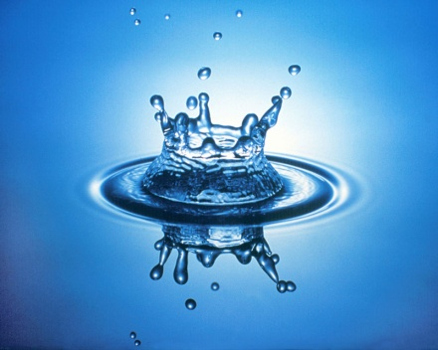
WATER
Water is the most essential constituent of life.
About 90% of water is present in protoplasm.
Water is available to the body through three sources-drinking water, water stored in food and metabolic water.

