Slide 1
The Drugs Revolution and the Development of Penicillin

Slide 2
Prevention and Cure
Prevention
Germ theory
Vaccinations
Smallpox
1906 Tuberculosis
1913 Diphtheria
Cure
Koch discovered that he could stain bacteria
Development of ‘magic bullets’
For example - Salvarsan 606 and Prontosil

Slide 3
Penicillin
1928 – Alexander Fleming discovers mould which kills germs – penicillin.
1929 – Fleming publishes an article on penicillin.

Slide 4
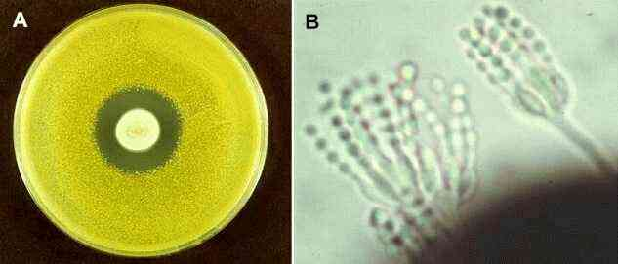
Chain and Florey
1937 – Chain and Florey do research on penicillin.
1940 – Experiment on mice.
1941 – successful tests on humans.

Slide 5
Factors

Slide 6
Government
1939 - British government fund Florey’s research
1942 – U.S. government fund production of penicillin.
1944 – mass production

Slide 7
Individuals
Alexander Fleming
Howard Florey
Ernst Chain
Research Teams

Slide 8
War
German bombing stopped Florey and Chain being able to mass produce penicillin in Britain.
America was not interested in penicillin until she entered the war in 1941.
1945 American Army using 2 million doses of penicillin a month.

Slide 9
Other Factors
Technology
Scientific experiment
Industry
Communications
Chance

Slide 10
This powerpoint was kindly donated to www.worldofteaching.com
http://www.worldofteaching.com is home to over a thousand powerpoints submitted by teachers. This is a completely free site and requires no registration. Please visit and I hope it will help in your teaching.

