Slide 1
Photosynthesis
By Deepthi Sri

Slide 2
Overview
All energy on earth comes from the sun.
We depend on:
Plants
Algae (underwater plants)
Cyanobacteria (photosynthetic bacteria)
To provide this energy to us!

Slide 3
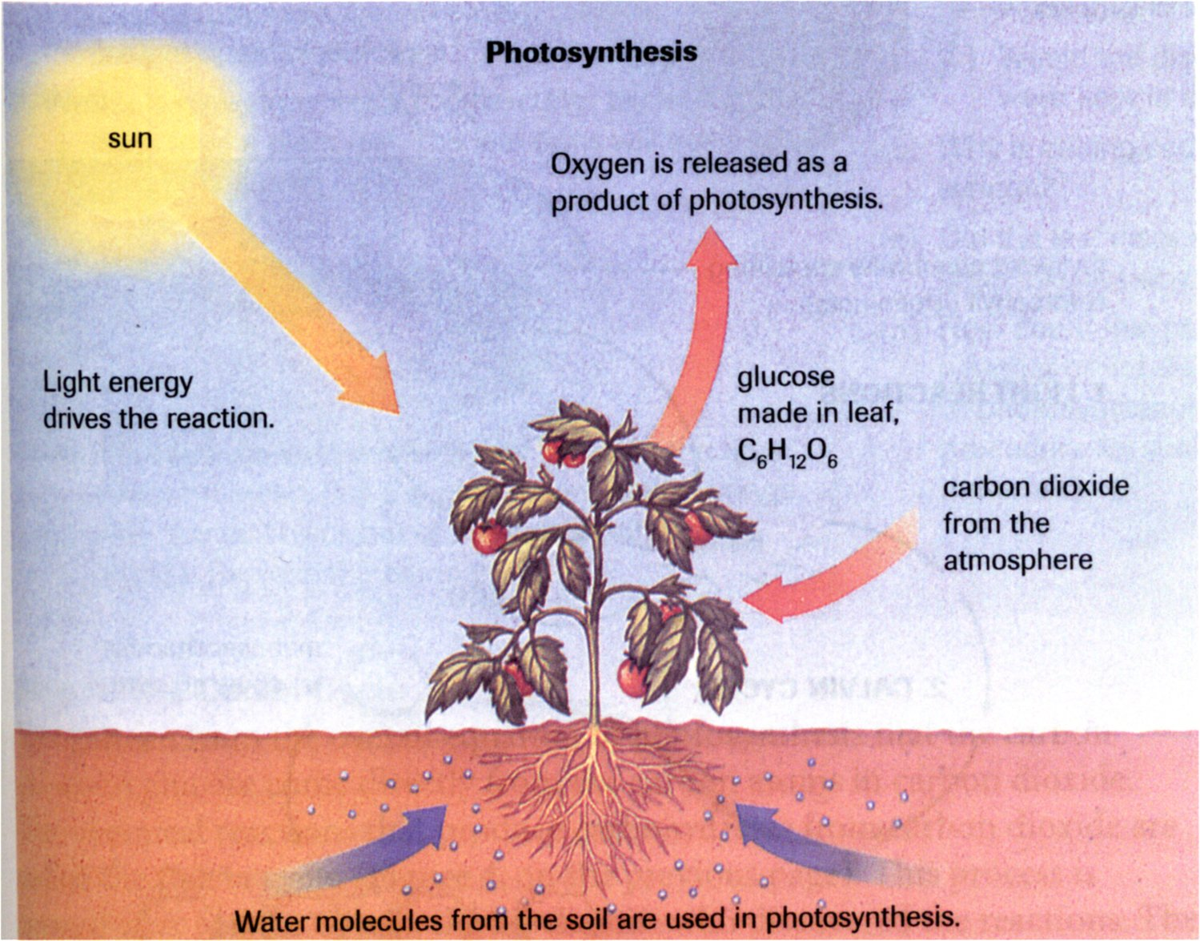
Overview

Slide 4
Overview
Carbon dioxide and water are taken in by plants
Plants absorb light energy and convert it to a usable form.
ATP
Energy is used to “fix” carbon dioxide into sugar molecules
Chemical energy
Sugar is converted to starch and stored for use by the plant, and by animals when they eat plants.

Slide 5
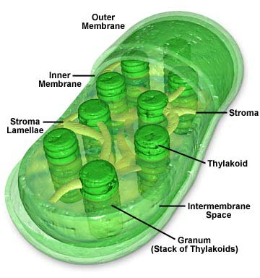
Chloroplasts
Have TWO membranes
A “bi-bilayer!”
The inner membrane is called the thylakoid.
The thylakoid is folded and looks like stacks of coins called granum (grana singular).
The stroma is the space surrounding the granum
Image source: http://www.daviddarling.info/encyclopedia/C/chloroplasts.html

Slide 6
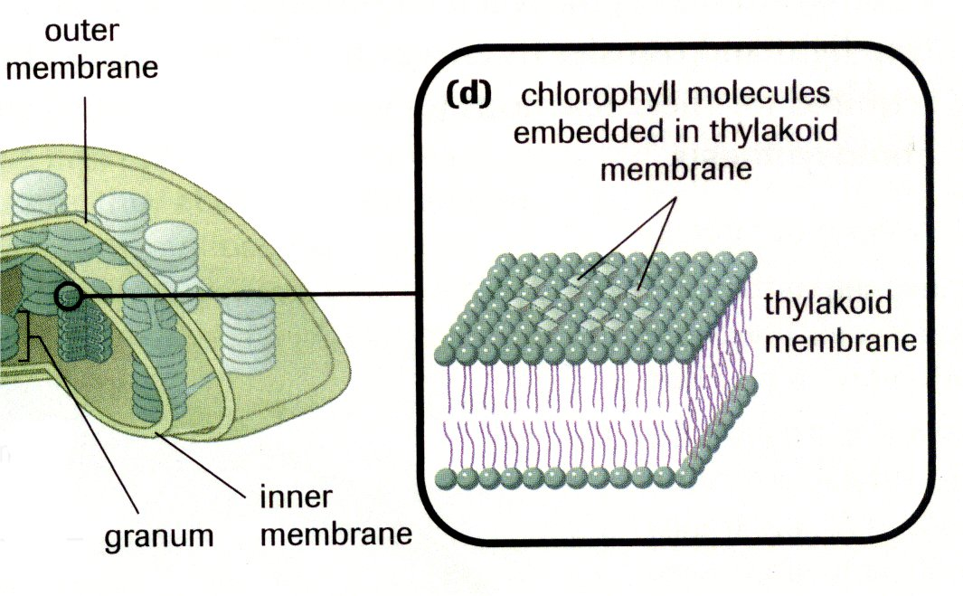
Chloroplasts
Chlorophyll molecules are embedded in the thylakoid membrane
Act like a light “antenna”
These molecules can absorb sunlight energy.
Image from Biology 11: College Preparation. Pg 73. Nelson, Toronto. 2003.

Slide 7
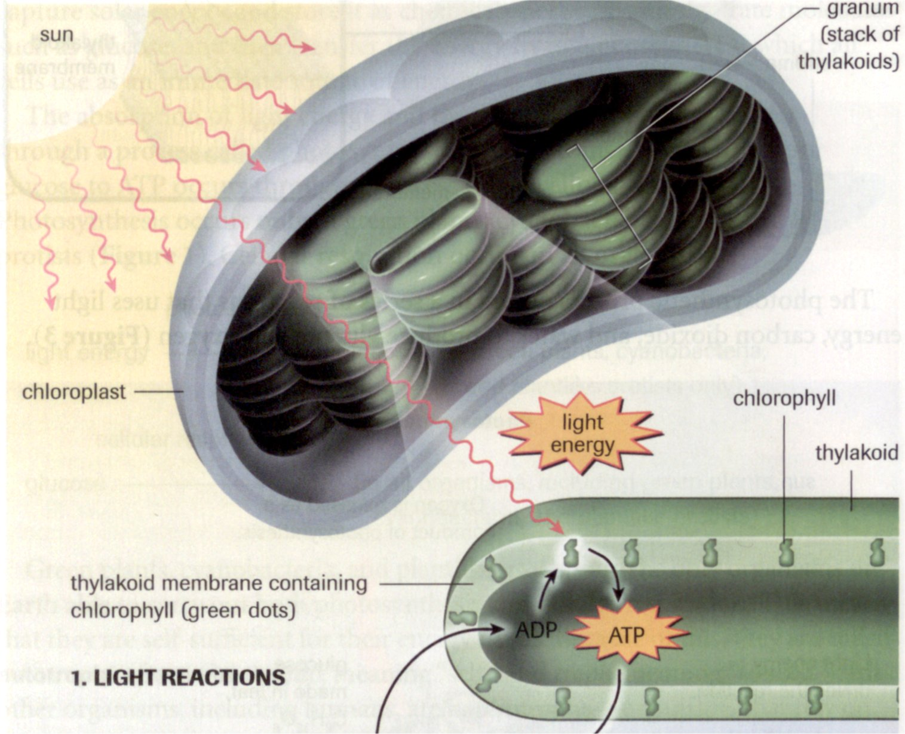
Light (dependent)Reactions
Happen ONLY in sunlight
Hence they depend on light!
Light is absorbed by chlorophyll molecules
The energy generates molecules of ATP
Image from: Biology 11: College Preparation. Pg 74. Nelson, Toronto. 2003.

Slide 8
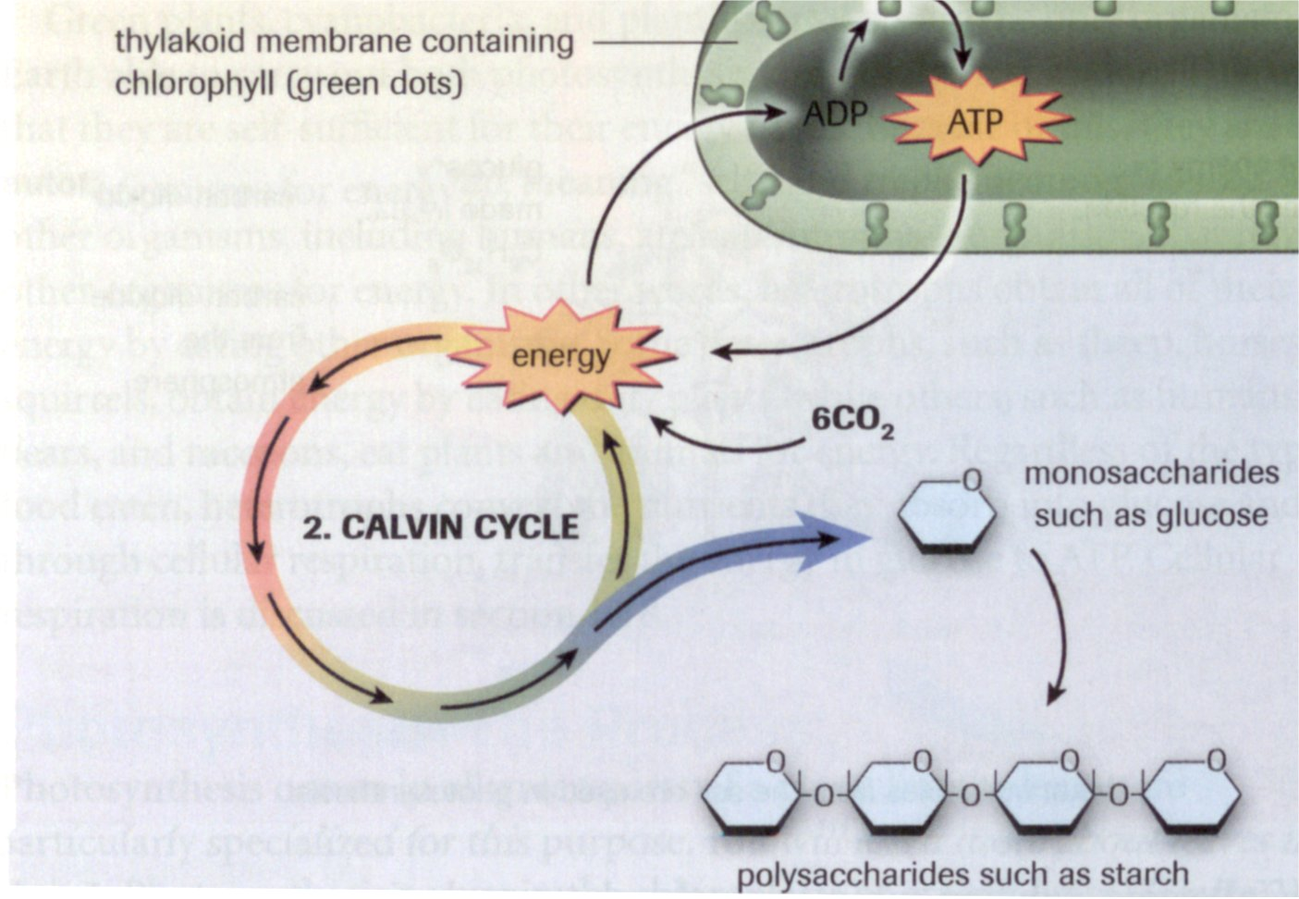
Light Independent Reactions (formerly the “dark reactions”)
Happen in sunlight, and in the dark.
Hence “independent of light”
ATP generated by sunlight drives the Calvin Cycle.
Monosaccarides (eg. glucose) are manufactured in the cycle.
Monosaccarides are used to “build” polysaccharides (eg. Starch).
Image from: Biology 11: College Preparation. Pg 74. Nelson, Toronto. 2003.

Slide 9
Overall Reaction
What is the equation for photosynthesis?
carbon dioxide + water → glucose + oxygen + energy
6CO₂ + 6H₂O → C₆H₁₂O₆ + 6O₂ + energy

Slide 10
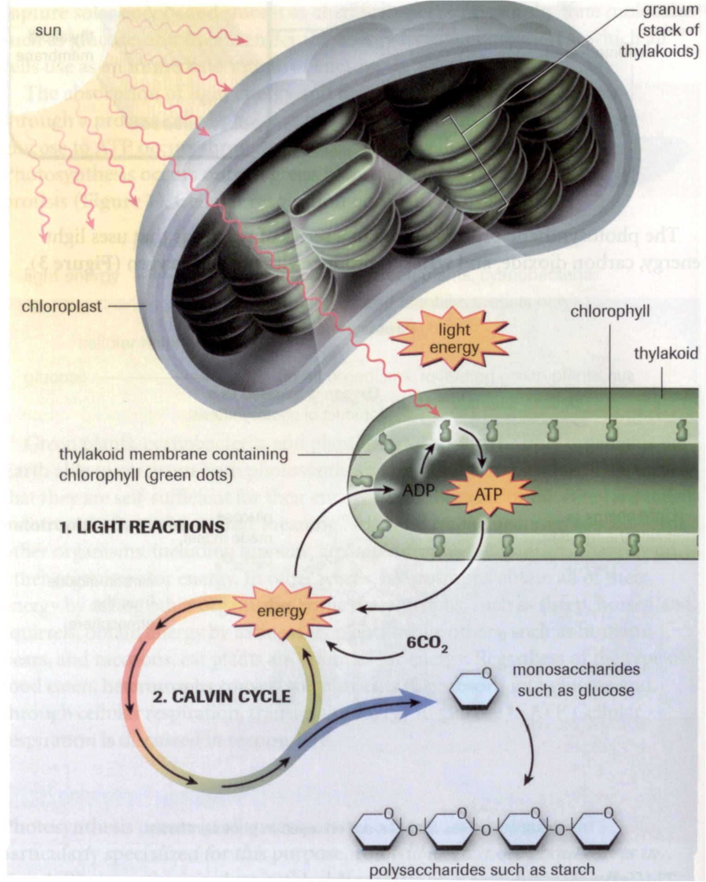
Summary
Image from: Biology 11: College Preparation. Pg 74. Nelson, Toronto. 2003.

Slide 11
Why do leaves turn brown in the fall?
It’s all about pigments!
Let’s go outside and collect some leaves!

Slide 12
This powerpoint was kindly donated to
www.worldofteaching.com
Home to well over a thousand free powerpoint presentations submitted by teachers. This a free site. Please visit and I hope it will help in your teaching

