Slide 1
PROTEIN STRUCTURES
To see some of these images in 3D you will need a Blue or Cyan filter on your left eye and a Red or Magenta filter on your right eye.
(Experiment with the filters for best effect)
Left Right

Slide 2
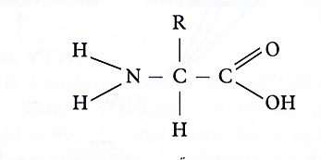
Proteins are formed from Amino Acids joined in a chain
AMINO ACID
Amino end
Carboxyl end
All Amino Acids have an alkaline Amino group (-NH₂) and an acid Carboxyl group (-COOH)
There are just 20 naturally occurring Amino Acids, each with a different -R group.

Slide 3
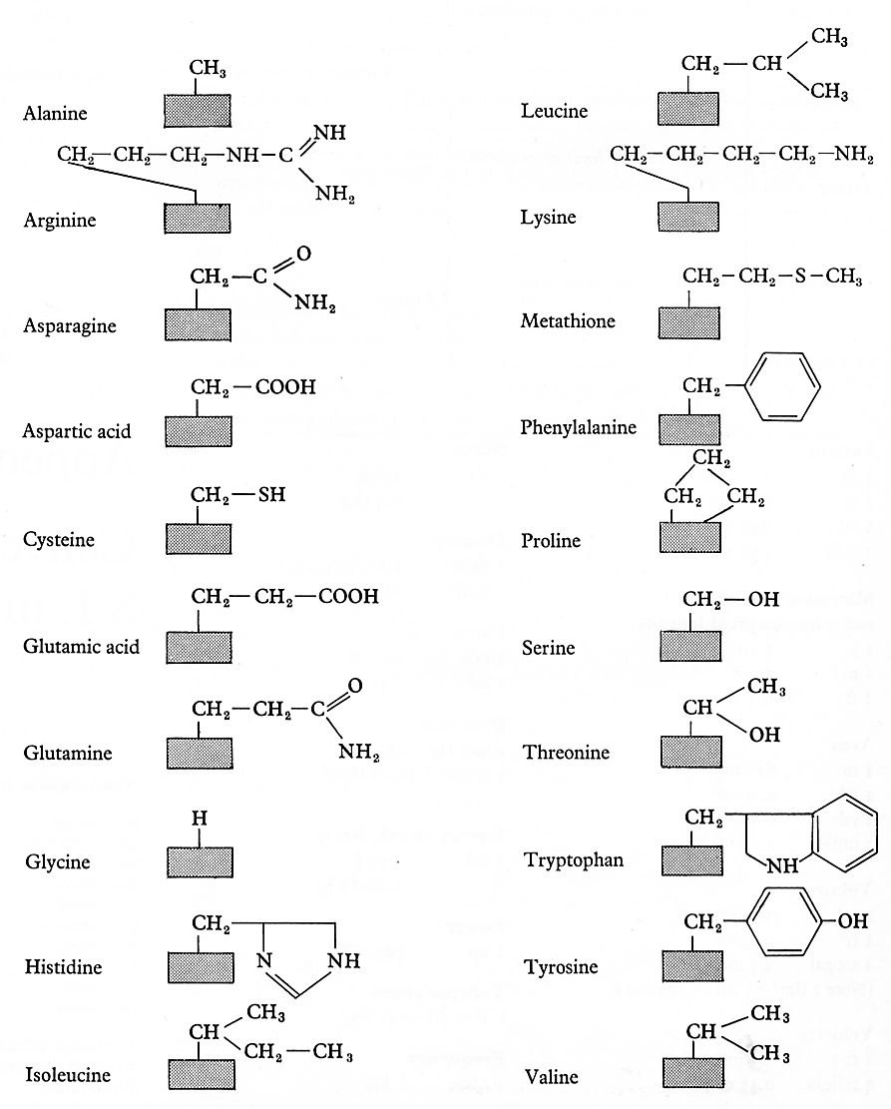
The 20 naturally occurring Amino Acids.
The shaded box is the same for all Amino acids. It is an single Carbon atom bonded to an Amino group, a Carboxyl Group and a Hydrogen atom...
Disulphide Bridge
R
NH₂ - C - COOH
H

Slide 4
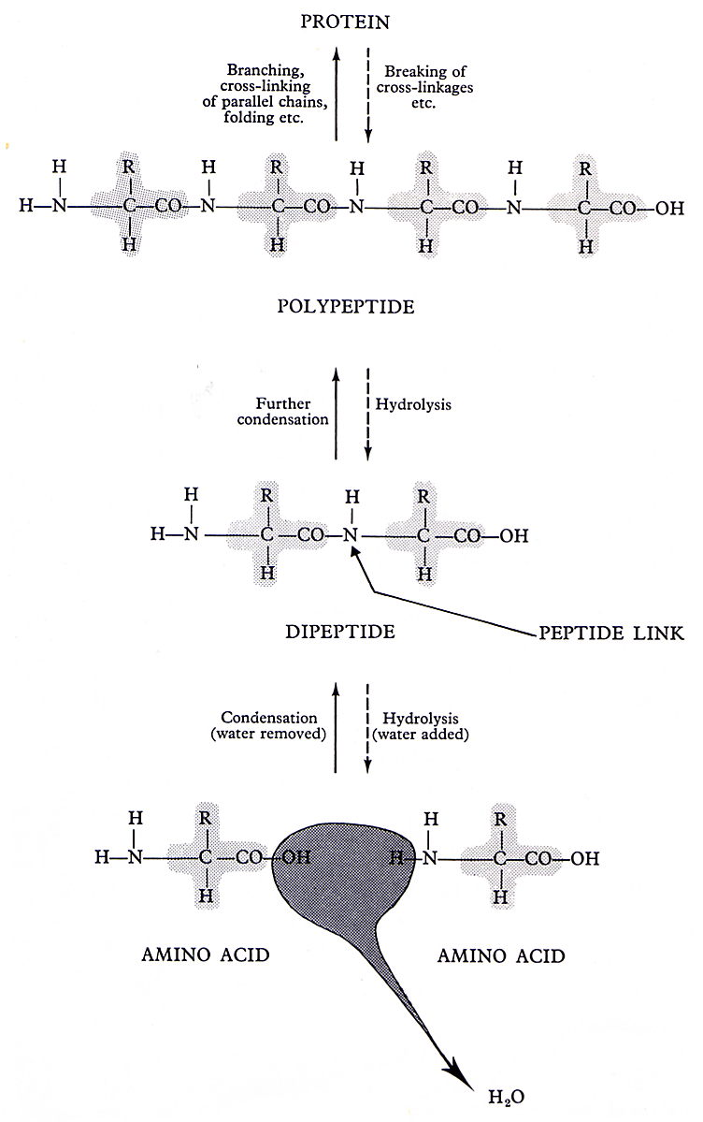
The bonds between Amino Acids are …
Peptide Bonds
Peptide bonds are formed by Condensation and broken by Hydrolysis

Slide 5
A PEPTIDE BOND
O H
- C - N -
One Amino Acid
Another Amino Acid
Formed by Condensation
Broken by Hydrolysis (Heat in acid condition)

Slide 6
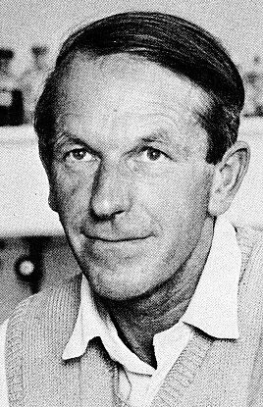
PRIMARY STRUCTURE
Primary structure is described by the sequence of Amino Acids in the chain
This diagram shows the primary structure of PIG INSULIN, a protein hormone as discovered by Frederick Sanger.
He was given a Nobel prize in 1958.

Slide 7
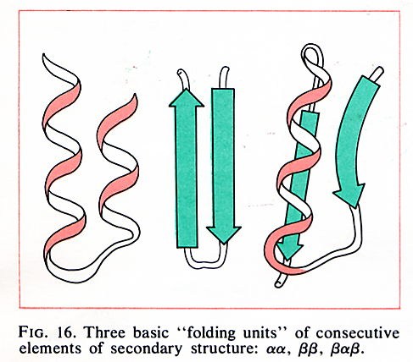
SECONDARY STRUCTURE
Secondary structure describes the way the chain folds.
Some chains fold in a repeating spiral e.g. Alpha Helix
Some chains fold in a series of zig zags e.g. Beta Pleated Sheets
Some chains have other combinations, as well as both those above.

Slide 8
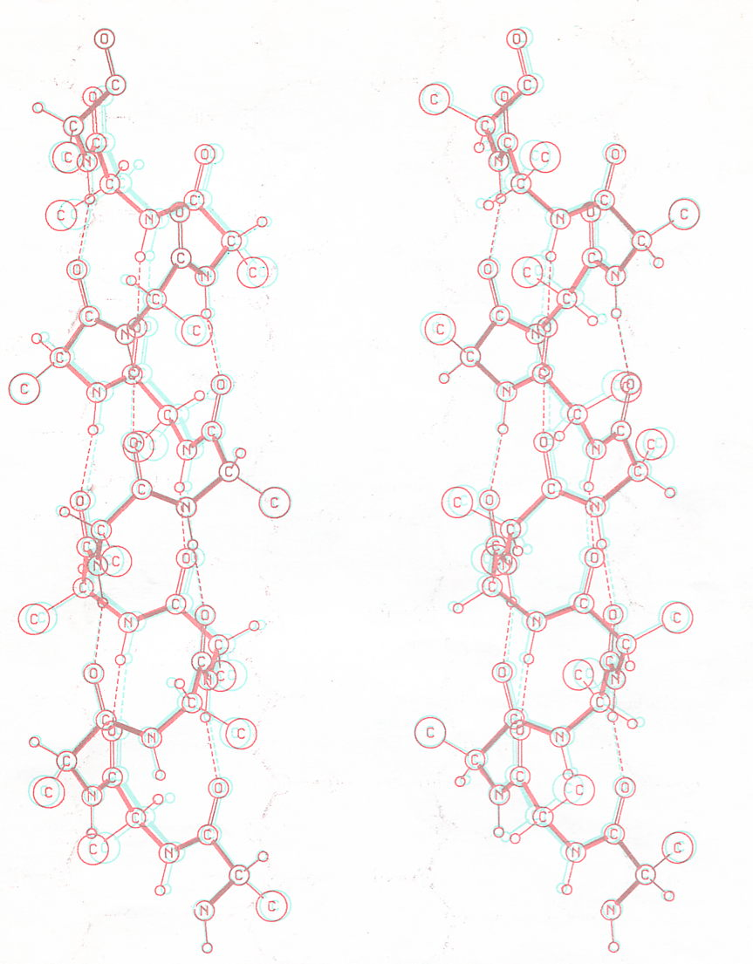
The Alpha Helix
Right handed
Left handed

Slide 9
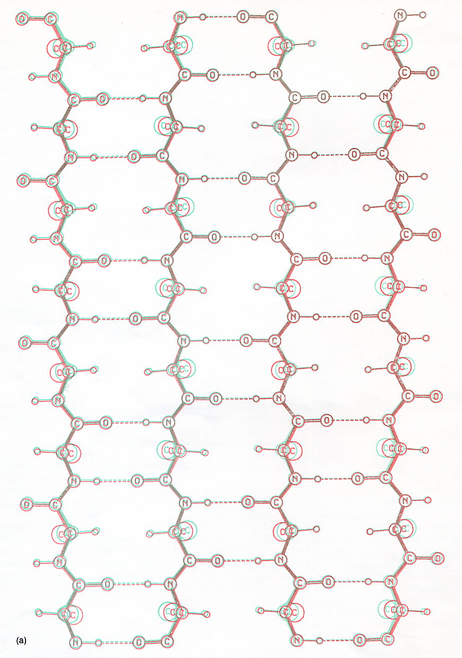
The dotted lines are hydrogen bonds which bind the strands together, making this a strong flat fibrous protein.
In Silk, these sheets stack together like a pile of corrugated iron.
H-bonds between the sheets make silk a very strong structural protein
Beta Pleated Sheet

Slide 10
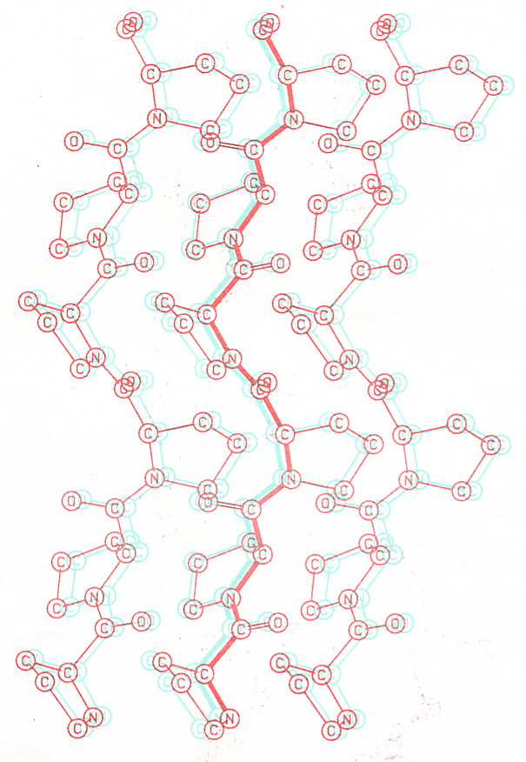
Poly-L-Proline
These strands contain repeating units of the Amino Acid, Proline.
When three such strands wrap around each other like rope they make a strong fibrous protein, similar to Collagen.
Collagen is found in skin, ligaments and tendons

Slide 11
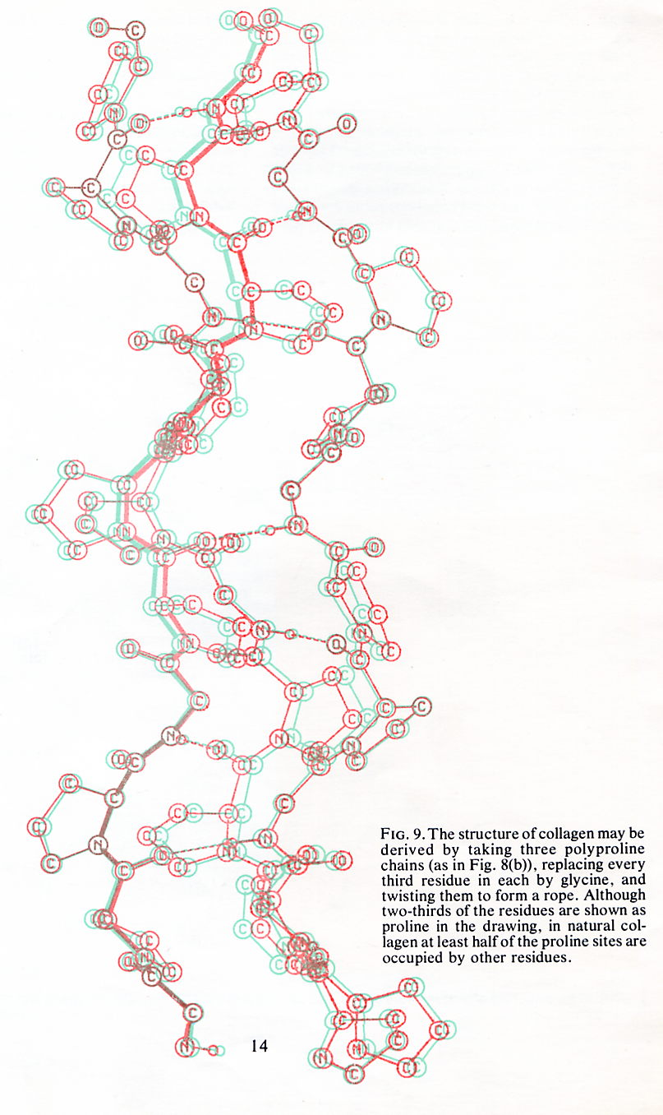
COLLAGEN
An important component of animal connective tissue.
Collagen is made from three strands consisting mainly of Glycine and Proline...
-Gly-Pro-Pro-
repeatedly wrapped into a rope, the whole forming an Helix.
Natural Collagen may also have some other Amino Acids inserted along parts of the chain.

Slide 12
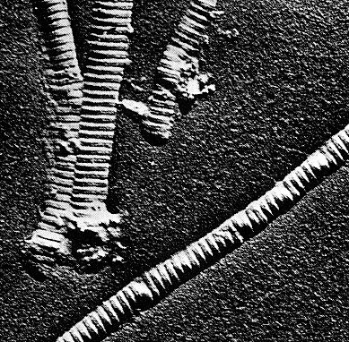
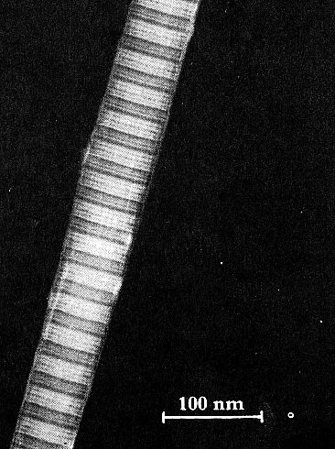
COLLAGEN - an important animal connective tissue
Left - Collagen Fibres from the tendon of a bird’s neck.
Right - Collagen Fibres from a rats tail

Slide 13
TERTIARY STRUCTURE
Tertiary Structure describes the shapes which form when the secondary spirals of the protein chain further fold up on themselves.
QUATERNARY STRUCTURE
Quaternary structure describes any final adjustments to the molecule before it can become active. For example, pairs of chains may bind together or other inorganic substances may be incorporated into the molecule. (Prosthetic Groups)

Slide 14
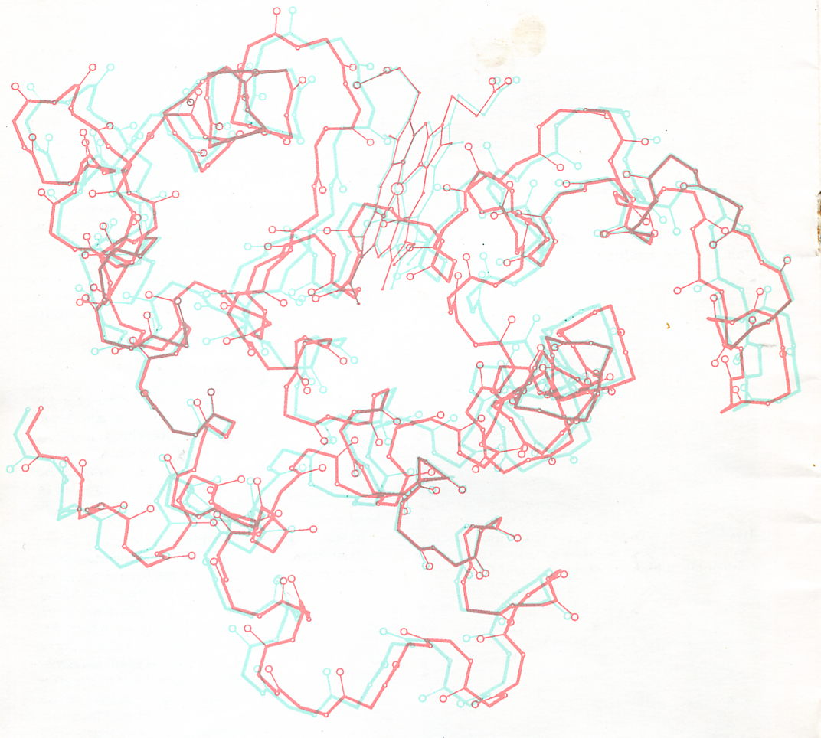
MYOGLOBIN - An oxygen carrier in muscle similar to Haemoglobin
Tertiary Stucture
Spot the Tertiary folding.
Quaternary Structure
Spot the Haem group
(Side chains have been omitted for clarity.)

Slide 15
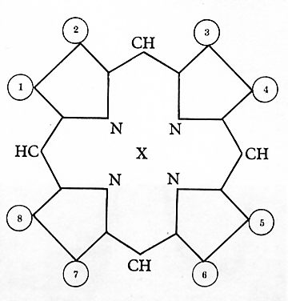
The Haem group looks like this...
Haem -
a prosthetic group
Fe
Haem is an inorganic molecule called a Porphryn Ring. In Haemoglobin and Myoglobin it has an Iron ion at its centre and is a vital for the carriage of Oxygen.
Such an inorganic structure, required to make a protein active, is called Prosthetic Group and this is part of the Quaternary structure of Myoglobin and Haemoglobin.
A similar Porphryn Ring, with Magnesium at its centre is the essential part of a Chlorophyll molecule.

Slide 16
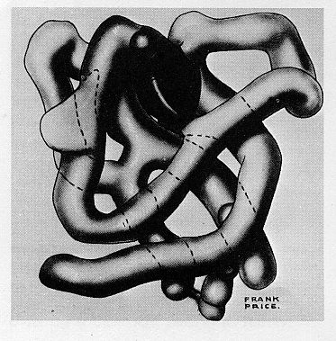
MYOGLOBIN - An oxygen carrier in muscle
Here is another way of visualising tertiary the structure
Tertiary Stucture
Spot the Tertiary folding.
Quaternary Structure
Spot the Haem group

Slide 17
FIBROUS PROTEINS
Fibrous proteins like Collagen, Silk, Keratin (hair) and Chitin (insect exoskeleton) tend to be insoluble and strong and so they have a structural role for support or protection.
GLOBULAR PROTEINS
Proteins which fold into a ball or ‘globule’ like Myoglobin are called Globular Proteins. They tend to be soluble. The most common group of Globular Proteins are ENZYMES which control the reactions in living cells. (They work because their Globular shape includes an Active Site).

Slide 18
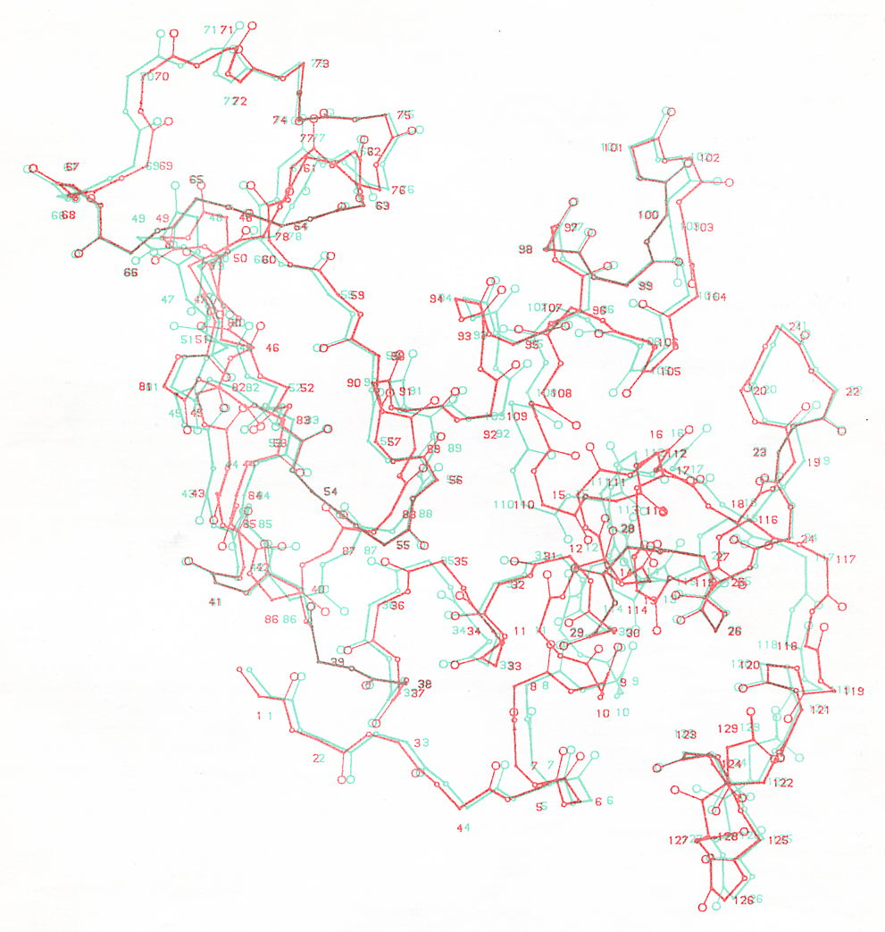
LYSOZYME
An enzyme found in tears and mucus which acts as a strong anti-bacterial agent because it digests bacteria cell walls.
It has 129 Amino Acids folded in both alpha helices and anti-parallel hairpins.
Can you see the active site?
(Side chains omitted for clarity)

Slide 19
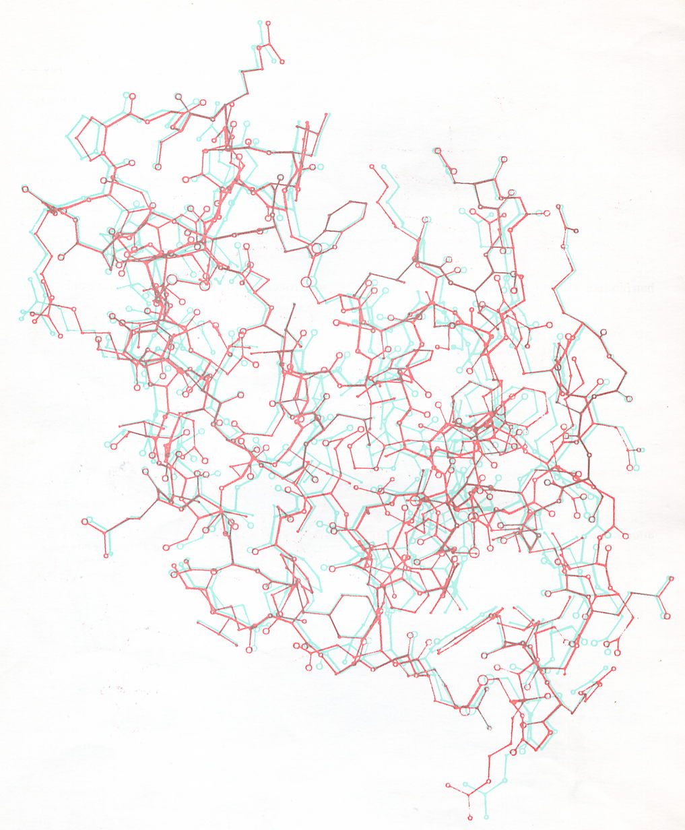
LYSOZYME
Including the Side chains.
Can you see any active site now?

Slide 20
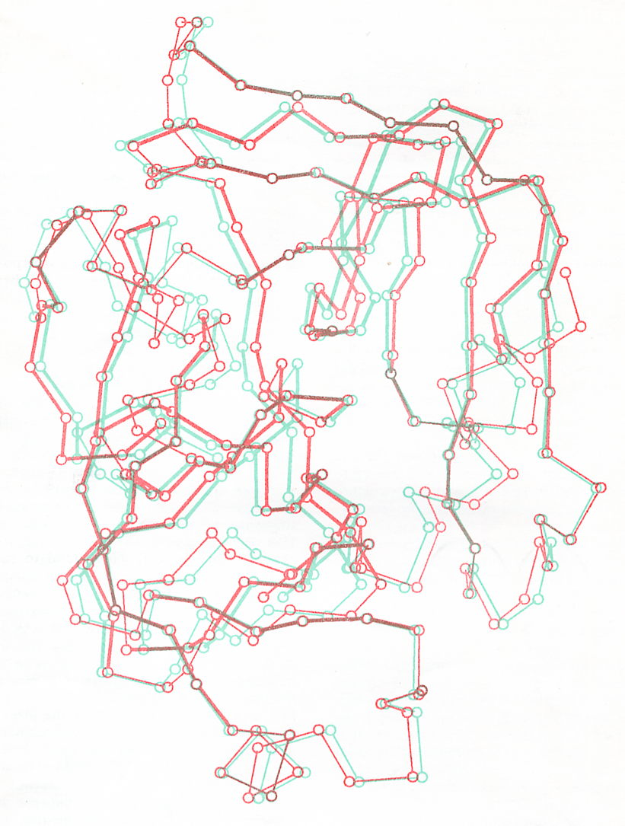
CHYMOTRYPSIN
A protein digesting enzyme in your stomach.
Only the carbon backbone is shown so the secondary structure can be seen.
Some parts are twisted into an Alpha Helix. Other parts (in bold) are the straight Beta strands.
Spot the Active Site

Slide 21
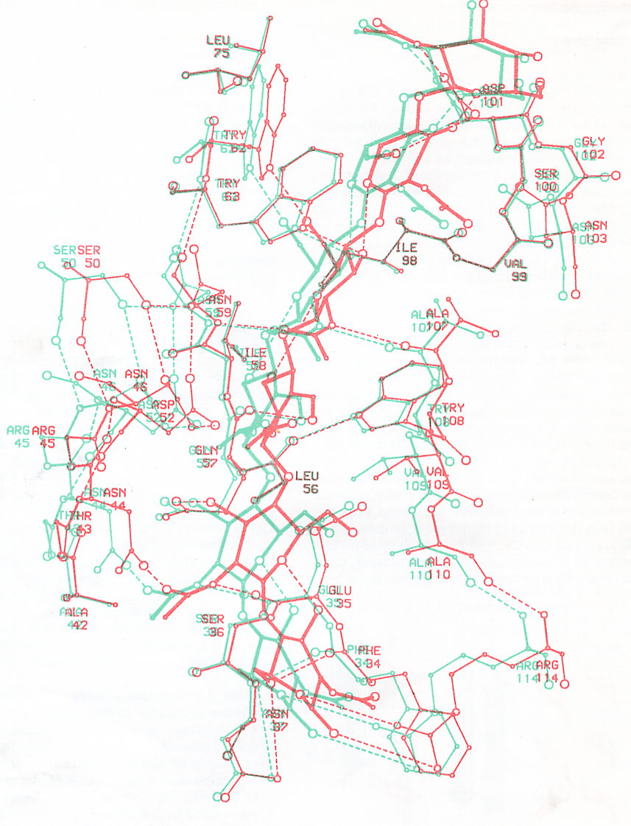
ENZYME-SUBSTRATE COMPLEX
This shows Subtilisin - a bacterial enzyme binding with its substrate.
The substrate is a short polysaccharide made from six sugar molecules, which is part of the bacterial cell wall.
The substrate (in bold) is wedged into its active site and held in place by the H-bonds shown as dotted lines.
This is the ‘Enzyme- substrate complex’ which forms for a brief moment during any enzyme controlled reaction.

Slide 22
This powerpoint was kindly donated to www.worldofteaching.com
http://www.worldofteaching.com is home to over a thousand powerpoints submitted by teachers. This is a completely free site and requires no registration. Please visit and I hope it will help in your teaching.

