Slide 1
Food Pyramids
2nd Year Biology

Slide 2
Energy loss in a food chain
Only 10% of energy is passed along to the next level in a food chain. The rest of the energy is lost through:
-waste
-heat
-movement
-respiration

Slide 3
A Pyramid of Numbers
Food chains and webs show the flow of materials and energy in habitats, but they do not give you any idea of how many organisms there are in the habitat.
A pyramid of numbers is a diagram showing the numbers of organisms present in each level of a food chain

Slide 4
Let's go back to the
grass vole barn owl food chain.
Suppose the numbers found in a particular habitat are as follows:
2000 grass plants
25 voles
1 barn owl

Slide 5
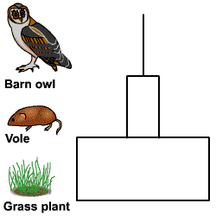
The pyramid of numbers would be as shown below.

Slide 6
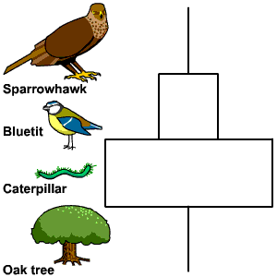
Sometimes you do not get a pyramid because one organism in the chain is unusually large, e.g. one large oak tree providing food for many caterpillars.

Slide 7
Pyramids of Biomass
Biomass is a word used to describe the mass of living material in an area.
If you could collect all of the plants and animals in an area and weigh them, this would be the biomass of that area.

Slide 8
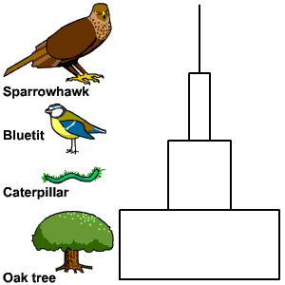
A pyramid of biomass is a diagram showing the total weight (mass) of organisms at each level of a food chain. Biomass always gives a pyramid since producers must have the most biomass and consumers must have less
Pyramids of biomass are always pyramid-shaped.

Slide 9
This powerpoint was kindly donated to www.worldofteaching.com
http://www.worldofteaching.com is home to over a thousand powerpoints submitted by teachers. This is a completely free site and requires no registration. Please visit and I hope it will help in your teaching.

