Slide 1
REPRODUCTION

Slide 2
Reproduction
The process of producing young ones from their parents is called reproduction

Slide 3
REPRODUCTION IN PLANTS
SEXUAL REPRODUCTION
ASEXUAL REPRODUCTION
VEGETATIVE
PROPOGATION

Slide 4
Asexual reproduction
The formation of new plants from the cells of a single parent is called asexual reproduction

Slide 5
ASEXUAL REPRODUCTION
BUDDING
FRAGMENTAT-ION
SPORE FORMATION

Slide 6
Budding
In this process ,a small bulb-like outgrowth called bud is formed formed from the cell.This bud keeps on increasing in size and forms an independent organism which separates from the parent.
Eg: yeast

Slide 7
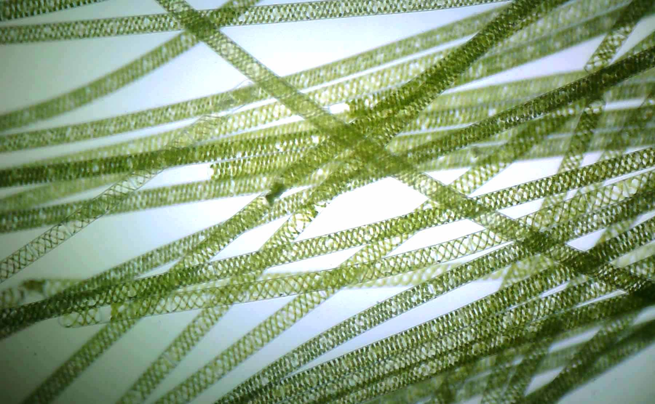
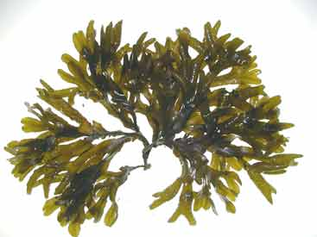
Fragmentation
In this process, the adult organism just breaks up into two or more pieces called fragments. Each of these fragments grows up to become a new plant .It is common in spirogyra & fucus.
SPIROGYRA
FUCUS

Slide 8
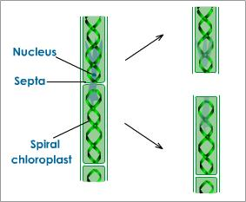
Fragmentation in spirogyra

Slide 9
Spore Formation
Some plants like ferns and mosses multiply asexually through spores . Spores are microscopic single celled or several celled reproductive bodies that are protected by a thick wall . During favourable conditions these spores burst out of the thick wall, start multiplying, and grow into new plants.

Slide 10
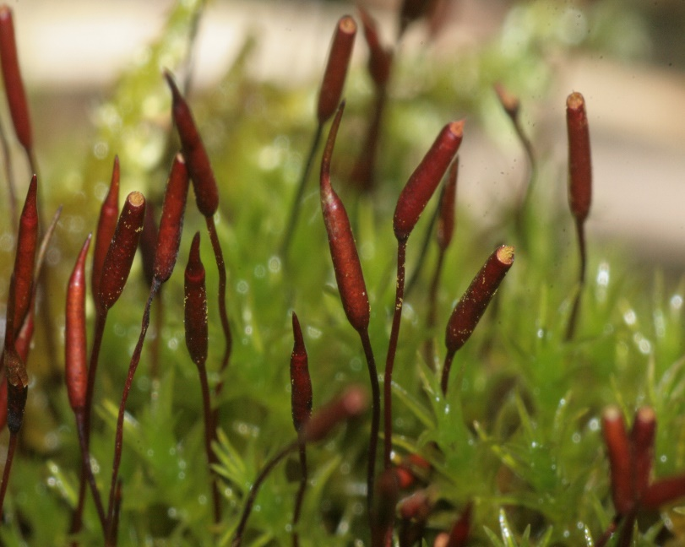
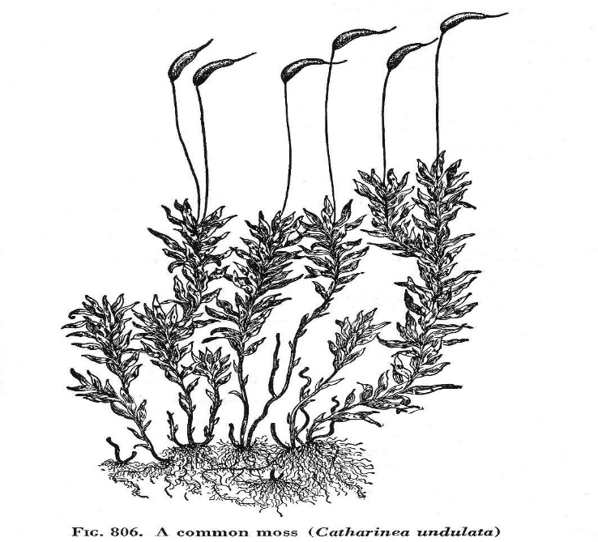
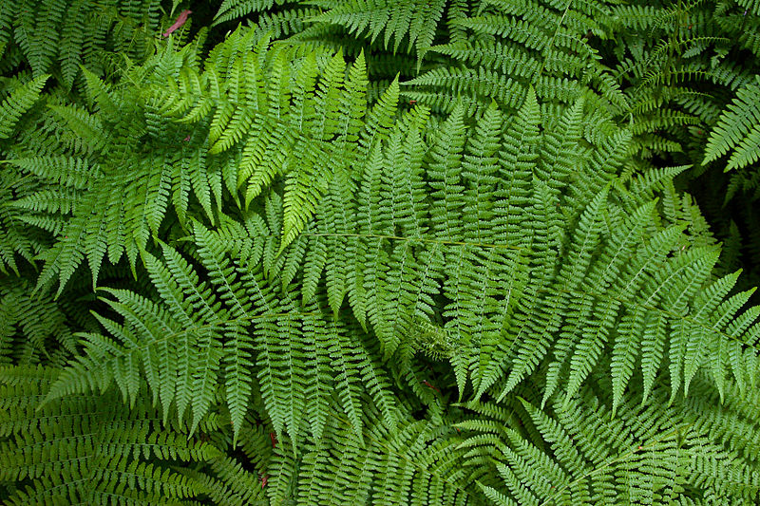
Mosses
Ferns

