Slide 1
Reproductive Systems
Male and Female

Slide 3
Uncomfortable Words?
Penis
Testis
Scrotum
Sperm tube
Gland
Vagina
Ovary
Uterus
Cervix
Egg tube

Slide 4
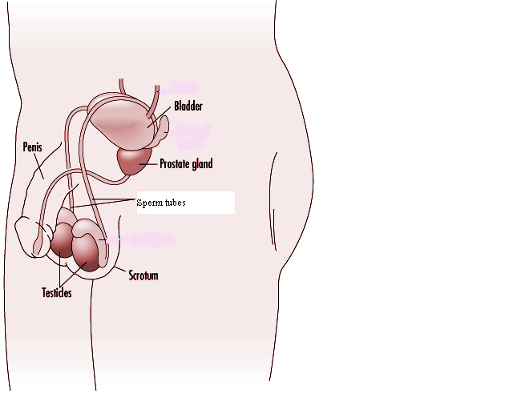
Male system

Slide 5
Scrotum
The testes are inside a sac called the scrotum.
It hangs outside the body, keeping the sperm cool.
Sperms only develop properly in cool conditions.

Slide 6
Sperm tube
Sperms are produced all the time.
They are stored in small tubes outside the testes.
Eventually they pass along a much bigger tube called the sperm tube.

Slide 7
Glands
Glands add a fluid which keeps the sperms alive.
The sperms and the fluid are called semen.

Slide 8
Penis
The penis must be erect for the semen to pass out.
This happens when blood is pumped into special spongy tissue in the penis.

Slide 9
Sperm
During an ejaculation semen is pumped out of the penis – due to a contraction of the muscles around the sperm tubes.
Each ejaculation makes about a teaspoon of semen but this can contain: 500 million sperms.

Slide 10
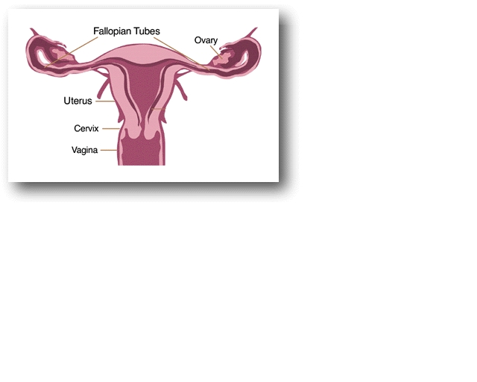
Female System

Slide 11
Ovaries
The ovaries are the female sex organs.
They produce the eggs.
They also make the female hormones oestrogen and progesteron (between 10 and 15 years).

Slide 12
Egg tube
An egg is released about every 28 days.
The egg passes out of the ovary and moves into the egg tube.
This is called ovulation and is when an egg may become fertilized.

Slide 13
Uterus
The egg slowly moves down towards the uterus (womb).
If sperms are present in the egg tube the egg will be fertilised.
If the egg is not fertilised it will dies after about a day.

Slide 14
Cervix
The lower end of the uterus has a ring of muscle called the cervix.
It leads to a muscular tube called the vagina that opens to the outside of the body
.

Slide 15
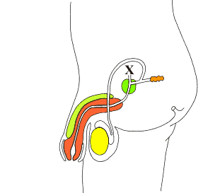

Slide 17
This powerpoint was kindly donated to www.worldofteaching.com
http://www.worldofteaching.com is home to over a thousand powerpoints submitted by teachers. This is a completely free site and requires no registration. Please visit and I hope it will help in your teaching.

