Slide 1
Rickets
Rickets is a disorder involving softening and weakening of the bones (of children).
It is caused by lack of vitamin D, calcium or phosphate in your diet.
What could we do to prevent getting rickets?

Slide 2
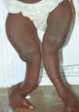
Rickets – causes softening and weakening of bones.

Slide 3
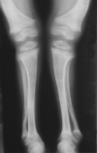
X-ray of a 20 month old boy with rickets
Notice the bow shape of the legs.

Slide 4
KWASHIORKOR
Kwashiorkor is a disease caused by a lack of protein in the diet.
Children and adolescents require protein for growth and development.
It occurs most commonly in areas of famine and limited food supply.

Slide 5
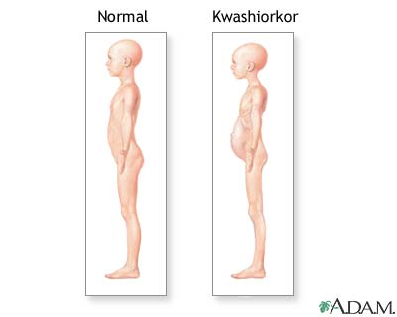
KWASHIORKOR

Slide 6
SCURVY
A condition caused by lack of vitamin C.
It causes weakness, gum disease and skin haemorrhages (bleeding).
Scurvy is most frequently seen in older, malnourished adults.

Slide 7
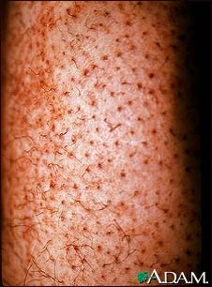
Scurvy - vitamin C deficiency.

Slide 8
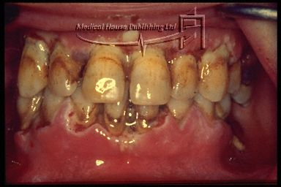
Another example of the effect of scurvy

Slide 9
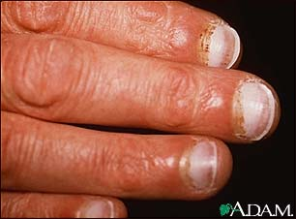
Scurvy

Slide 10
This powerpoint was kindly donated to www.worldofteaching.com
http://www.worldofteaching.com is home to over a thousand powerpoints submitted by teachers. This is a completely free site and requires no registration. Please visit and I hope it will help in your teaching.

