Slide 1
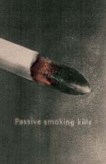
Smoking – To Die For!

Slide 2
Lesson Objectives:
State that tobacco smoking can cause-
Emphysema, bronchitis, cancer and heart disease.
Describe how cigarette smoke effects ciliated epithelial cells and how this is linked to “smoker’s cough”

Slide 3
Facts:
Fewer than 10% of lung cancer patients survive five years after diagnosis.
Smokers who smoke between 1 and 14 cigarettes a day have eight times the risk of dying from lung cancer compared to non-smokers. Smokers who smoke more than 25 cigarettes a day have 25 times this risk compared to non-smokers.
Smoking leads to an earlier menopause: on average women smokers go through the menopause up to 2 years earlier than non-smokers and are at a greater risk of developing osteoporosis. Smoking has been associated with increased sperm abnormalities and with impotence in men.
Giving up smoking can reduce the risk of developing many of these problems. Within 10-15 years of giving up smoking, an ex-smoker's risk of developing lung cancer is only slightly greater than that of a non-smoker. A young smoker suffering from bronchitis or emphysema who gives up may see some improvement in lung function as a result: damage to lungs caused by years of smoking is permanent but quitting smoking prevents it worsening.
It is estimated that several hundred cases of lung cancer and several thousand cases of heart disease in non-smokers in the UK every year are caused by passive smoking.
Tobacco use kills around 120,000 people in the UK every year, about 330 every day - as if a plane crashed every day and killed all its passengers, around 20% of all deaths.
Smoking causes at least 80% of all deaths from lung cancer, around 80% of all deaths from bronchitis and emphysema and around 17% of all deaths from heart disease. About half of all regular cigarette smokers will eventually be killed by their habit.
.

Slide 4
Diseases
We are going to look at the main types of diseases which you can get from smoking, which are:
Bronchitis
Emphysema
Heart disease
cancer

Slide 5
Bronchitis
What is chronic bronchitis?
Chronic bronchitis is a chronic inflammatory condition in the lungs that causes the respiratory passages to be swollen and irritated, increases the mucus production and may damage the lungs. The symptoms are coughing and breathlessness, which will get worse over the years.
The definition of chronic bronchitis is chronic cough or mucus reproduction for at least three months in two successive years when other causes have been excluded.

Slide 6
Emphysema
Effects the alveoli
The smokers cough weekens the walls of the alveoli, therefore the lungs can not take in enough oxygen which leads to breathlessness.

Slide 7
Cancer
Increased risk of developing lung cancer
Number of cigarettes smoked per day Annual death rate per 100,000 men
010-14 (8 times that of non-smokers)
15-25 (13 times that of non-smokers)
25 or more25 (25 times that of non-smokers)

Slide 8
Lung Cancer
Lung cancer kills more people than any other type of cancer and at least 80% of these deaths are caused by smoking. In 1999, 29,406 people in England and Wales died of lung cancer.[
It is the tar in the `cigarettes which contain the carcinogenic “cancer causing” substances
Not only are you susceptible to lung cancer, but also: mouth, throat, stomach cancer. Cigarette tars contain some of the most carcinogenic chemicals known to man. Consider this when watching people smoking and exhaling only 10% of the tars they actually take in. Not only are these chemicals being painted into the lung, but smoker are also constantly painting them up on their lips, tongue, larynx, swallowing some and thus painting it in the esophagus and throughout the digestive tract. Smokers have increased incidents of cancer in all of these exposed sites.

Slide 9
Heart Disease
The role of smoking in Coronary Heart Disease
Inhaling tobacco smoke causes several immediate responses within the heart and its blood vessels. Within one minute of starting to smoke, the heart rate begins to rise: it may increase by as much as 30 percent during the first 10 minutes of smoking.
Nicotine raises blood pressure: blood vessels constrict which forces the heart to work harder to deliver oxygen to the rest of the body. Meanwhile,
carbon monoxide in tobacco smoke exerts a negative effect on the heart by reducing the blood’s ability to carry oxygen.

Slide 10
Heart Disease
Smoking tends to increase blood cholesterol levels.
Carbon monoxide attaches itself to haemoglobin (the oxygen-carrying pigment in red blood cells) much more easily than oxygen does. This reduces the amount of oxygen available to the tissues. This again will put pressure on the heart!

Slide 11
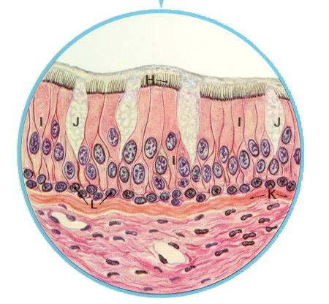
Cilia and smoking
The following series of slides illustrate microscopic changes that happen when a person smokes. The first slide is showing an illustrated blow-up of the normal lining of the bronchus. On the top we see the cilia, labeled (H). They are attached to columnar cells, labeled (I). The cilia sweep the mucous produced in the goblet cells, labeled (J) as well as mucous coming from deeper glands within the lungs and the particulate matter trapped in the mucous. The bottom layer of cells, labeled (L) are the basal cells.

Slide 12
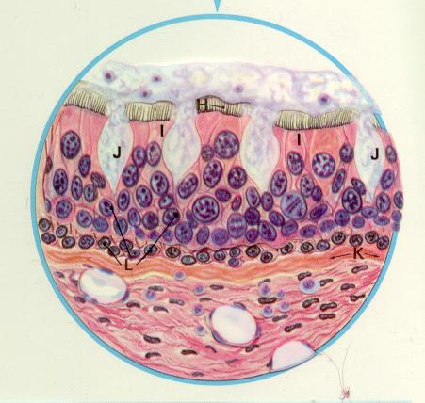
Cilia and smoking
Below we start to see the changes that occur as people begin to smoke. You will see that the columnar cells are starting to be crowded out and displaced by additional layers of basal cells.
Not only are fewer cilia present but the ones that are still functioning are doing so at a much lower level of efficiency. Many chemicals in tobacco smoke are toxic to cilia, first slowing them down, soon paralyzing them all together and then destroying them.

Slide 13
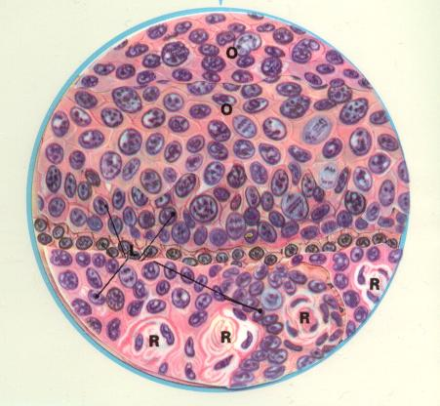
Cilia and smoking
As you see with the cilia actions being diminished, mucous starts to build up in the small airways making it harder for the smoker to breathe and causing the characteristic smokers cough in order to clear out the airways.
Eventually though, the ciliated columnar cells are totally displaced. As can be seen below ominous changes have taken place. Not only is the smoker more prone to infection from the loss of the cleansing mechanism of the cilia, but these abnormal cells (O) are cancerous squamous cells. These cells will eventually break through the basement membrane wall and invade into underlying lung tissue and often spread throughout the body long before the person even knows they have the disease.

Slide 14
Cilia and smoking
If a smoker quits before cancer actually starts, even if the cells are in a precancerous state, the process is highly reversible.
. Cilia regeneration starts in about 3 days once smoking stops. Even if cilia has been destroyed and not present for years, the lining tissue of the windpipe will start to repair.
Even the precancerous cells will be sloughed off over time, reversing the cellular process to the point where the lining tissue goes back to normal. But if a smoker waits too long and cancer starts, it may be too late to save his or her life.

Slide 15
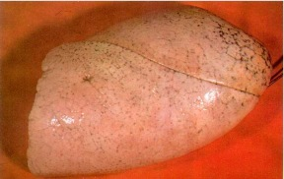
Healthy Lungs
You can see how the lung looks without the effects of inhalation of smoke.
Note black specks throughout indicative of carbon deposits from pollution.

Slide 16
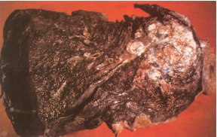
Lung after smoking
Smokers lung with cancer. White area on top is the cancer, this is what killed the person. The blackened area is just the deposit of tars that all smokers paint into their lungs with every puff they take.

Slide 17
This powerpoint was kindly donated to www.worldofteaching.com
http://www.worldofteaching.com is home to over a thousand powerpoints submitted by teachers. This is a completely free site and requires no registration. Please visit and I hope it will help in your teaching.

