Slide 1
AGENDA
What is symbiosis?
What are the different kinds of symbiosis?
Examples
What is Homeostasis?
What are some examples of how organisms maintain homeostasis?

Slide 2
What is symbiosis?
Literal definition: the act of living together
What it means:
Two organisms that live together
Temporarily or for a longer time
At least one of the organisms benefits from the relationship

Slide 3
What are the different kinds of symbiosis?
Mutualism
Commensalism
Parasitism
both organisms benefit
one organism benefits
one organism benefits
one organism is unaffected
one organism is harmed

Slide 4
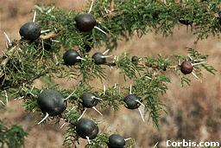
Example 1: Acacia plant with ant galls
Ants lay eggs on acacia tree Acacia covers the infected area with brown flesh (gall)
Parasitism: one benefits, one is harmed

Slide 5
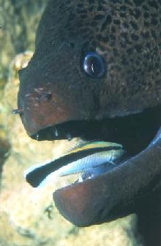
Mutualism: both benefit
Example 2: Moray Eel with Cleaner Fish
Moray Eel gets a clean mouth Cleaner Fish gets a meal

Slide 6
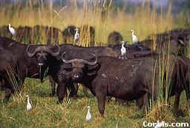
Example 3: Cattle with cattle egrets
Cattle stir up insects as they eat grass Egrets hang around and eat insects
Commensalism: one benefits, one is unaffected

Slide 7
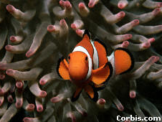
Example 4: Clown fish with anemone
Clown fish gets protection Anemone is unaffected
Commensalism: one benefits, one is unaffected

Slide 8
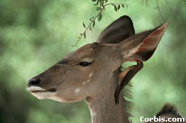
Mutualism: both benefit
Example 5: Antelope with Oxbird
Antelope gets rid of parasites Oxbird gets a meal

Slide 9
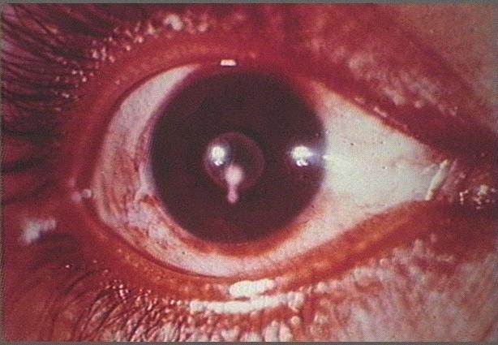
Example 6: Taenia worm in human eye
Worm infects human blood stream Human may go blind
Parasitism: one benefits, one is harmed

Slide 10
Homeostasis
Maintaining a stable internal environment.

Slide 11
Examples of Homeostasis
The thickening of fur in winter
The darkening of skin in sunlight
The seeking of shade in heat,
The production of more red blood cells at high altitude.
A dog panting to release body heat.

Slide 12
More examples
The regulation of the amounts of water and minerals in the body. This is known as osmoregulation. This happens in the kidneys.
Cold-blooded animals lying in the sun to warm up.
The removal of metabolic waste. This is known as excretion. This is done by the excretory organs such as the kidneys and lungs.

Slide 13
Even More Examples
The regulation of body temperature. This is mainly done by the skin.
The regulation of blood glucose level. This is mainly done by the liver and the insulin secreted by the pancreas.

Slide 14
This powerpoint was kindly donated to www.worldofteaching.com
http://www.worldofteaching.com is home to over a thousand powerpoints submitted by teachers. This is a completely free site and requires no registration. Please visit and I hope it will help in your teaching.

