Slide 1
Periodic table
Important information about its beginnings

Slide 2
What is the Periodic Table?
The periodic table is the most important reference in Chemistry.
It is organized with all known elements.
The elements are organized from left to right and top to bottom in ascending order of their atomic number.

Slide 3
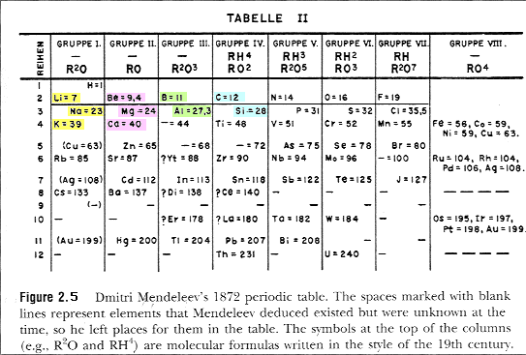
Who organized the elements?
Russian chemist Dmitri Mendeleev, in 1869, proposed a table to organize the known elements.
He organized the first table using the atomic weight of the elements. It is now organized by its atomic number.
This was his table from 1869.

Slide 4
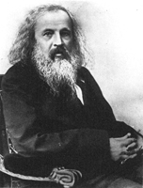
Who organized the elements?
Dmitri left some spaces on the table because he though that there where other elements that have not yet being discovered at that moment.
This is Mendeleev…

Slide 5
What can we find on the table?
On the periodic table there is individual information on each element..
It shows the atomic number of the element –which is the number of protons that the elements have.
The symbol – this is one or two letters that represent that element. If there are two letters the second will always be lower case.
Atomic mass – is the mass of the element
Some will have more information some less but all of them will have at least the symbol.

Slide 6
What can we find on the table?
10 Ne
20.18
Atomic Number
Symbol
Atomic Mass

Slide 7
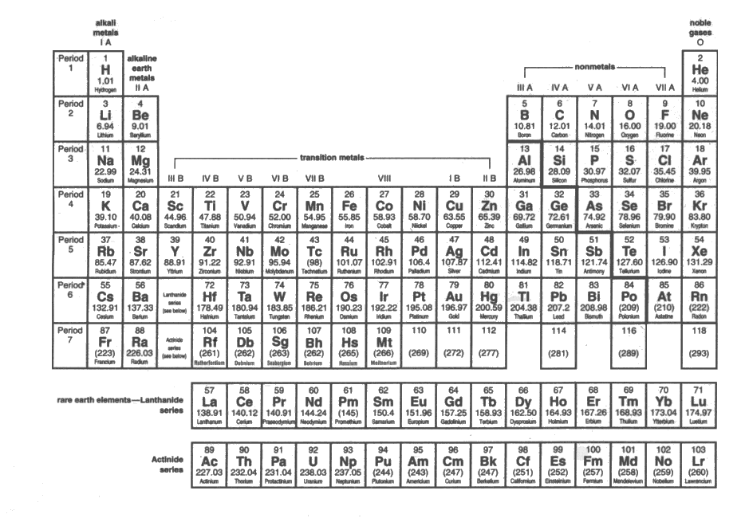
How is organized?
The horizontal lines of the table are called PERIODS.
The vertical lines are called FAMILIES.

Slide 8
This is the Periodic Table…

Slide 9
This powerpoint was kindly donated to
www.worldofteaching.com
http://www.worldofteaching.com
Is home to well over a thousand powerpoints submitted by teachers. This a free site. Please visit and I hope it will help in your teaching
Notes:
9

