Slide 1
Tobacco
and its dangers

Slide 2
Tobacco smoke
Tobacco smoke contains about 1000 chemicals, many of them being harmful
Smoking kills 12 times the number of people killed in road accidents
It contains nicotine which is addictive
Tar is a black sticky substance that forms in the moist lungs
Tar contains 17 chemicals (carcinogens) that are known to cause cancer
Carbon monoxide is a poisonous gas that stops red blood cells from carrying oxygen around the body

Slide 3
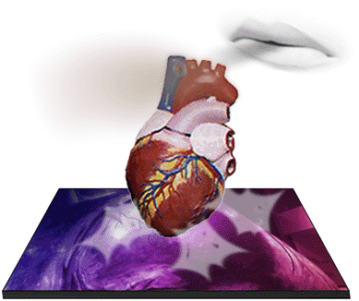
Heart disease
Heart disease is 3 times more common among smokers
Smokers have more chance of a heart attack (when the heart stops working)

Slide 4
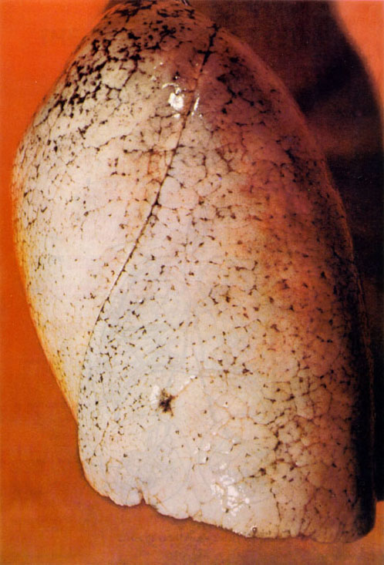
Healthy, clean lungs
A healthy lung looks like a pink sponge
The air sacs give the lungs a large surface area for gas exchange to take place
This ensures that enough oxygen gets into the blood and around the body

Slide 5
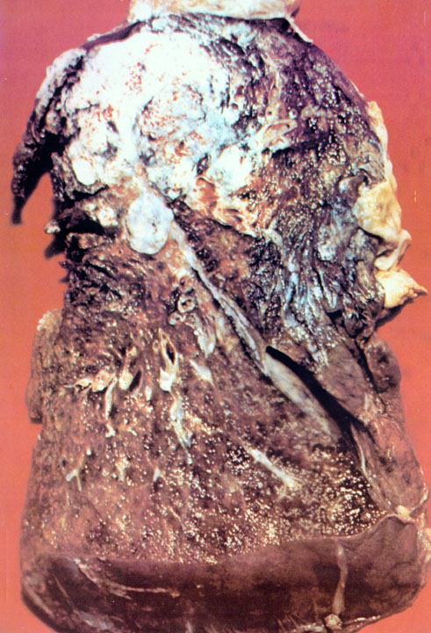
Lung cancer
Cancers of the lungs, mouth, gullet (oesophagus), and the bladder are caused by chemicals called carcinogens in tobacco smoke
9 out of 10 people who die from lung cancer are smokers

Slide 6
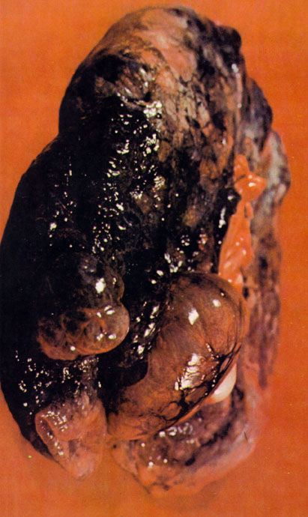
Emphysema
Emphysema is a lung disease caused by tar.
Lung tissue is destroyed and large holes develop which blow up like balloons.
Breathing becomes very difficult.

Slide 7
Bronchitis
This lung disease is usually found in smokers
The air passages (bronchi) to the lungs become irritated by smoke
These air passages become swollen and sore
There are tiny hairs called cilia which keep these air passages clear
Smoking damages these cilia and stops them working
The lungs fill up with mucus which the smoker now has to try and physically cough up!

Slide 8
Other problems caused by smoking:
Tobacco smoke is often very unpleasant for other people
It makes your breath, hair, clothes and house smell
It can irritate those who suffer with hayfever or asthma
Passive smokers can also develop lung damage
Pregnant mothers who smoke can have smaller babies than non-smokers. The babies also have an increased risk of getting asthma
It is thought that smoking in a house may contribute to causing cot deaths

Slide 9
This powerpoint was kindly donated to www.worldofteaching.com
http://www.worldofteaching.com is home to over a thousand powerpoints submitted by teachers. This is a completely free site and requires no registration. Please visit and I hope it will help in your teaching.

