Slide 1
Virus Structure and Method of Invasion
Higher Biology

Slide 2
Introduction to viruses
Obligate parasites
Specific to type of cells they target
-poliomylelitis virus attacks nerve cells
-hepatitis virus attacks liver cells
Reproduction is their only true characteristic of being alive
Much smaller than bacteria (20-300nm)

Slide 3
Viral Structure
Not a cell!
DNA or RNA (retrovirus)
Surrounded by protective protein coat (capsid)
Genetic material carries information for multiplication
Hijacks biochemical machinery of host cell to carry these processes out

Slide 4
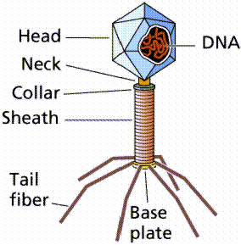
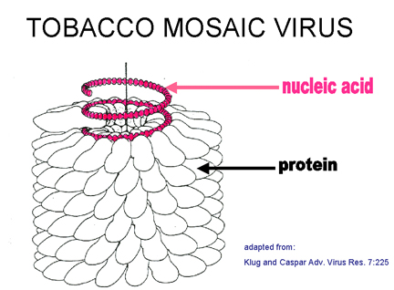
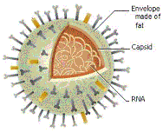
Bacteriophage

Slide 5
Invasion of a cell by a virus
Virus can lie dormant for many years until it comes into contact with a suitable host cell
Binds with molecules on surface of host cell
Herpes
-whole virus enters cell
Bacteriophage
-viral DNA injected via hollow tail

Slide 6
Alteration of Cell Instruction
Virus takes control of cell machinery
Depends on host for
-ATP
-supply of free nucleotides
Virus suppresses cell’s normal nucleic acid replication and protein synthesis
Manufactures many identical copies of viral nucleic acid and protein coats

Slide 7
New viral particles become assembled and become released by:
Lysis
-viral nucleic acid used to synthesise lysis enzymes
-bursting of host cell to release viral particles
OR
2. Buds contaning virus are formed

Slide 8
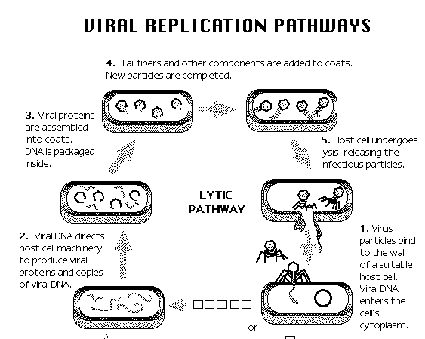

Slide 9
Retrovirus
Contains RNA
No DNA to transcribe into mRNA
Reverse transcriptase injected into cell by virus with RNA
-enzyme reverses normal transcription
-Produces viral DNA from RNA
-Virus uses DNA to replicate

Slide 10
Some video clips
Bacteriophage entering a cell
HIV replication

Slide 11
This powerpoint was kindly donated to www.worldofteaching.com
http://www.worldofteaching.com is home to over a thousand powerpoints submitted by teachers. This is a completely free site and requires no registration. Please visit and I hope it will help in your teaching.

