Slide 1
Leucocytes White Blood Cells
Basar

Slide 2
White Blood Corpuscles
White Blood cells are also known as Leucocytes as they are colorless due to lack of Haemoglobin.
There are about 6000-8000mm of WBC for 1ml of blood.
These are also called Scavengers & Microscopic policemen

Slide 3
WBC’s
Five Types
Classified according to the presence or absence of granules and the staining characteristics of their cytoplasm.
Leucocytes appear brightly colored in stained preparations, they have a nuclei and are generally larger in size than RBC’s.

Slide 4
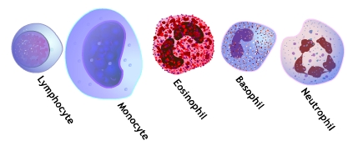

Slide 5
Type of WBC’s
Granulocytes—have large granules in their cytoplasm
Neutrophils
Eosinophils
Basophils

Slide 6
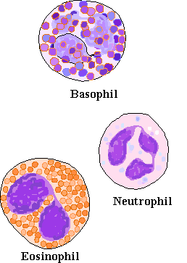
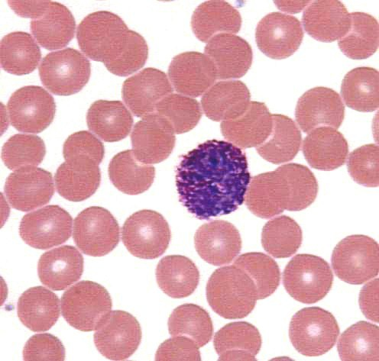

Slide 7
Types of WBC’s
Agranulocytes—do not have granules in their cytoplasm
Lymphocytes
Monocytes

Slide 8
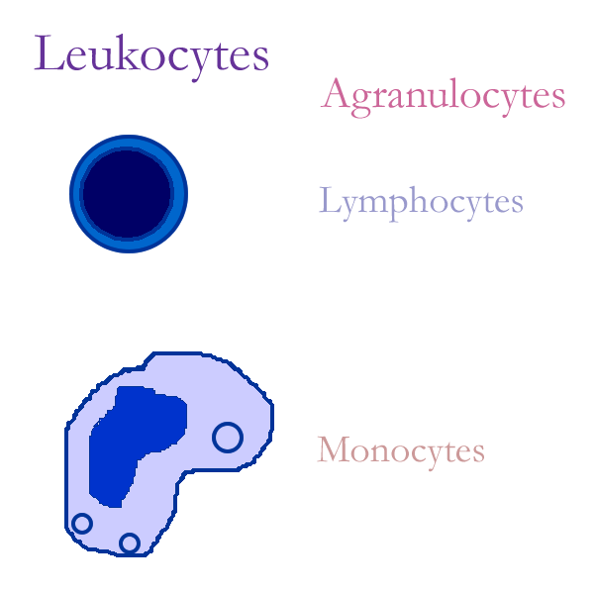
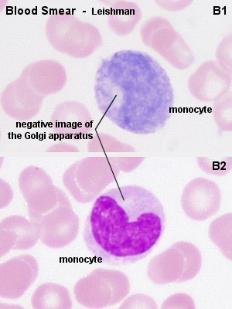

Slide 9
Granuloctyes
Neutrophils
Stain light purple with neutral dyes
Granules are small and numerous—course appearance
Several lobes in nucleus
65% of WBC count
Highly mobile/very active
Diapedesis—Can leave blood vessels and enter tissue space
Phagocytosis (eater), contain several lysosomes (janitor)

Slide 10
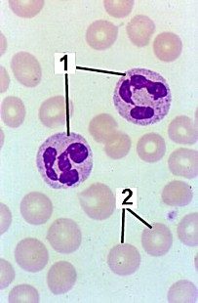
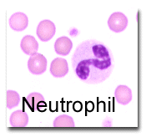

Slide 11
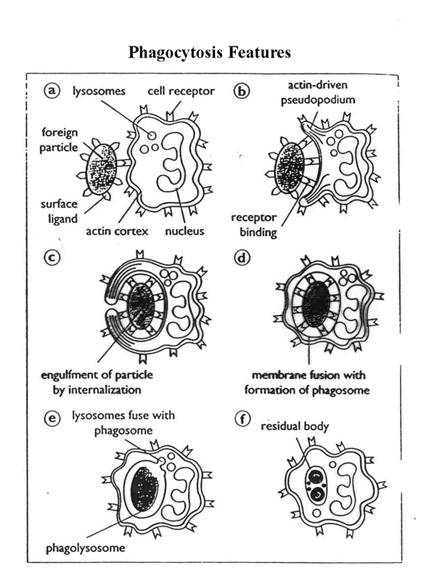

Slide 12
Granulocytes
Eosinophils or Acidophils:
Large, numerous granules
Nuclei with two lobes
2-5% of WBC count
Found in lining of respiratory and digestive tracts
Important functions involve protections against infections caused by parasitic worms and involvement in allergic reactions
Secrete anti-inflammatory substances in allergic reactions

Slide 13
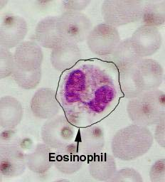

Slide 14
Granulocytes
Basophils
Least numerous--.5-1%
Diapedesis—Can leave blood vessels and enter tissue space
Contain histamine,serotonin,heparin—inflammatory chemical

Slide 15
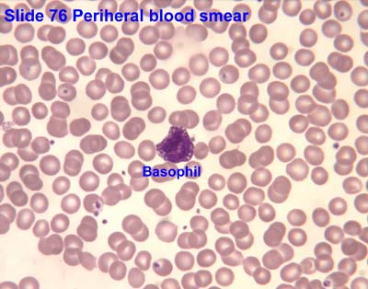
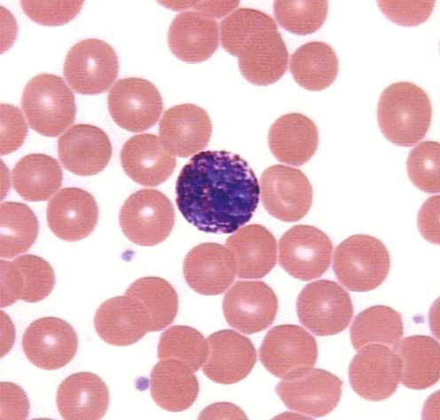

Slide 16
Agranulocytes
Lymphocytes
Smallest WBC
Large nuclei/small amount of cytoplasm
Account for 25% of WBC count
Two types—T lymphocytes—attack an infect or cancerous cell, B lymphocytes—produce antibodies against specific antigens (foreign body)

Slide 17
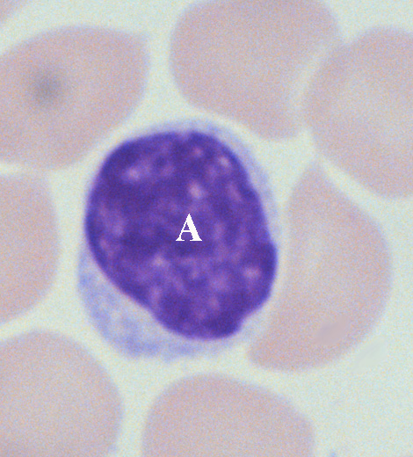
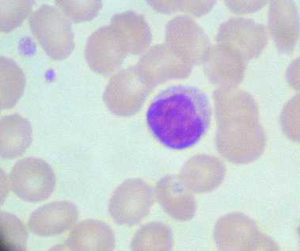

Slide 18
Agranulocytes
Monocytes
Largest of WBCs
Dark kidney bean shaped nuclei
Highly phagocytic

Slide 19
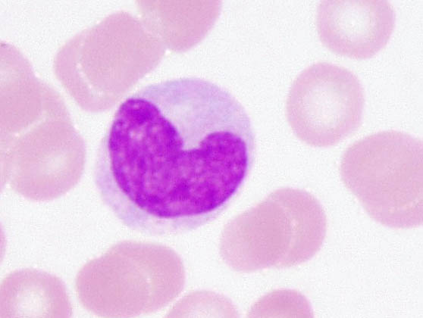

Slide 20
WBC Numbers
Doctors look at WBC numbers.
If number goes up there is some kind of infection and surgery might be needed.
Clinics will count the number of WBC’s in a blood sample, this is called differential count.
A decrease in the number of white blood cells is leukopenia
An increase in the number of white blood cells is leukocytosis.

Slide 21
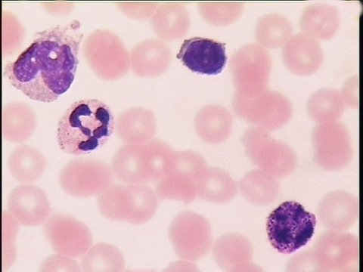

Slide 22
Formation of WBC’s
Leucocytes are formed in the red marrow of many bones.
They can also be formed in lymphatic tissue.
They live for about 13-20 days.

Slide 23
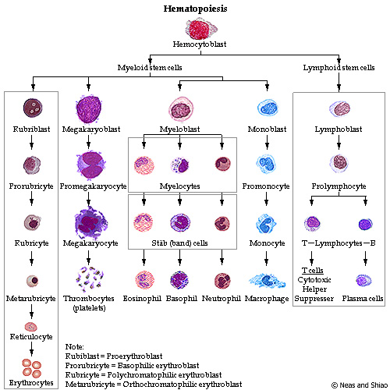

Slide 24
Created by
N.RajaSekhar
RGUIIIT,Basar

Slide 25
This powerpoint was kindly donated to
www.worldofteaching.com
http://www.worldofteaching.com
Is home to well over a thousand powerpoints submitted by teachers. This a free site. Please visit and I hope it will help in your teaching
Notes:
25

