Slide 1
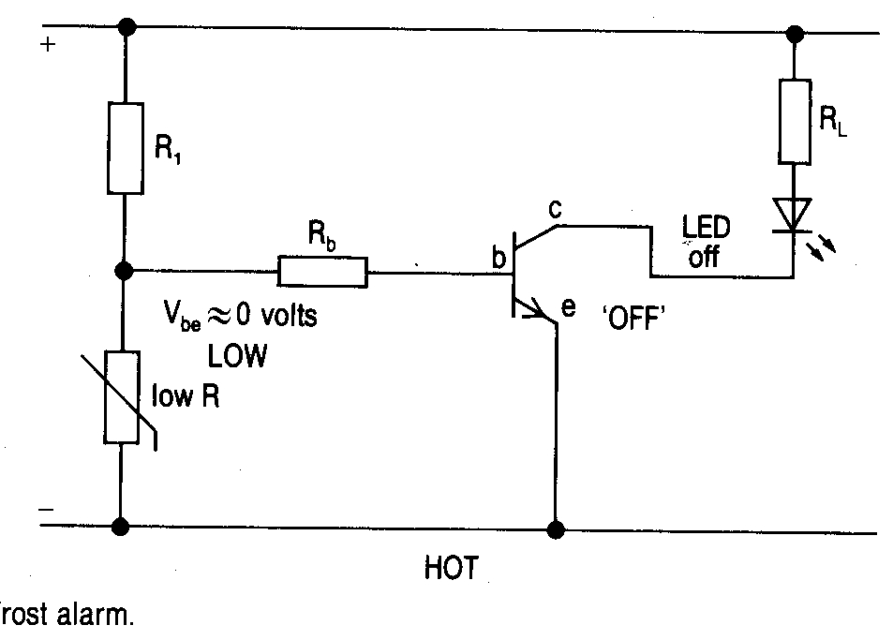
ELECTRONICS
Frost Alarm

Slide 2
ELECTRONICS
When the thermistor temp is high the resistance is low and the transistor is off.

Slide 3
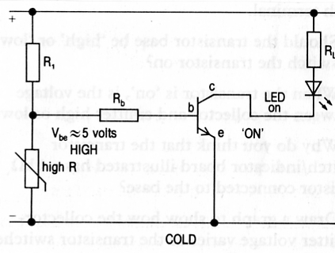
ELECTRONICS
Frost Alarm

Slide 4
ELECTRONICS
When the thermistor temp is low , the resistance is high and the transistor switches on.

Slide 5
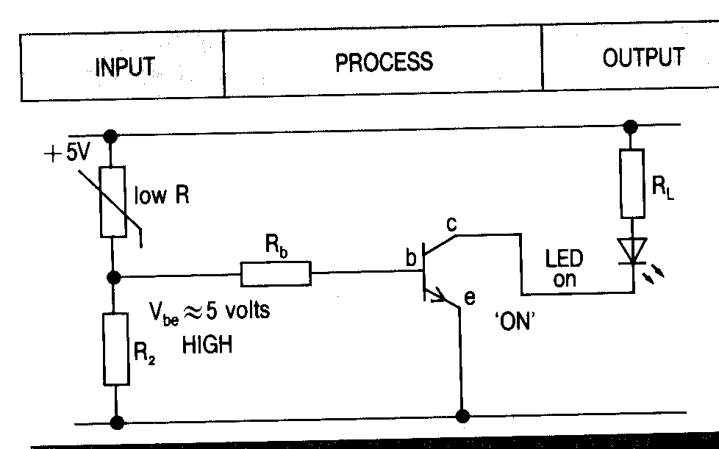
ELECTRONICS
Fire Alarm

Slide 6
ELECTRONICS
When the temp is hot the thermistor resistance is low so it takes little voltage and so the resistor takes most of the voltage and so the transistor switches on.

Slide 7
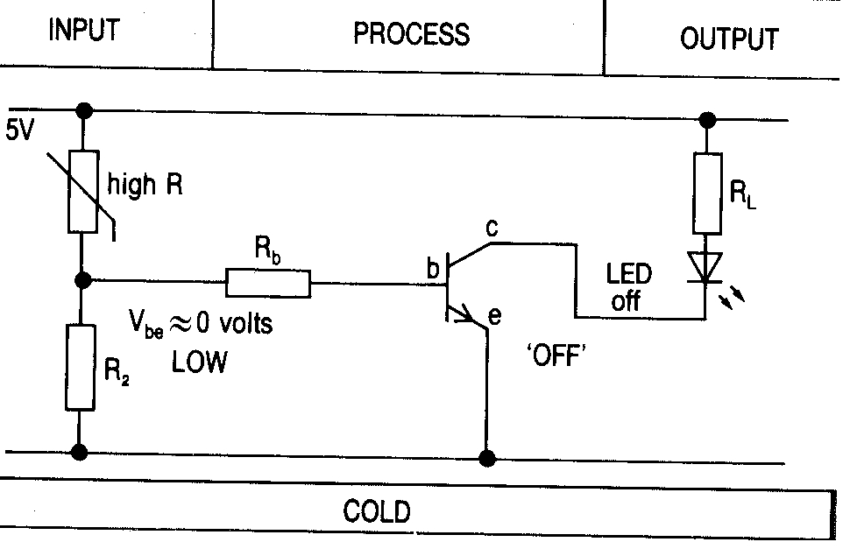
ELECTRONICS
Fire Alarm

Slide 8
ELECTRONICS
When the temp is cold the thermistor takes most voltage and so the resistor takes little and the transistor is off.

Slide 9
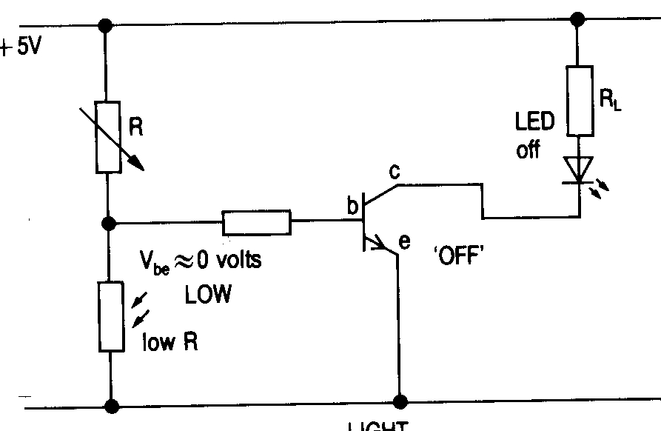
ELECTRONICS
Burglar Alarm

Slide 10
ELECTRONICS
When the L.D.R. is in the light ,the resistance is low so the voltage is low and the transistor is off

Slide 11
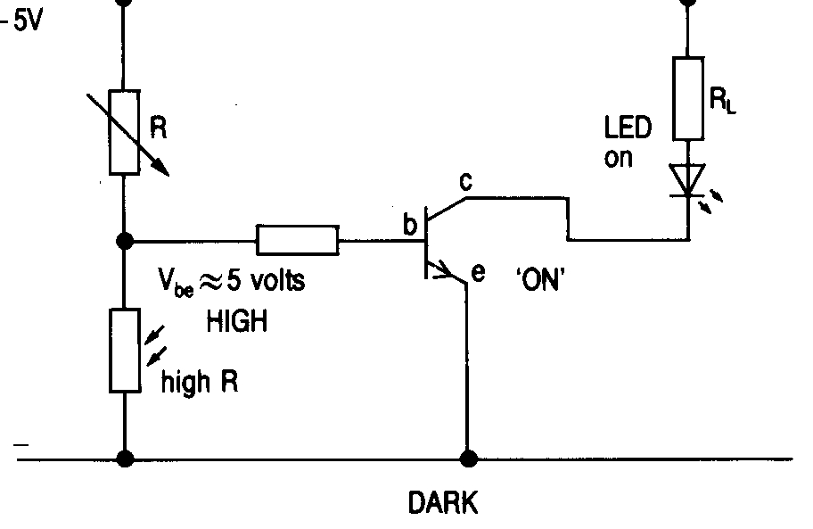
ELECTRONICS
Burglar Alarm

Slide 12
ELECTRONICS
When the L.D.R. is in the dark its resistance is high and the transistor switches on.

Slide 13
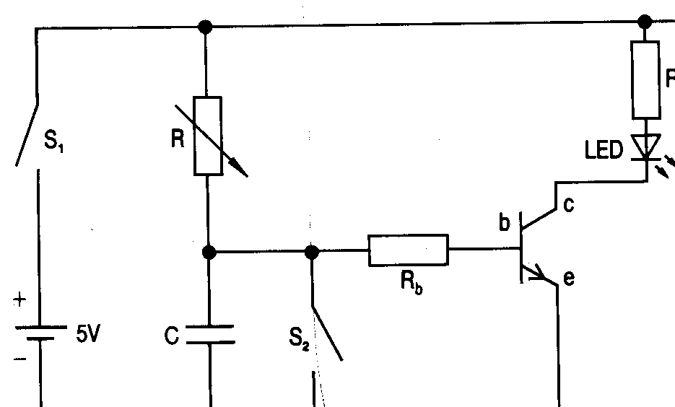
ELECTRONICS
Time Delay Circuit

Slide 14
ELECTRONICS
When the capacitor charges up to a certain voltage after a certain time , the transistor switches on.

Slide 15
ELECTRONICS

Slide 16
ELECTRONICS
There are 3 process devices,
The NOT gate
The AND gate
The OR gate

