Slide 1
The Brain
By the end of the lesson you should be able to
Describe the structure and function of the brain
State the function and location of cerebrum, cerebellum, medulla and hypothalamus
State the location of sensory and motor strip

Slide 2
The Brain
weighs 1300 - 1400 g
made up of about 100 billion neurons
“the most complex living structure on the universe” Society for Neuroscience
makes us who we are

Slide 3
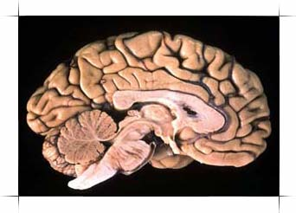
The Brain
Phineas gage

Slide 4
Brain structure
Cerebrum
cerebellum
hypothalamus
Pituitary gland
medulla
brain functions

Slide 5
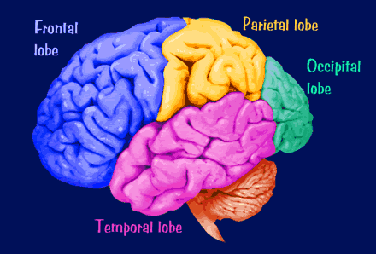
Parts of the cerebrum
memory game

Slide 6
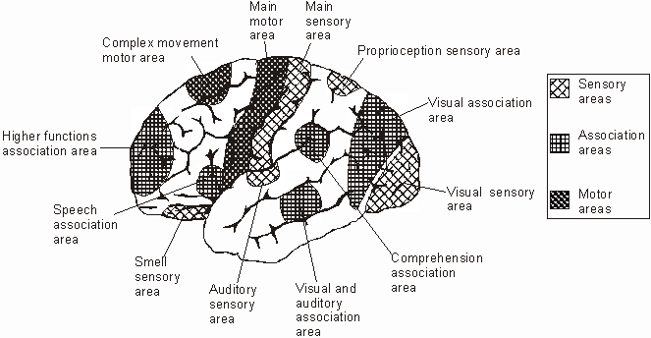
Parts of the cerebrum
alcohol and the brain

Slide 7
Sensory and motor strips

Slide 8
Sensory homunculus

Slide 9
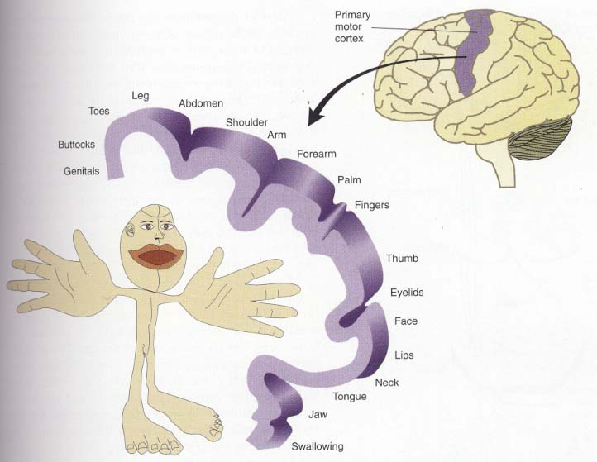
Motor strip and homunculus
Motor strip

Slide 10
The Brain
Can you
Describe the structure and function of the brain
State the function and location of cerebrum, cerebellum, medulla and hypothalamus
State the location of sensory and motor strip

Slide 11
This powerpoint was kindly donated to www.worldofteaching.com
http://www.worldofteaching.com is home to over a thousand powerpoints submitted by teachers. This is a completely free site and requires no registration. Please visit and I hope it will help in your teaching.

