Slide 1
Chapter Seven
A View of the Cell

Slide 2
Cellular Organization
Cell
Tissue – group of cells functioning together.
Organ – group of tissues functioning together.
Organ System – group of organs functioning together.
Organism – group of organ systems functioning together.

Slide 3
The History of the Cell
The Cell
The basic unit of an organism
Discovery made possible by the invention of the microscope

Slide 4
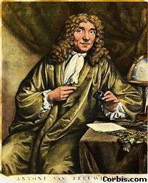
Microscopes and Cells
1600’s.
Anton van Leeuwenhoek first described living cells as seen through a simple microscope.

Slide 5
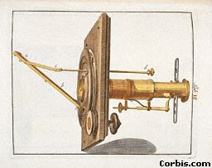
Microscopes and Cells
Robert Hooke used the first compound microscope to view thinly sliced cork cells.
Compound scopes use a series of lenses to magnify in steps.
Hooke was the first to use the term “cell”.

Slide 6
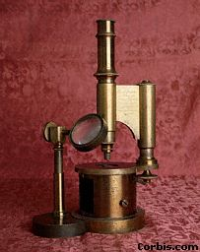
Microscopes and Cells
1830’s.
Mathias Schleiden identified the first plant cells and concluded that all plants
made of cells.
- Thomas Schwann made the same conclusion about animal cells.

Slide 7
Cell Theory:
All organisms are made up of one or more cells.
The cell is the basic unit of organization of all organisms.
All cells come from other cells all ready in existence.

Slide 8
Two Basic Cell Types
1) Prokaryote
Lacks internal compartments.
No true nucleus.
Most are single-celled (unicellular) organisms.
Examples: bacteria

Slide 9
Two Basic Cell Types
2) Eukaryote
Has several internal structures (organelles).
True nucleus.
Either unicellular or multicellular.
unicellular example: yeast
multicellular examples:
plants and animals

Slide 10
The Parts of The Eukaryotic Cell 1) Boundaries
A) Plasma Membrane
-- Serves as a boundary between the cell and its external environment.
-- Allows materials to pass in and out of the cell.

Slide 11
1) Boundaries
B) Cell Wall
-- Surrounds the plasma membrane of the cells of plants, bacteria, and fungi.
-- Plant cell walls contain cellulose while fungi cell walls contain chitin.

Slide 12
The Parts of The Eukaryotic Cell: 2) Controls
A) Nucleus
Regulates cell function.
Surrounded by a double-layered membrane (nuclear enveloped) with large pores that allow materials to pass in and out of the nucleus.
Contains chromatin – long tangles of DNA.

Slide 13
2) Controls
B) Nucleolus
Found in the nucleus and responsible for ribosome production. Ribosomes are the sites of protein production.

Slide 14
The Parts of The Eukaryotic Cell: 3) Assembly
Cytoplasm
The jelly-like material that surrounds the organelles.

Slide 15
The Parts of The Eukaryotic Cell: 4) Transport
A) Endoplasmic reticulum
Folded membrane that acts as the cell’s delivery system.
Smooth E.R. contains enzymes for lipid synthesis.
Rough E.R. is studded with ribosomes for protein synthesis.

Slide 16
4) Transport
B) Golgi apparatus (or Golgi body)
A series of flattened sacs where newly made lipids and proteins from the E.R. are repackaged and shipped to the plasma membrane.

Slide 17
The Parts of The Eukaryotic Cell: 5) Storage
A) Vacuoles
A sac of fluid surrounded by a membrane used to store food, fluid, or waste products.

Slide 18
5) Storage
B) Lysosomes
Contain a digestive enzyme.
Can fuse with vacuoles to digest food, or can digest worn cell parts.
Also known as “suicide sacs” because they can also destroy the whole cell.

Slide 19
The Parts of The Eukaryotic Cell: 6) Energy Transformers
Mitochondria
Produce the energy for the cell.
Also known as the “powerhouse of the cell”.
Has a highly folded inner membrane (cristae).

Slide 20
6) Energy Transformers
B) Chloroplasts
-- Found in plant cells and some protists.
-- Transforms light energy into chemical energy which is stored in food molecules.
-- Contain chlorophyll – a green pigment that traps light energy and gives plants their green color.

Slide 21
The Parts of The Eukaryotic Cell: 7) Support
Cytoskeleton
A network of thin, fibrous materials that act as a scaffold and support the organelles.
Microtubules – hollow filaments of protein.
Microfilaments – solid filaments of protein.

Slide 22
The Parts of The Eukaryotic Cell: 8) Locomotion
1) Cilia
Short, numerous, hair-like projections from the plasma membrane.
Move with a coordinated beating action.

Slide 23
8) Locomotion
B) Flagella
Longer, less numerous projections from the plasma membrane.
Move with a whiplike action.

Slide 24
The Parts of The Eukaryotic Cell: 9) Cell Division
Centrioles
made of protein.
play a role in the splitting of the cell into two cells.
found in animal and fungi cells.

Slide 25
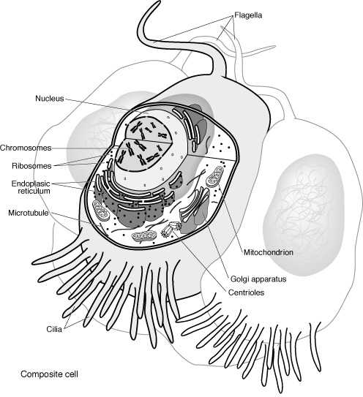
Flagella
Nucleus
nucleolus
Chromosomes
Ribosomes
Endoplasic
reticulum
Microtuble
Mitochondrion
Golgi apparatus
Centrioles
Cillia
Composite Animal Cell
Notes:
Picture adapted from Access Excellence’ rescource center:
http://www.accessexcellence.org/RC/

Slide 26
Composite Animal Cell
Notes:
Teachers: you may want to print out this diagram, photocopy it for each
student and have them fill in the blanks as you go through this presentation.

Slide 27
This powerpoint was kindly donated to www.worldofteaching.com
http://www.worldofteaching.com is home to over a thousand powerpoints submitted by teachers. This is a completely free site and requires no registration. Please visit and I hope it will help in your teaching.

