Slide 1
How do changes in the environment affect organisms?

Slide 2
Living things are adapted to daily changes in their habitat…………….

Slide 3
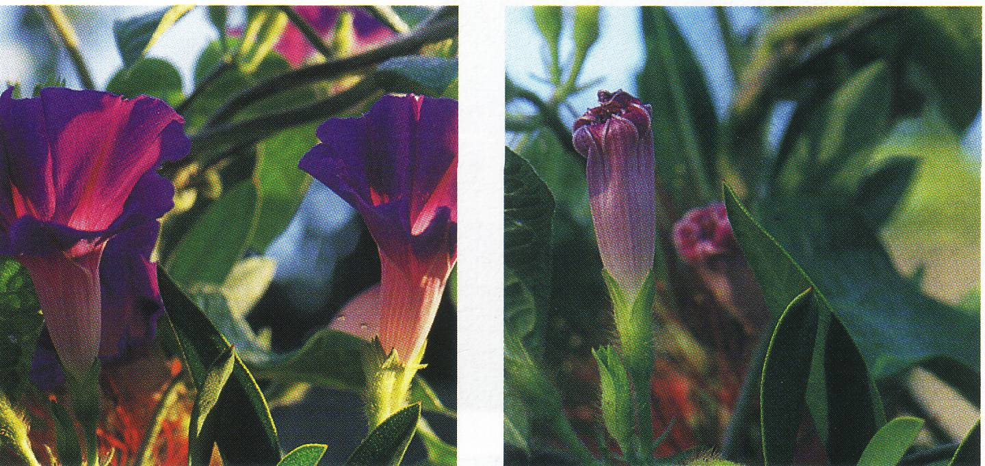
Daily changes
Flowers open and close

Slide 4
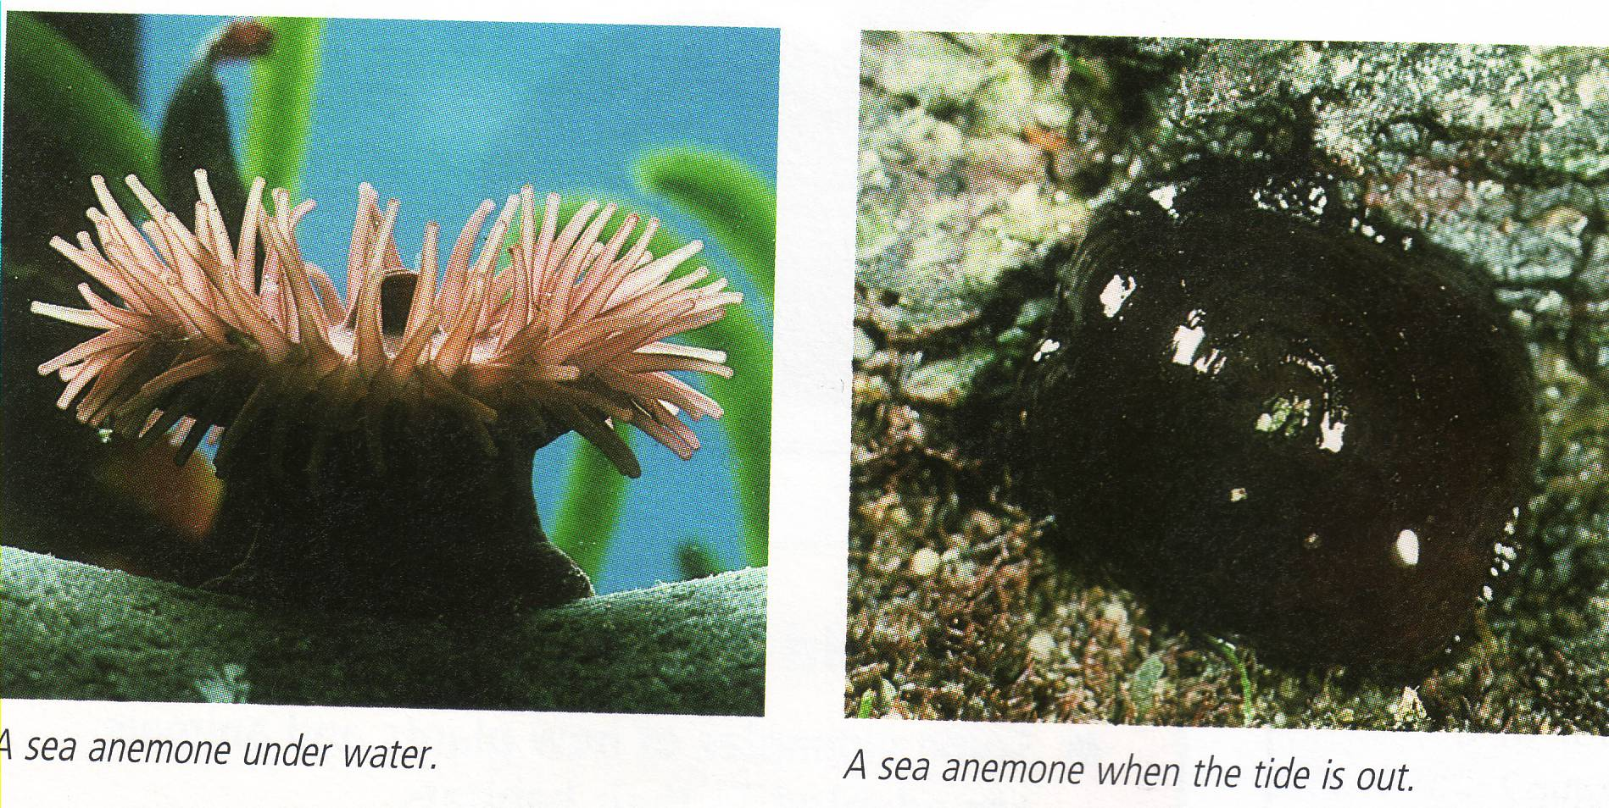
Daily changes
Sea anemones pull in their tentacles when the tide goes out to stop them drying out.

Slide 5
Living things are adapted to seasonal changes in their habitat

Slide 6
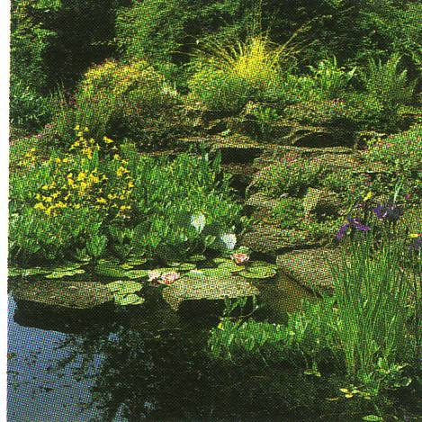
Seasonal changes in a garden
A garden in
the summer

Slide 7
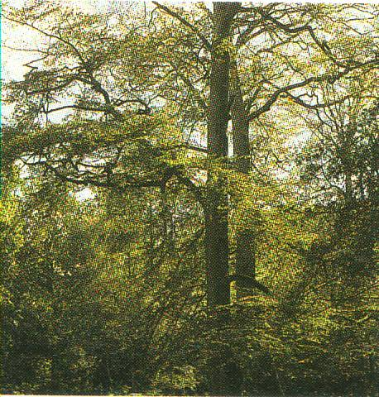
A woodland
A woodland
in spring

Slide 8
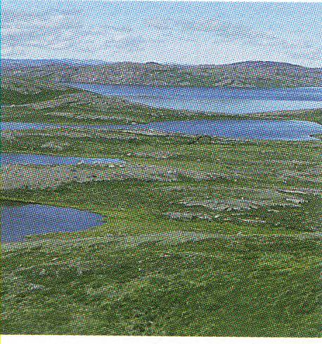
The Arctic

Slide 9
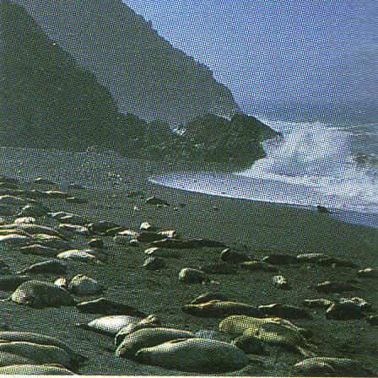
The Seashore

Slide 10
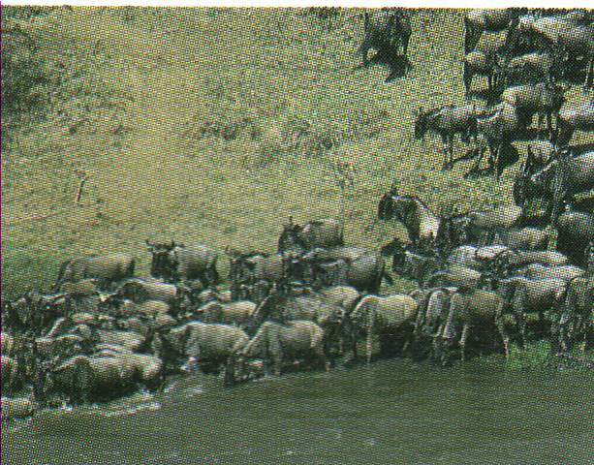
Wilderbeast
Wilderbeast migrate.
They travel hundreds of miles every winter looking for grass to eat.
Grass will only grow where it rains.

Slide 11
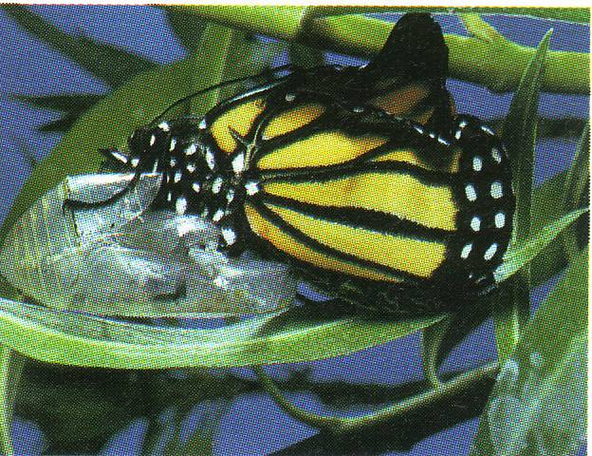
Some insects spend winter in protective cases called pupua.
This butterfly is emerging from a pupa.

Slide 12
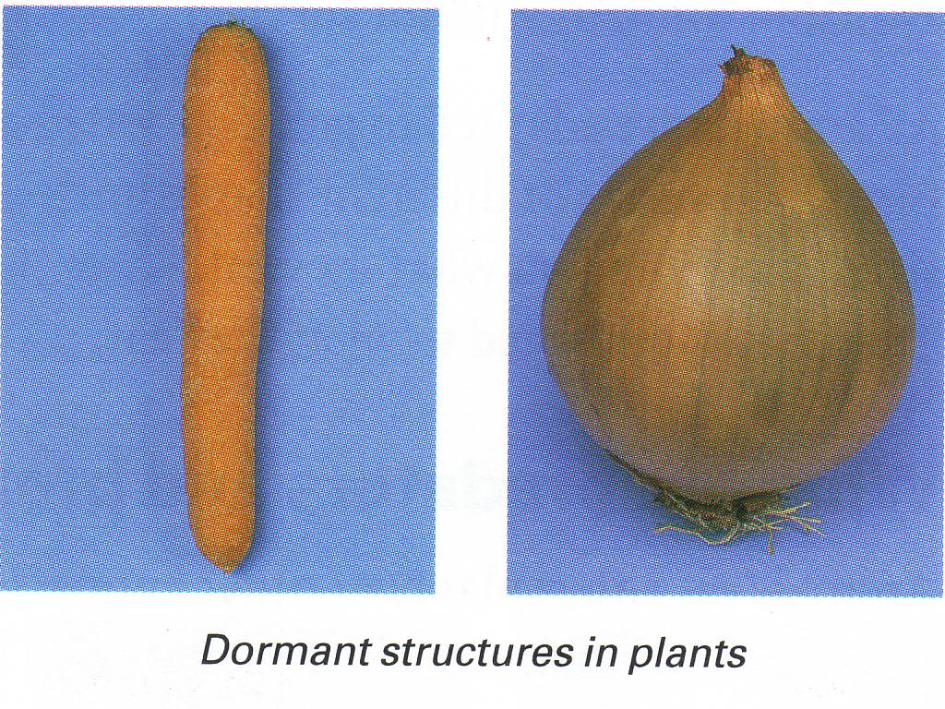
Some plants store their food for winter underground in their roots and stems.

Slide 13
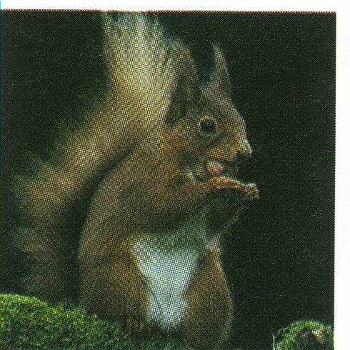
Squirrels store foods like nuts in the autumn to eat during the winter when there is not much food around.

Slide 14
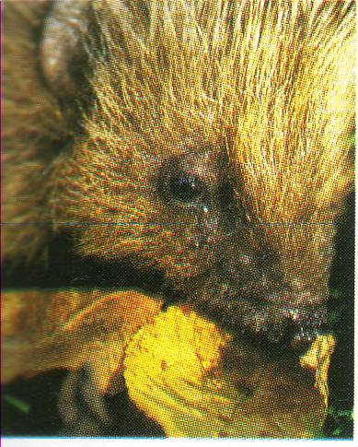
Some animals like tortoises, hedgehogs and bears, cannot store food to keep them warm. Instead they go to sleep in a warm sheltered place, such as undera pile of old leaves or inside an old tree trunk. This is called hibernation.

Slide 15
This powerpoint was kindly donated to www.worldofteaching.com
http://www.worldofteaching.com is home to over a thousand powerpoints submitted by teachers. This is a completely free site and requires no registration. Please visit and I hope it will help in your teaching.

