Slide 1
Aim: What happens after fertilization?
Do Now: Describe the process of fertilization.
A sperm enters an ovum, and the nuclei combine to form one with 46 chromosomes.

Slide 2
Fertilization: Four Major Steps
Sperm contacts the egg
Sperm or its nucleus enters the egg
Egg becomes activated and developmental changes begin
Sperm and egg nuclei fuse

Slide 3
Words to know…
Fuse- to physically join together
Ovum – egg cell (female gamete)
Cleavage – process of cell division during development
Differentiation – the process of forming different kinds of cells from similar cells of the early embryo
Embryo – an organism in an early stage of development
Morula – solid ball of cells formed from cleavage
Blastula – hollow ball of cells formed from cleavage
Gastrula – a hollow ball of cells with an “in pushing” and 3 layers (germ layers)

Slide 4
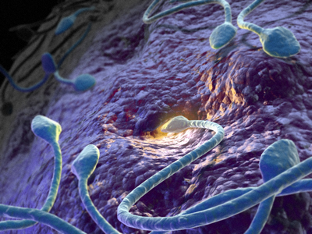
Fertilization

Slide 5
The Nuclei Fuse Together

Slide 6
What happens now?
Development of the zygote, the study of which is known as embryology or developmental biology.
The zygote undergoes a series of mitotic cell divisions called cleavage.
The stages of development are: Fertilized ovum (zygote) → 2-cell stage → 4-cell stage → 8-cell stage → Morula → Blastula → Early Gastrula → Late Gastrula

Slide 7
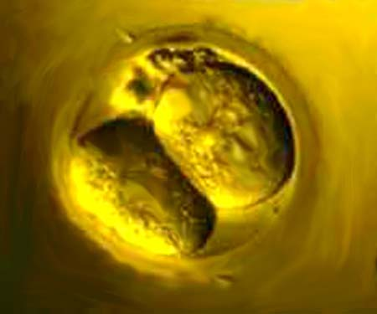
Cleavage (divide via mitosis) forms the 2 cell stage

Slide 8
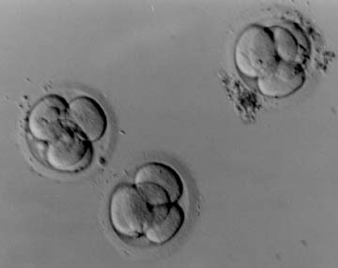
They split again to form the 4 cell stage

Slide 9
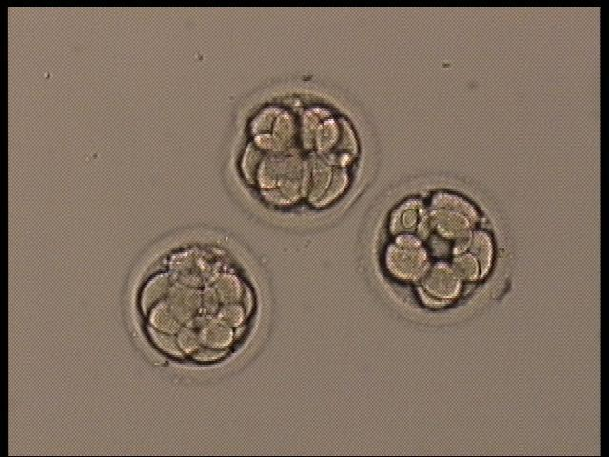
And again to form the 8 cell stage…

Slide 10
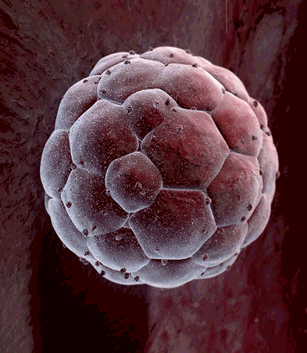
And eventually form a Morula

Slide 11
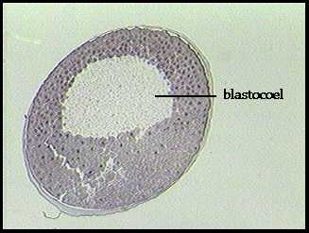
Next it becomes a blastula

Slide 12
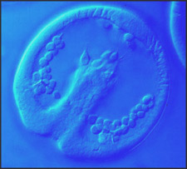
And next, a gastrula

Slide 13
The Regents Diagram…
Sperm and ovum
Zygote (fertilized ovum)
2-cell stage
4-cell stage
Morula
Blastula
Gastrula

Slide 14
Aim: What happens after cleavage begins?
Do now: How does a single celled zygote become a gastrula?

Slide 15
Differentiation (Organogenesis)
Organogenesis is the formation of the organs (Organo = organs, genesis = creation)
Arises from the layering of cells that occurs during gastrula stage
The layers are germ layers; they have specific fates in the developing embryo:
Endoderm
The innermost layer
Goes on to form the gut
Mesoderm
In the middle
Goes on to form the muscles, circulatory system, blood and many different organs
Ectoderm
The outermost
Goes on to form the skin and nervous system

Slide 16
Late Gastrula
Endoderm
Ectoderm
Mesoderm

Slide 17
Differentiation of Primary Germ Layers (from the gastrula)
Ectoderm | Mesoderm | Endoderm
Nervous system | Skeleton | Digestive tract
Epidermis of skin | Muscles | Respiratory system
 | Circulatory system | Liver, pancreas
 | Gonads | Bladder

Slide 18
Early Human Development Summary
Meiosis makes sperm in males and ovum in females
Sperm and ovum unite nuclei to form a zygote
Zygote undergoes cleavage and becomes gastrula with 3 germ layers

Slide 19
Embryonic Membranes
Protect and nourish the embryo
There are four embryonic membranes
Develop from the germ layers, but are not part of the embryo and are lost at birth
The chorion and amnion enclose the embryo
The chorion surrounds the entire embryo
The amnion encloses the embryo and forms an open volume between the embryo & the amnion called the amniotic cavity
The amniotic cavity fills with amniotic fluid, which envelops the embryo and cushions it
The amniotic fluid can be sampled to test for developmental abnormalities
The allantois is an outgrowth of the gut
In reptiles and birds, it stores nitrogenous wastes
The yolk sac encloses the yolk in vertebrates with yolk-rich eggs
In humans, there is no yolk sac, but the yolk aids in formation of red blood cells

Slide 20
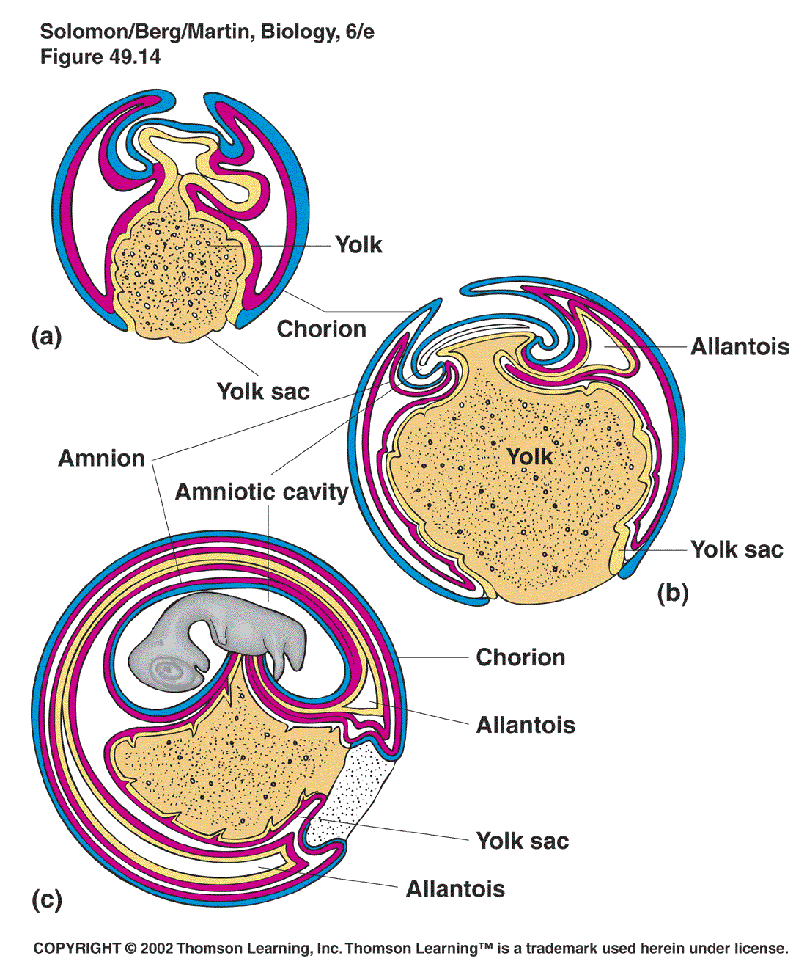
Extraembryonic Membranes

Slide 21
Human Prenatal Development
Gestation lasts 266 days from fertilization to birth
Development begins in the oviduct
About 24 hours after fertilization, the zygote has divided to form a 2-celled embryo
The embryo passes down the oviduct by cilia and peristalsis
The zona pellucida has dissolved by the 5th day, when the embryo enters the uterus
The embryo floats free for several days, nourished by fluids from glands in the uterine wall
At this point, it is called a blastocyst

Slide 22
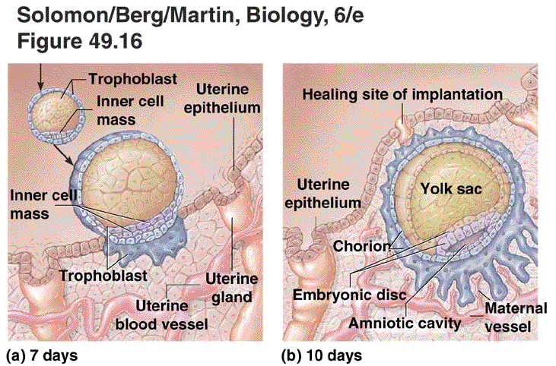
Implantation
The embryo implants in the wall of the uterus on about the 7th day of development

Slide 23
12-day Human Embryo

Slide 24
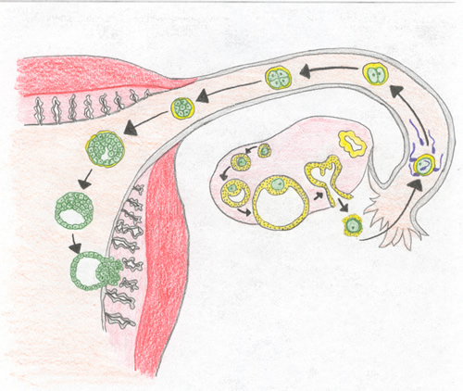
Where does this all take place?

Slide 25
The Placenta
The placenta is the site of nutrient, gas, and waste exchange
Secretes hormones that maintain pregnancy
Trophoblast cells release human chorionic gonadotropin (hCG) which signals the corpus luteum to enlarge and produce progesterone
The placenta develops from the embryonic chorion and maternal uterine tissue
Chorionic villi are formed from the chorion, and project into the endometrium of the uterus
The umbilical cord, containing two umbilical arteries and one umbilical vein connects the embryo and the placenta

Slide 26
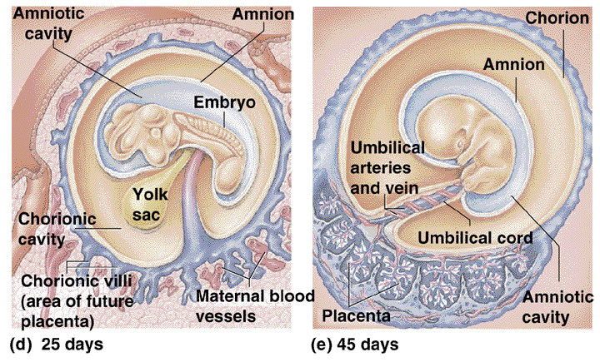
Development of the Placenta

Slide 27
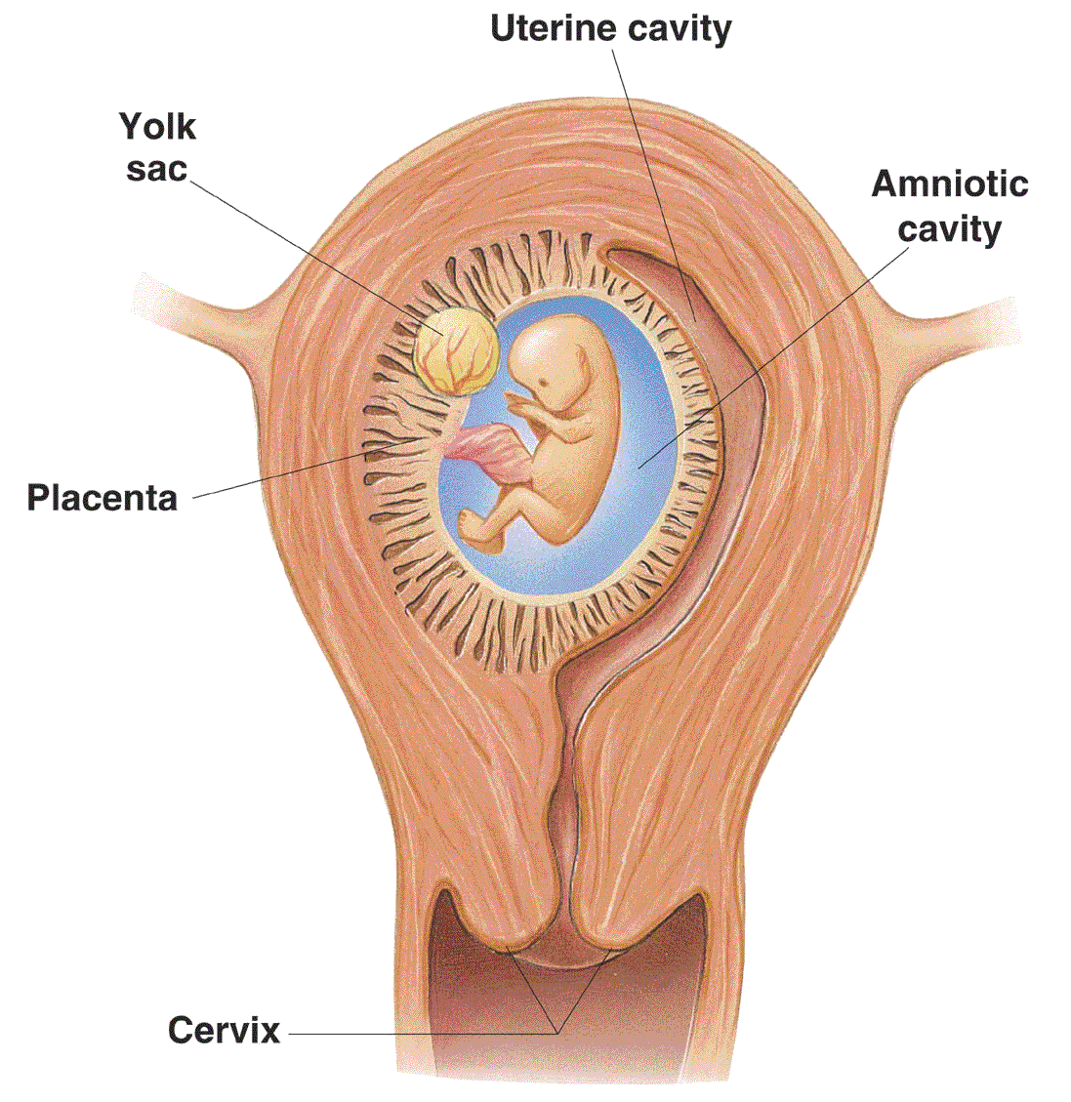
Human Fetus at Ten Weeks

Slide 28
This powerpoint was kindly donated to www.worldofteaching.com
http://www.worldofteaching.com is home to over a thousand powerpoints submitted by teachers. This is a completely free site and requires no registration. Please visit and I hope it will help in your teaching.

