Slide 1
Welcome
Today’s agenda:
Take notes,
Complete activity.

Slide 2
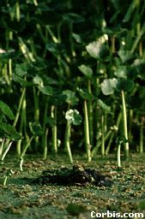
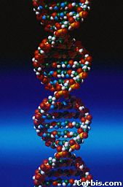
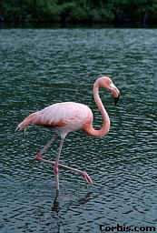
The Structure of DNA
Mr. Coleman
Biology
Notes:
All life on earth uses a chemical called DNA to carry its genetic code or blueprint. In this lesson we be examining the structure of this unique molecule.
{Point out the alligator’s eyes in the first picture.} By the way, can you make out what this is?
***************************************************************
[The goal of this presentation is to introduce high school biology students to the chemical structure of DNA. It is meant to be presented in the classroom while accompanying the teacher’s lecture, under the control of the teacher.]

Slide 3
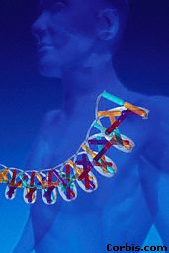
DNA
DNA is often called the blueprint of life.
In simple terms, DNA contains the instructions for making proteins within the cell.
Notes:
Why is DNA called the blueprint of life?

Slide 4
Why do we study DNA?
We study DNA for many reasons, e.g.,
its central importance to all life on Earth,
medical benefits such as cures for diseases,
better food crops.
Notes:
About better food crops, this area is controversial. There is a Dr. Charles Arntzen who is working on bioengineering foods with vaccines in them. People in poor countries could be immunized against diseases just by eating a banana, for instance.

Slide 5
Chromosomes and DNA
Our genes are on our chromosomes.
Chromosomes are made up of a chemical called DNA.
Notes:
{Ask students where the chromosomes are in this picture. Or ask them where the DNA is. Remind them that the mitochondria also have DNA.}

Slide 6
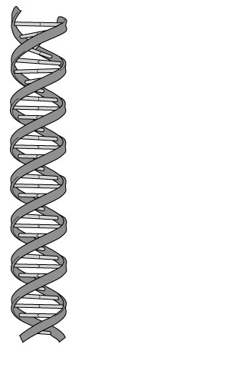
The Shape of the Molecule
DNA is a very long polymer.
The basic shape is like a twisted ladder or zipper.
This is called a double helix.
Notes:
{Show students a model of the double helix. Explain what a spiral is and a helix is.}

Slide 7
The Double Helix Molecule
The DNA double helix has two strands twisted together.
(In the rest of this unit we will look at the structure of one strand.)
Notes:
We will take apart the DNA molecule to see how it is put together.
First, we will look at one strand.

Slide 8
One Strand of DNA
The backbone of the molecule is alternating phosphate and deoxyribose, a sugar, parts.
The teeth are nitrogenous bases.
phosphate
deoxyribose
bases
Notes:
{Point to the 3-D mode, if you have one, to show the parts as you discuss them.}

Slide 9
Nucleotides
O -P O
O
ATP
One deoxyribose together with its phosphate and base make a nucleotide.
O
O -P O
O
O
O -P O
O
O
Nitrogenous
base
C
O
Phosphate
C
C
C
C
Deoxyribose
O
ribose
Notes:
{Ask students where they have seen a similar molecule before in this class.
Answer: ATP . Emphasize that nucleotides are the basic building blocks or units of a DNA molecule and that a single molecule has many millions of nucleotides.}

Slide 10
One Strand of DNA
nucleotide
One strand of DNA is a polymer of nucleotides.
One strand of DNA has many millions of nucleotides.
Notes:
{Point to the 3-D mode, if you have one, to show the parts as you discuss them.}

Slide 11
Four nitrogenous bases
DNA has four different bases:
Cytosine C
Thymine T
Adenine A
Guanine G
Notes:
These four bases are abbreviated by using their respective first letters.

Slide 12
Two Kinds of Bases in DNA
Pyrimidines are single ring bases.
Purines are double ring bases.
N
N
C
O
C
C
N
C
N
N
C
C
C
N
N
C
N
C

Slide 13
Thymine and Cytosine are pyrimidines
Thymine and cytosine each have one ring of carbon and nitrogen atoms.
N
O
N
N
C
C
O
C
C
O
C
C
C
N
C
N
C
thymine
cytosine

Slide 14
Adenine and Guanine are purines
Adenine and guanine each have two rings of carbon and nitrogen atoms.
N
O
N
C
N
C
C
C
N
C
C
N
N
N
C
N
C
Guanine
C
Adenine
C
N
N

Slide 15
Two Stranded DNA
Remember, DNA has two strands that fit together something like a zipper.
The teeth are the nitrogenous bases but why do they stick together?
Notes:
{Point to the 3-D model to show the parts as you discuss them.}

Slide 16
Hydrogen Bonds
N
The bases attract each other because of hydrogen bonds.
Hydrogen bonds are weak but there are millions and millions of them in a single molecule of DNA.
(The bonds between cytosine and guanine are shown here.)
N
C
O
C
C
N
C
O
N
C
N
C
C
N
N
C
C
N

Slide 17
Hydrogen Bonds, cont.
O
When making hydrogen bonds, cytosine always pairs up with guanine,
And adenine always pairs up with thymine.
(Adenine and thymine are shown here.)
N
C
O
C
C
C
N
N
C
N
C
C
C
N
N
C
N
C

Slide 18
Important:
Adenine and Thymine always join together
A T
Cytosine and Guanine always join together
C G

Slide 19
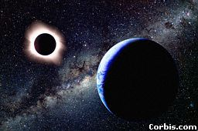
DNA by the numbers
Each cell has about 2 m of DNA.
The average human has 75 trillion cells.
The average human has enough DNA to go from the earth to the sun more than 400 times.
DNA has a diameter of only 0.000000002 m.
The earth is 150 billion m
or 93 million miles from
the sun.
Notes:
If you unravel all the DNA in the chromosomes of one of your cells, it would stretch out 2 meters. If you did this to the DNA in all your cells, it would stretch from here to sun more than 400 hundred times!

Slide 20
Thank You

Slide 21
This powerpoint was kindly donated to www.worldofteaching.com
http://www.worldofteaching.com is home to over a thousand powerpoints submitted by teachers. This is a completely free site and requires no registration. Please visit and I hope it will help in your teaching.

