Slide 1
energy
Energy in the home
By the end of this unit you should :-
Know that energy is required for heating, lighting and operating appliances.
Know that energy can be supplied from electricity,gas oil, or solid fuel.
Know that the cost of home heating depends on the fuel and installation costs.
Know that the cost of running an appliance depends on the power.

Slide 2
energy
energy in the home
Know that energy costs can be calculated from the difference
between two meter readings.
Know that energy losses cost money.
Know that energy can be lost by convection ,conduction and radiation.
Know that heat loss can be cut down by insulation, double glazing, and draught excluders.
Know that heat waste can be cut down by for example using showers instead of baths.

Slide 3
energy
energy in the home
10. Know that many appliances use thermostats to keep a steady temperature.

Slide 4
heating
lighting
These are the four main activities that people use energy for in a house.
cooking
fun

Slide 5
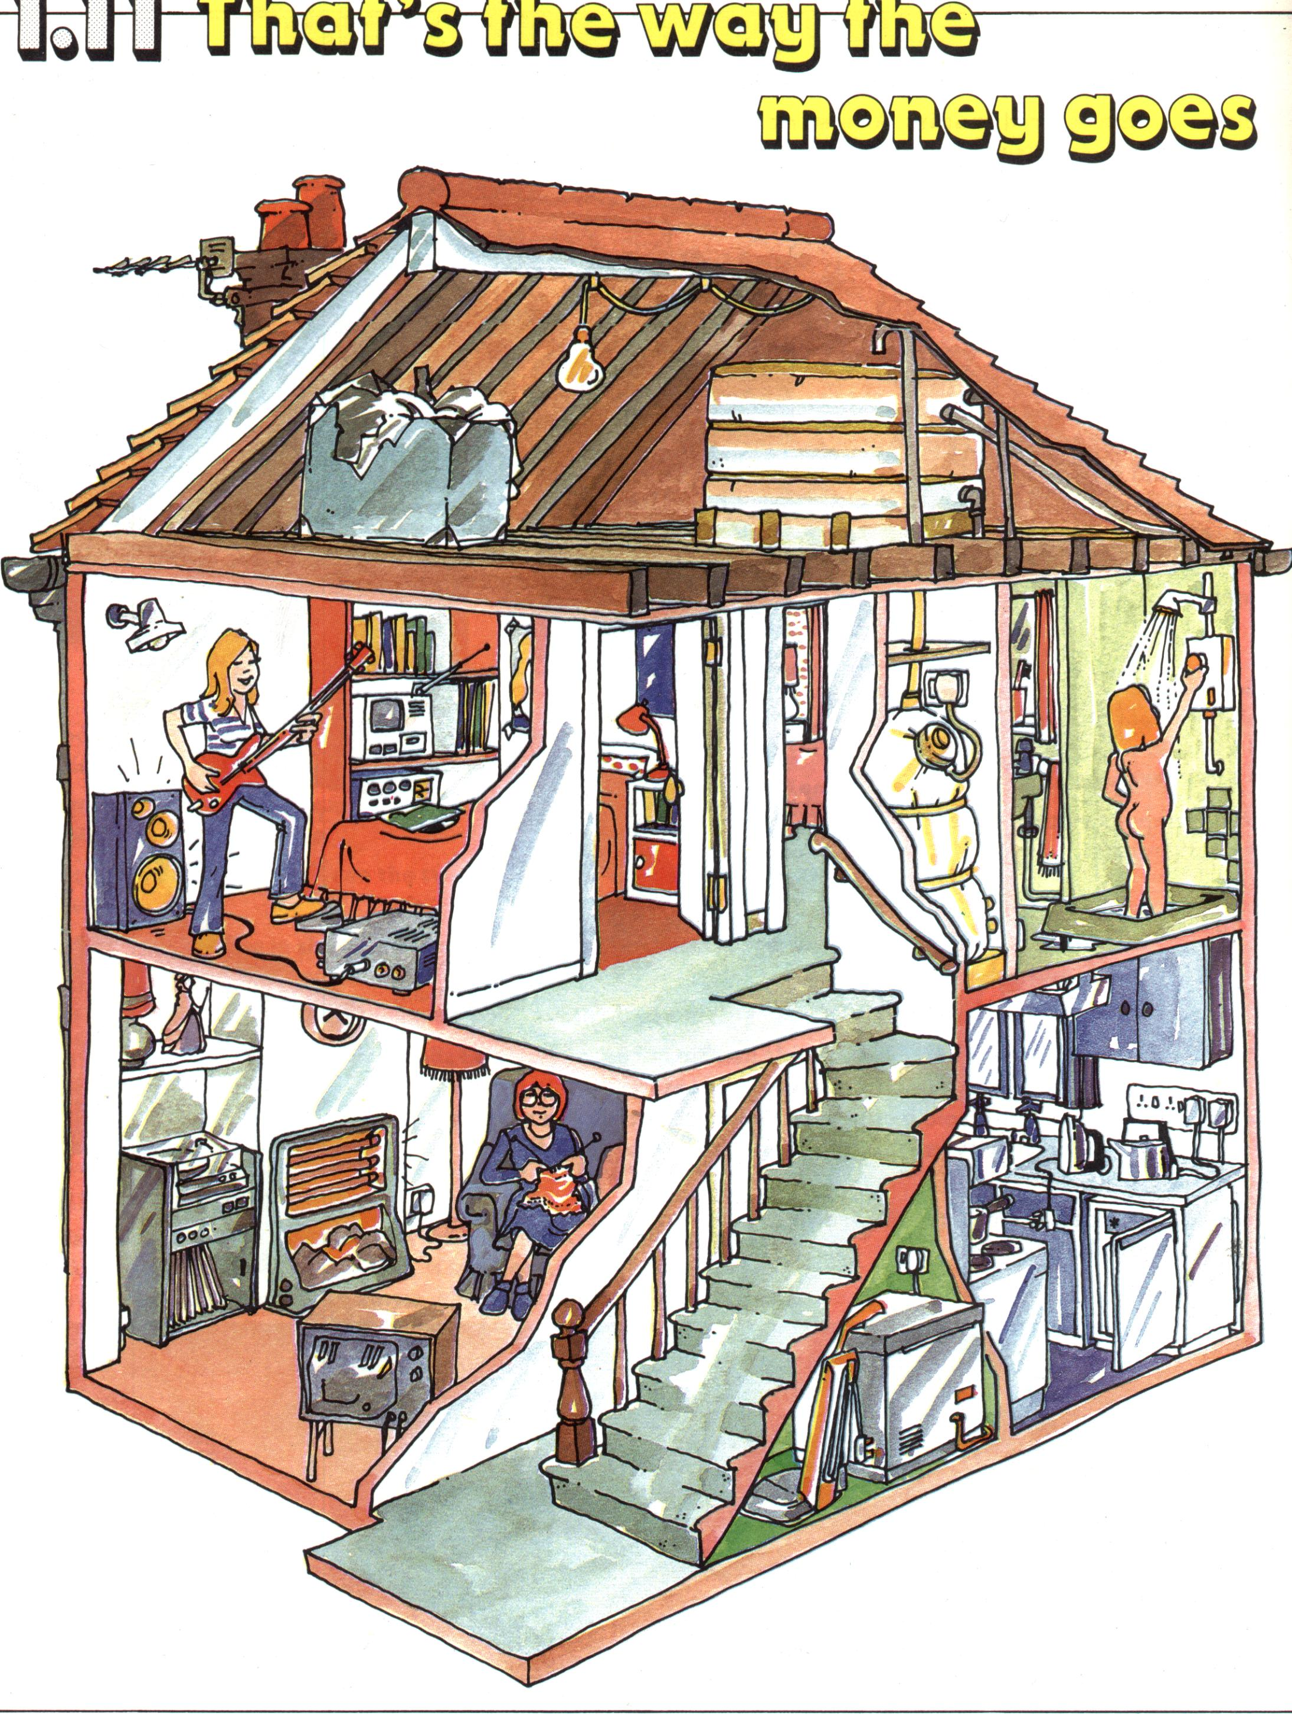
energy
1. By looking at the picture
shown, list the number
of ways in which energy
is used.
Which appliances use
the most energy?

Slide 6
energy
energy in the home
Energy can be supplied to the home in three ways.
Electricity :- this is brought to us from power stations.It
comes via pylons and underground cables.
Gas :- this comes from the north sea.It is pumped along
pipelines to gas stations.
Solid fuel :- this is the form of coal, wood or peat.Coal is
mined and peat is cut from the ground.

Slide 7
types of heating
Most houses use either
Gas central heating.
Electric central heating.
Gas fires.
4. Electric fires.

Slide 8
energy
uses of energy in the home
Hot water
Room
Heating
65%
20%
TV
10%
cooking
10%

Slide 9
energy
uses of energy in the home
The next slide shows the uses of energy in the home.
The uses are :- 1. Hot water 20%.
2. T.V. ,lights etc. :-5%.
3. Cooking :- 10%.
4. Room heating :- 65%.
Think of other appliances and add them to the diagram.

Slide 10
energy
which fuel?
We see from the pie chart and previous slides that :-
More than two thirds of energy is used for heating
and lighting.
This energy can come from coal , gas, or electricity.
The following table compares the cost of installing
and running the three different types of fuel.

Slide 11
energy
which fuel cont`d?
2 Bedroom flat without cavity wall insulation
Solid fuel
Mains gas
electricity
installing
£1400
£1200
£800
Running
Cost per
year
£240
£210
£300

Slide 12
energy
which fuel cont`d?
Once you have copied the previous slide, copy and answer the
Following questions.
Which fuel is the cheapest to install?
Which fuel is the cheapest to use?
3. Which fuel would be least popular in flats? Why?

Slide 13
What do I
Do with the
Ashes?
It’s a
Very dry
Heat.
energy
which fuel cont`d?
Here are some things that people have said about different fuels.
I can switch
On the heat as
Soon as I come
In.
Its easy to use.
Its dirty
It
smells
Its heavy
To carry.
.
We`re not
On the
Mains.
What about
Power?
We`re not

Slide 14
energy
which fuel cont`d?
Fill in the table below to say which fuel each comment is about.
Solid fuel
Mains gas
electricity

Slide 15
energy
using electrical energy
The table below shows how a family of four used their electricity
during one week.
Appliance Units
______________________________________
hair tongs 0.2
vacuum cleaner 1
toaster 1.5
fryer 2
kettle 3.5
freezer 7
T.V. 8
washing machine 9
cooker 20
oil filled radiator 50
water heater 65

Slide 16
energy
paying for electricity
Use the information from the previous table to work out the cost
of your electricity bill for the week.The cost of one unit of
Electricity is about 7p.
How much does this work out for twelve weeks?
How much did they pay for the heat producing appliances?

Slide 17
energy
using electrical energy
Collect a sheet of graph paper and put the information on to
A bar chart.
Questions.
_______________________
Which thre appliances use the most energy?
What do these appliances produce?

Slide 18
energy
paying for bills
To calculate the following bills,you must take the previous reading
away from the present reading.Then you must multiply the units by
the cost of one unit which is 7p.Then you add on the fixed charge
to get your total bill.
Bill A
Present previous units fixed charge amount
15600 15300 7p £10 -------
Bill B
Present previous cubic metres kWh charges
5500 100 3082

Slide 19
energy
paying for bills cont`d
Bill B cont`d
Standing charge £8.37
Charge per kWh = 1.6p Total =

Slide 20
energy
energy losses
Energy can be lost from our homes in a variety of ways -:
Roof
£75
Windows
£50
Walls
£50
Door
£25

Slide 21
energy
energy losses
As can be seen from the previous slide,energy can be lost from
walls, roofs, doors and windows.
To reduce these losses and in doing so ,save money,there are a
number of ways this can be done.We have to make use of various
ways of insulating our homes.
Draught proofing 2. Lagging pipes
Laying carpets 4. Loft insulation
5. Double glazing 6. Wall insulation

Slide 22
energy
energy losses
DRAUGHT PROOFING
If a door or window does not shut tightly,cold air can blow in.By
using plastic materials which mould into the shape of the gap,we can
reduce the losses.
LAGGING PIPES
When hot water is going through pipes below the floor or in the loft,
it can cool quickly.Lagging is a covering of fabric or foam which
can cut this type of loss.

Slide 23
energy
energy losses
LAYING CARPETS
Carpets look nice on the eye but they also provide good insulation
for a room by keeping heat from escaping through the floorboards.
LOFT INSULATION
A thick glass wool layer up in the loft will stop heat going through
the roof.

Slide 24
ENERGY
ENERGY LOSSES
DOUBLE GLAZING
This method of insulation sees two glass panels separated by an
air free space.A side view is shown below.
air free space
glass
glass

Slide 25
energy
energy losses
CAVITY WALL INSULATION
The cavity or space between outer walls can be filled with material
such as polystyrene foam to stop heat loss.
Reducing energy waste.
Have showers instead of baths.
Close doors when you leave a room.
Switch off heaters in rooms you are not using.
Don`t boil a full kettle if you are only making one cup of tea.

Slide 26
energy
simple energy savers
Thermostats -: used in most homes in several situations.
They turn the heating on or off in a room automatically.
They can be placed on the walls in a room or on individual
radiators.
An oven thermostat allows you to set the oven at a certain
temperature.
An iron thermostat allows the iron to be set at a temperature
which will not burn your clothes.

Slide 27
energy
simple energy savers
Your immersion heater has a thermostat to control the temperature
of the water.
Your kettle has a thermostat which does the same job.

Slide 28
energy
simple energy savers
THE THERMOSTAT HOW IT WORKS
The thermostat consists of two metals stuck together back to back.
brass
Room temperature
iron
When it gets cold or hot ,one metal expands more than the other
and the metal bar bends up or down.This arrangement is called a
Bimetallic strip.
Experiment -: place the bimetallic strip in a bunsen flame and see
what happens.

Slide 29
energy
simple energy savers
iron
iron
brass
cold
hot
brass
The bimetallic strip should look as shown above.

Slide 30
energy
electrical safety in the home
Electricity can be sent over large distances.
Electrical cables allow you to send electricity to different
parts of a room.
Electricity can also be very dangerous if not treated properly.
An electric shock can paralyse us and cause our heart to stop
beating.
Deaths from electric shocks is more common in young people
and the elderly.

Slide 31
energy
electrical safety in the home
The wires in a three pin plug are coloured as follows :-
1 LIVE BROWN
NEUTRAL BLUE
3. EARTH GREEN/YELLOW

Slide 32
energy
electrical safety in the house
THE THREE PIN PLUG
1.Collect a diagram of the three pin plug which has been
provided.
2.Stick it into your notebook.
Information :- the earth is for safety .The fuse is for safety,
and the switch is for safety.The electricity flows FROM the
LIVE wire and BACK via the NEUTRAL
3.You will be shown how to wire the plug by your teacher.

Slide 33
energy
electrical safety in the house
INFORMATION
THE THREE PIN PLUG CONT`D
THE FUSE
A fuse is a thin piece of wire which will melt if too much
current flows through it.If more than 3 amperes flows through
a 3 ampere fuse it will melt and will cause all the electricity to
be switched off.This means that the plug wires cannot overheat
and cause a fire.Fuses are of two types in a three pin plug.
If an appliance uses more than 3 amperes(3A) then a 13 ampere
fuse must be used.If it uses less than 3A then a 3A fuse is used.

Slide 34
ELECTRICAL ENERGY
Fuses.
We generally have two types of fuse , the 3Amp and the 13 Amp.
The fuse is a safety device in the three pin plug.
If the power of an appliance is greater than 700Watts , e.g. a kettle , we use a 13Amp fuse.If it is less than 700 Watts , e.g. a lamp , we fit a 3Amp fuse.

Slide 35
energy
electrical safety in the house
INFORMATION THE EARTH WIRE
Normally the earth does nothing in a circuit, but if the live wire
somehow touches the casing of an appliance such as a toaster,
You would get an electric shock and be badly injured.To stop this
happening,the earth wire causes a large current to flow.This
blows the fuse and the appliance becomes dead.

Slide 36
NON RENEWABLE SOURCES OF ENERGY
The Fossil Fuels.
These are coal , oil and gas.
Coal is made from dead plant material milloins of years old.
Oil and Gas are made from dead sea creatures millons of years old.
Once they have been used they can no longer be used and are therefore running out.

Slide 37
CRUDE OIL
Crude oil is a mixture of hundreds of different compounds and is difficult to burn.
It is taken from the worlds oil fields to refineries where it is cleaned.
It is separated into different chemicals we can use.
Each different chemical is separated out at a different temperature.

Slide 38
CRUDE OIL
Crude oil products include the following ,
Bottled gas at 20⁰C.
Petrol at 70⁰C for vehicles.
Paraffin oil at 170⁰C for jets and lighting.
Diesel at 270⁰C for trains.
Lubricating oils for oil , polishes.
Bitumen at 350⁰C for roads.

Slide 39
POLLUTION
Burning Fuels.
When fuels are burned in oxygen , heat is produced but carbon dioxide and water vapour are also produced.
Sulphur dioxide and nitrogen are also produced.
These gases cause global warming and acid rain.

Slide 40
  POLLUTION
    Another gas is produced when fuel does not burn completely.This is called Carbon Monoxide.
    This gas has no smell and can cause death.
    Cars are now fitted with catalytic converters which convert this gas into a harmless gas.

