Slide 1
environments
food helps all living things to grow
all energy comes originally from the sun
habitat is the
normal home of
living things

Slide 3
environments
FILL IN THE MISSING WORDS
+
+
-------
--- ---
=
----
-----

Slide 4
environments
producers and consumers
Green plants are called PRODUCERS because they can make
their own food.
Animals eat food because they cannot make their own food.They
are called CONSUMERS.
CONSUMERS that eat plants are called HERBIVORES.
Animals that eat other animals are called CARNIVORES.They
prey on other animals.
5. Consumers that eat plants or animals are called OMNIVORES.

Slide 5
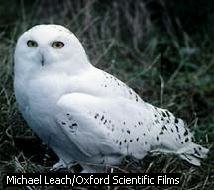
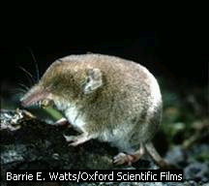
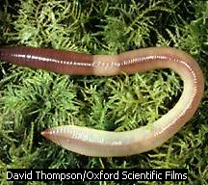
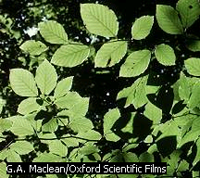
environments
food chains and food webs
owl
shrew
leaf
earthworm

Slide 6
This powerpoint was kindly donated to www.worldofteaching.com
http://www.worldofteaching.com is home to over a thousand powerpoints submitted by teachers. This is a completely free site and requires no registration. Please visit and I hope it will help in your teaching.

Slide 8
environments
food webs
An example of a food web can be seen on the next slide.

Slide 9
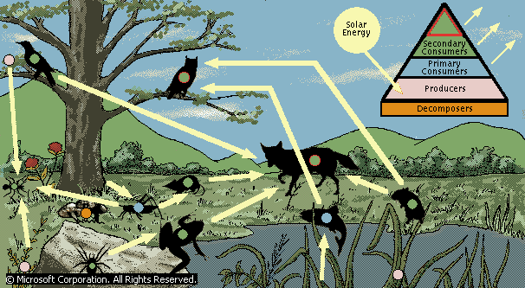

Slide 10
ENVIRONMENTS
FOOD CHAINS AND WEBS
ENERGY LOSS IN FOOD CHAINS AND WEBS
The more steps we have in a food chain ,the the less energy
is used for growth.Most of the energy is used for movement
and to keep things warm.
The further up a food chain we go,the less animals there are.
Food webs are all the chains in a habitat put together.
4. Food webs allow us to study environmental changes.

Slide 12
environments
changing food webs
Some food webs can change for short periods e.g. when there
is a shortage of rain ,a river bed may dry up but the plant and
animal life will survive.
When conditions are changed permanently, some animals
can be lost forever.They are said to be extinct.
Animals adapt to their environments, e.g. worms like dark damp
conditions.Try to think of other examples.
4. Food webs can be changed in several ways.

Slide 14
environments
changing food webs
REASONS FOR CHANGE
PREDATION Predators that eat smaller animals mean that
these smaller animals breed more quickly.
DISEASE Disease in an area can mean that the lack of
one type of animal can affect other types.
COMPETITION The introduction of one type of animal can
the population of another type.The red squirrel population in
Britain has went down due to the introduction of the grey
squirrel.

Slide 16
enviroments
changing food webs
MAN`S ACTIONS The activities of human beings affects
food webs, e.g. cutting down forests can affect the animal
population in these forests.
MAN`S ACTIONS The activities of humans can also affect
marine life, e.g. fish farming in Scotland has affected the
populations of sea animals.Try and find out about this.
DISASTERS Disasters like oil pollution,radiation,
industrial waste can affect food webs,

Slide 17
environments
making compost
Compost heaps are used by gardeners to fertilize the soil.
They use waste products from both home and garden to do this.
3, The organic waste contains HUMUS which helps to hold water.
A food web exists inside the compost consisting of decomposers,
producers and consumers.

Slide 19
environments
making compost
DECOMPOSERS, PRODUCERS AND CONSUMERS
Decomposers break down recyclable materials.
Producers trap the sun`s energy and turn it into food.
3. Consumers feed on producers or other consumers.
producers
decomposers
consumers
consumers

Slide 20
environments
making compost
The next slide shows the procedure for making compost.

Slide 21
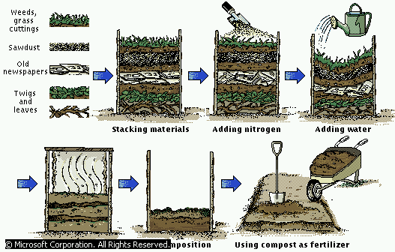

Slide 22
environments
enviromental factors
The following factors affect where animals and plants will be found.
The temperature of the environment.
The humidity of the air.
The pH of the area.
The light intensity of the area.
The flow rate of the water in the area.
6. The flow rate of wind in the area.

Slide 24
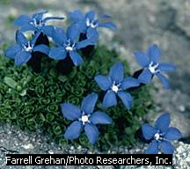
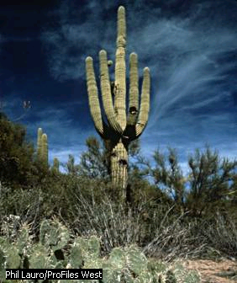
environments
environmental factors
Temperature :-the spring
Gentian is famous for its
blue flowers and grows where
the temperature is low.
Cactus plant found in Arizona .Grows to
a height of twelve feet.Stores every
available amount of water.

Slide 26
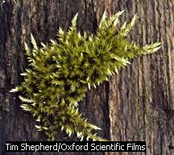
environments
environmental factors
Humidity :- Mosses are simple plants which do not have the
ability to absorb water.They are found in damp places.

Slide 28
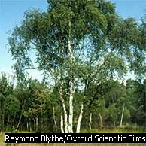
environments
environmental factors
Light intensity :- this is the amount of light in the environment.
It is measured with a
light meter similar to that
used with a camera.

Slide 29
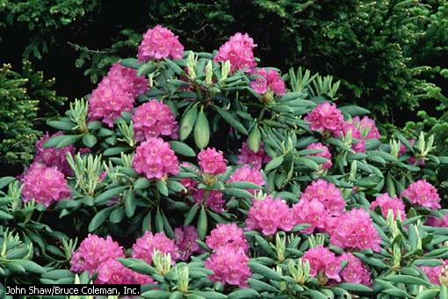
environments
environmental factors
Ph :- This is a measure of the acidity of the soil.It is measured
with Ph paper.Acid turns pH paper red .The soil in high rainfall
areas tends to be acidic.Plants like rhododendrons and azaleas
grow in this type of soil.

Slide 30
environments
environmental factors
Water flow rate :- this tells us the flow rate of moving water.We can
measure this by using a cork and seeing how fast it flows in a stream.
These animals have streamlined bodies to cope with the
fast moving streams.They are shown on the next slide.Take a note
of their names.

Slide 31
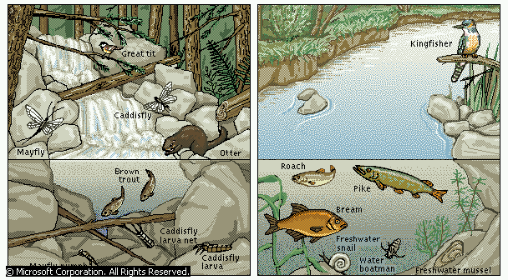

Slide 32
environments
environmental factors
Water flow rate cont`d
The animals shown on the next slide can survive in more still waters.

Slide 33
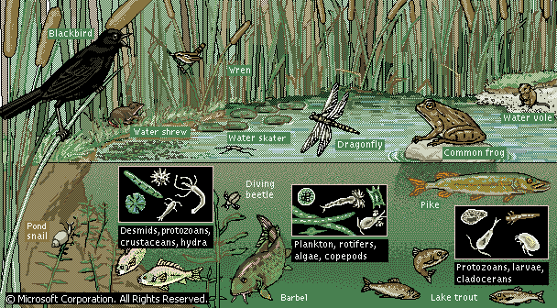

Slide 34
environments
environmental factors
Wind flow rate :- this tells about how fast the wind is flowing in a
particular area.It is measured with a wind speed gauge.Some trees
become windswept and indeed in windy conditions,some trees
will not grow at all.

Slide 36
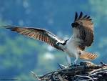
environments
population change
Within each habitat , we find populations of different living things.
A population is the number of a particular species in a certain area.
For example we may have a local magpie population.
Climate affects populations , for example the Osprey shown below
migrate to Africa in the winter to return to breed in the spring.

Slide 38

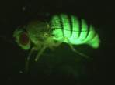
POPULATION CHANGE
FACTORS AFFECTING CHANGE
1. Predators during the 1970`s huge numbers of ladybirds appeared.
2. This was because of a large greenfly population increase.
3. This made more food available for the ladybirds which grew in number.

Slide 39
FACTORS AFFECTING CHANGE
Competition for space
1. Ladybird overcrowding was so bad that in some places they covered the ground

Slide 41

FACTORS AFFECTING POPULATION CHANGE
Disease
This can spread quickly through a large dense population but not through a small one.

Slide 43
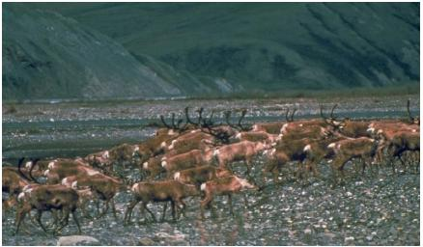
FACTORS AFFECTING POPULATION CHANGE
Migration
Birds flying south Africa can cause a seasonal change in population.

Slide 45

FACTORS AFFECTING POPULATION CHANGE
Climate change.
Changes in weather can cause change in population.
Dinosaurs may have disappeared due to this type of change.

Slide 47
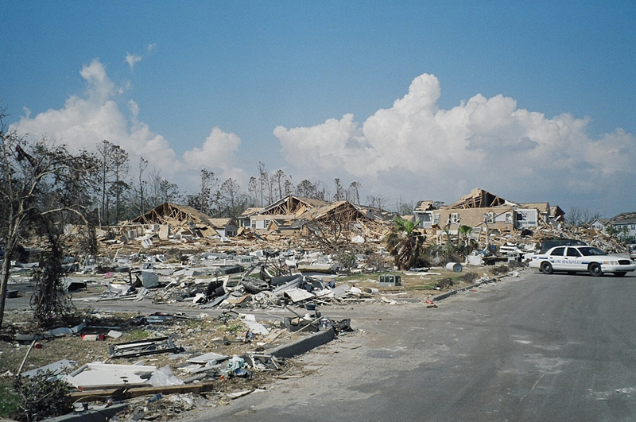
FACTORS AFFECTING CHANGE
Floods and Famine.
Both of these can change where people and animals will change their places of life.
Katrina

Slide 49
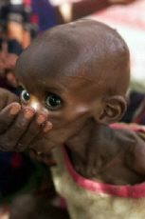
FACTORS AFFECTING CHANGE
FAMINE

Slide 51
RECYCLING
Types of Waste.
The waste in our homes includes the following.
1. Plastic
2. Metal
3. Glass
4. Paper
5. Ashes
6. Rags
7. Animal and Vegetable material.

Slide 53
RECYCLING
Recycle bin
Miscellanious 19%
Paper and cardboard 30%
Plastics 9%
Glass 9%
Kitchen waste 22%
Metals 8%
Textiles 3%

Slide 55
Recycling Types of Waste
Plastic comes mainly from packaging as it is strong and lightweight.Also some comes from broken toys etc.
Metal waste mainly from food and drinks cans.Also from old pots and pans.
Glass waste from bottles and other containers.Costs a lot to make from sand .
Paper comes mainly from newspapers and packaging.
Ashes from coal fires but no longer a great amount of waste because most people now have central heating.
Rags small amount of waste from old clothes.
Animal and vegetable waste from food mainly.

