Slide 1
Photomicrographs
Plant Tissues
Free powerpoints at http://www.worldofteaching.com
Free powerpoints at http://www.worldofteaching.com
Free powerpoints at http://www.worldofteaching.com

Slide 2
BOTANY
Algae
Cladophora species
Filament in form
Several cells
Free powerpoints at http://www.worldofteaching.com

Slide 3
BOTANY
Algae
Chlamydomonas sp.
One cell

Slide 4
BOTANY
Algae
Euglena gracilis
One cell with flagella

Slide 5
BOTANY
Algae
Spirogyra species
View of one cell

Slide 6
BOTANY
Spirogyra species
Filamentous algae
Conjugation (sexual reproduction)
Phase contrast photomicrograph

Slide 7
BOTANY
Algae
Spirogyra species
Filament in form
Spores: union of 2 cells
Bridge

Slide 8
BOTANY
Algae
Acetabularia species
Many cells

Slide 9
BOTANY
Algae
Chara species
Many cells

Slide 10
BOTANY
Algae
Oedogonium species
Zygote

Slide 11
BOTANY
One cell
Algae
filament

Slide 12
BOTANY
Algae
Ulothrix species
Many cells in filament

Slide 13
BOTANY
Algae
Oscillatoria species
Filament in form
Series of cells

Slide 14
BOTANY
Oscillatoria species
Algae
Many cells

Slide 15
BOTANY
Algae
Volvox species
Hundreds of cells in hollow sphere
Cells have flagella
Spirogyra species

Slide 16
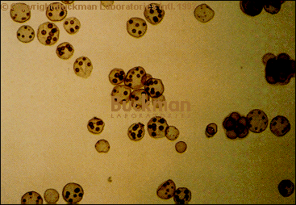
Volvox colonies

Slide 17
BOTANY
Green algae
Pediastrum species
Group of cells

Slide 18
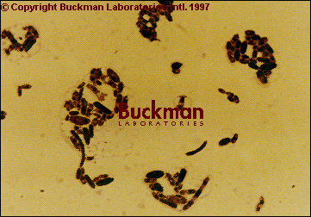
Yeast (clumped)

Slide 19
Next groups
Mosses and Ferns

Slide 20
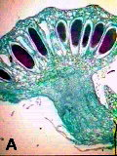
Marchantia, male

Slide 21
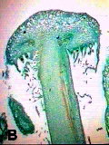
Marchantia, female

Slide 22
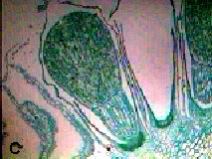
BOTANY
Marchantia

Slide 23
BOTANY
Liverwort
20X magnification
Related to mosses

Slide 24
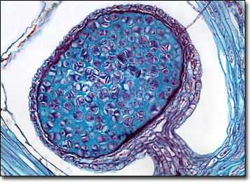
BOTANY
Liverwort, spore case

Slide 25
BOTANY
Bryophyte life cycle
Moss species

Slide 26
BOTANY
Bryophyte
Moss species: Mnium
Female gametophyte
Male gametophyte

Slide 27
BOTANY
Bryophyte
Moss species
Sporophyte attached to
Female gametophyte

Slide 28
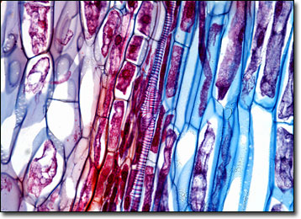
BOTANY
Horsetail, l.s.

Slide 29
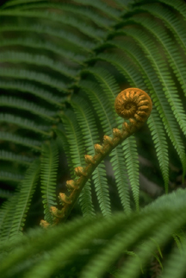
BOTANY
Ferns

Slide 30
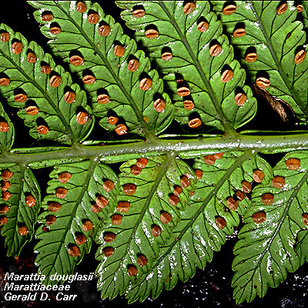
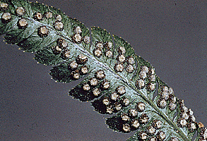
BOTANY
Ferns leaves with sporangia

Slide 31
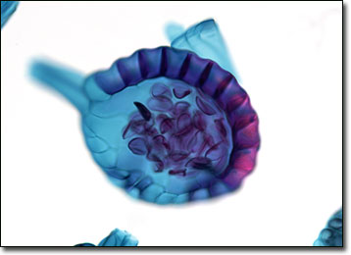
BOTANY
Fern, spore case

Slide 32
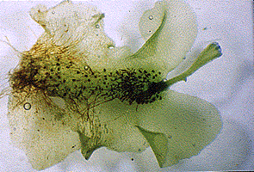
BOTANY
Fern with gametophyte
Young leaf

Slide 33
This powerpoint was kindly donated to www.worldofteaching.com
http://www.worldofteaching.com is home to over a thousand powerpoints submitted by teachers. This is a completely free site and requires no registration. Please visit and I hope it will help in your teaching.

