Slide 1
Lungs
By the end of the lesson you should be able to:
Label the internal structures of the lungs
State the features of the alveoli which allow efficient gas exchange
Explain the role of diffusion in gas exchange
State the features of the capillary network that allow efficient gas exchange

Slide 2
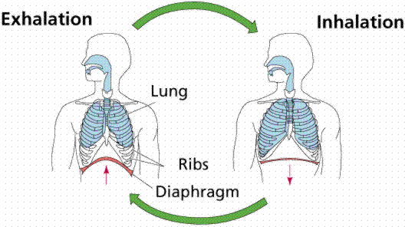
Breathing
footprints breathing

Slide 3
The lungs
organs that allow gas exchange
oxygen in / CO₂ out
trachea
- has rings of cartilage
bronchi (bronchus)
bronchioles
alveoli (alveolus)
computer animation

Slide 4
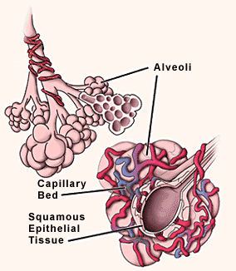
Alveoli (air sacs)
provide large surface area for gas exchange
one lung equivalent to a tennis court of surface area using alveoli
footprints alveoli

Slide 5
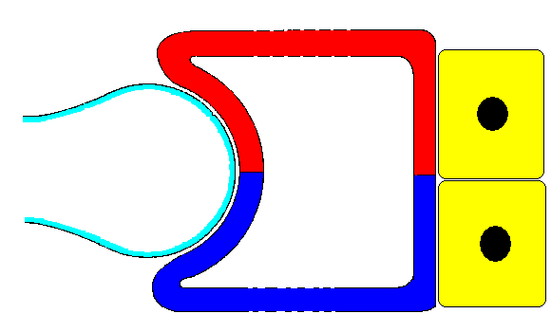
oxygenated blood
air in
air out
air sac in lungs
deoxygenated blood
body cells
skool gas exchange

Slide 6
Features of Alveoli for efficient gas exchange
large surface area to absorb oxygen.
moist surface to allow oxygen to dissolve.
thin lining to allow easy diffusion of gases.
dense network of blood capillaries for easy gas exchange.
skool adaptation of alveoli

Slide 7
Features of capillaries for efficient gas exchange
dense network to carry CO₂ and O₂
Large surface area to transport gases
Lining is one cell thick so gases can pass through quickly and easily.

Slide 8
Lungs
Can you?
Label the internal structures of the lungs
State the features of the alveoli which allow efficient gas exchange
Explain the role of diffusion in gas exchange
State the features of the capillary network that allow efficient gas exchange

Slide 9
This powerpoint was kindly donated to www.worldofteaching.com
http://www.worldofteaching.com is home to over a thousand powerpoints submitted by teachers. This is a completely free site and requires no registration. Please visit and I hope it will help in your teaching.

