Slide 1
Today’s Lesson Nervous System and Drug Addiction
Notes:
Contemporary Issue – The Nervous System and Drug Addiction
Lesson Goals
To understand the major components of the nervous system and to differentiate between the central nervous system and the peripheral nervous system.
To differentiate between sensory neurons, motor neurons, and interneurons.
To understand how a nerve impulse is conducted down a neuron.
To understand the basic pathway of the nervous system from a sensory neuron to the central nervous system and then to a motor neuron.
To learn about neurotransmitters (neurotransmitters) and understand their function in transmitting a nerve impulse between neurons.
To identify the function of dopamine and understand how the use of various drugs affect the levels of dopamine in the brain.
To understand the cost of drug addiction to the U.S. and society in general.
To understand how the scientific view of drug addiction has changed, and how this change has influenced treatment of drug addiction.
Key Terms;
Central nervous system peripheral nervous system stimulus receptor integrators interneuron motor neuron effector response dendrite cell body axon Na+ K+ depolarization repolarization sodium/potassium pump polarity synapse acetylcholine dopamine serotonin postsynaptic membrane enzyme monoamine oxidase (MAO) monoamine oxidase inhibitor (MAOI) cocaine amphetamine nicotine

Slide 2
Overview of Lesson
Nervous system
Synapses and neurohormones
Drug addiction
Notes:
Advance Organizer
The first portion of the lesson will describe the major components of the nervous system and differentiate between the central nervous system (CNS) and the peripheral nervous system (PNS). Different types of neurons will be discussed as will their ability to conduct electrical signals from one to another.
The second portion of the lesson will describe the junction between two adjacent neurons (synapse) and the neurotransmitters (neurotransmitters) that allow the adjacent neurons to communicate with each other. The role of dopamine as the “master molecule” of addiction will be discussed.
The third portion of the lesson will describe the physiology of drug addiction in relation to dopamine levels and the cost of drug addiction on the U.S. and society in general.

Slide 3
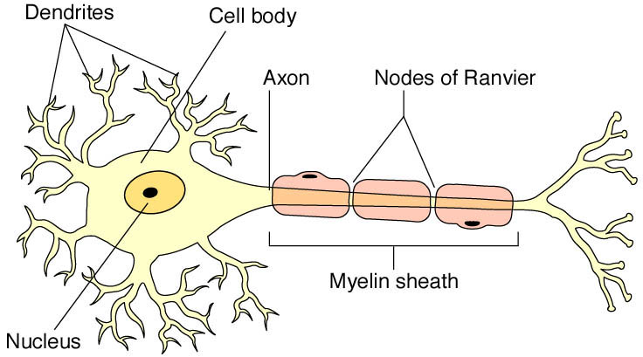
Neuron
Based on: Raven et al., Biology, McGraw-Hill
Notes:
Main Idea(s) of This Slide -
This slide depicts a neuron. Neurons are composed of three primary parts; the dendrites, the cell body, and the axon.
Dendrites receive input from sensory receptors throughout the body or from other neurons. The impulse is carried up the dendrites of the neuron to the neuron cell body.
The cell body of the neuron is where the nerve impulse is generated in response to the sensory input. This impulse is then transmitted down the axon portion of the neuron.
The axon carries the nerve impulse down the neuron to the effector (muscle or gland) or to another neuron.

Slide 4
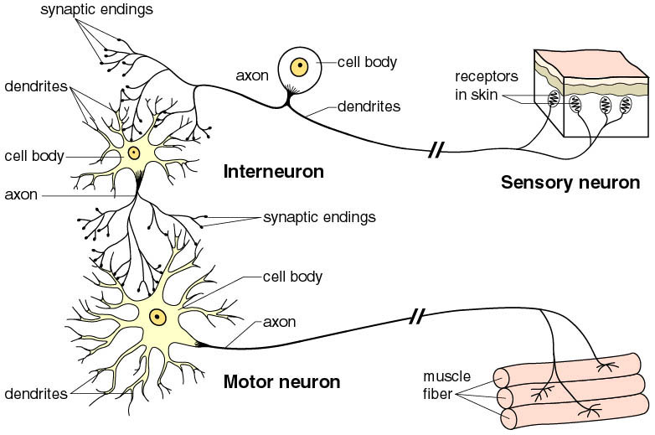
Types of Neurons
Based on: Mader, S., Inquiry Into Life, McGraw-Hill
Sensory neurons - carry impulses to the
interneurons of the brain
Interneurons of the brain - interpret impulses
Motor neurons - carry impulses to the muscles
Notes:
Main Idea(s) of This Slide -
There are three primary types of neurons in the nervous system.
Sensory neurons carry impulses to the brain and spinal cord (CNS).
Interneurons (in the brain and spinal cord) “process” and “interpret” the incoming information.
Motor neurons then carry impulses from the CNS to the effectors throughout the body.
Note – a “nerve” is a bundle of many sensory or motor neurons wrapped together in a sheath of connective tissue.

Slide 5
Nerve Impulse
Stimulation of neuron, opens channels so
that sodium (Na⁺) goes in, depolarizing the
membrane
The adjacent section of membrane allows
Na+ to go in, depolarizing it
This wave of depolarization continues at a
rapid rate down the neuron, resulting in a
nerve impulse traveling to the brain in
milliseconds
Notes:
Main Idea(s) of This Slide -
The nerve impulse is accomplished by what is called a depolarization wave. To understand how this is accomplished it is important to first realize that all cells throughout the body have a negative electrical charge on the inside of their cell membrane and a positive electrical charge to the outside of their cell membrane. The negative charge (on the inside) is due to protein molecules just inside the membrane. There are also many potassium ions (K+) inside the cell which carry a positive charge, but the net charge of the cells interior is negative (due to the excess of negatively charged protein molecules). Outside of the cells of the body (in the extracellular fluid) are many sodium ions (Na+) which have a positive charge. Because the inside of the cell membrane is negatively charged (due to the proteins) and the outside of the cell is positively charged (due to the sodium ions), the membrane is considered electrically “polar” (different) in nature.

Slide 6
Neuron at Rest: Polarized Membrane
Outside of neuron is positively charged due to positive sodium ions
Inside of neuron is negatively charged due to negative ions
+ + + + + + + + +
- - - - - - - - - - -
Inside of Neuron
Notes:
Main Idea(s) of This Slide -
At rest a neuron has a polar nature to it’s membrane. Because there is an excess of sodium ions (Na+) outside of the cell and an excess of negatively charged proteins just inside the membrane, there is a positive charge outside the cell and a negative charge inside the membrane.

Slide 7
Nerve Impulse
+ + + + + + + +
- - - - - - - - - -
Polarized membrane of resting neuron
Neuron
+ + + + + + + +
- - - - - - - - - -
Sodium (Na) moves inside to depolarize
Neuron
+ + + + +
0 0 0 0
Nerve impulse is wave of depolarization moving down neuron
- - - - - -
Neuron
Nerve
impulse
Notes:
Main Idea(s) of This Slide -
To change the polar nature of the membrane (and begin a nerve impulse), sodium channels open in the cell membrane allowing positively charged sodium ions into the cell. Once one region of the membrane is “depolarized” in this fashion, adjacent sodium channels open allowing the depolarization to move down the neuron.

Slide 8
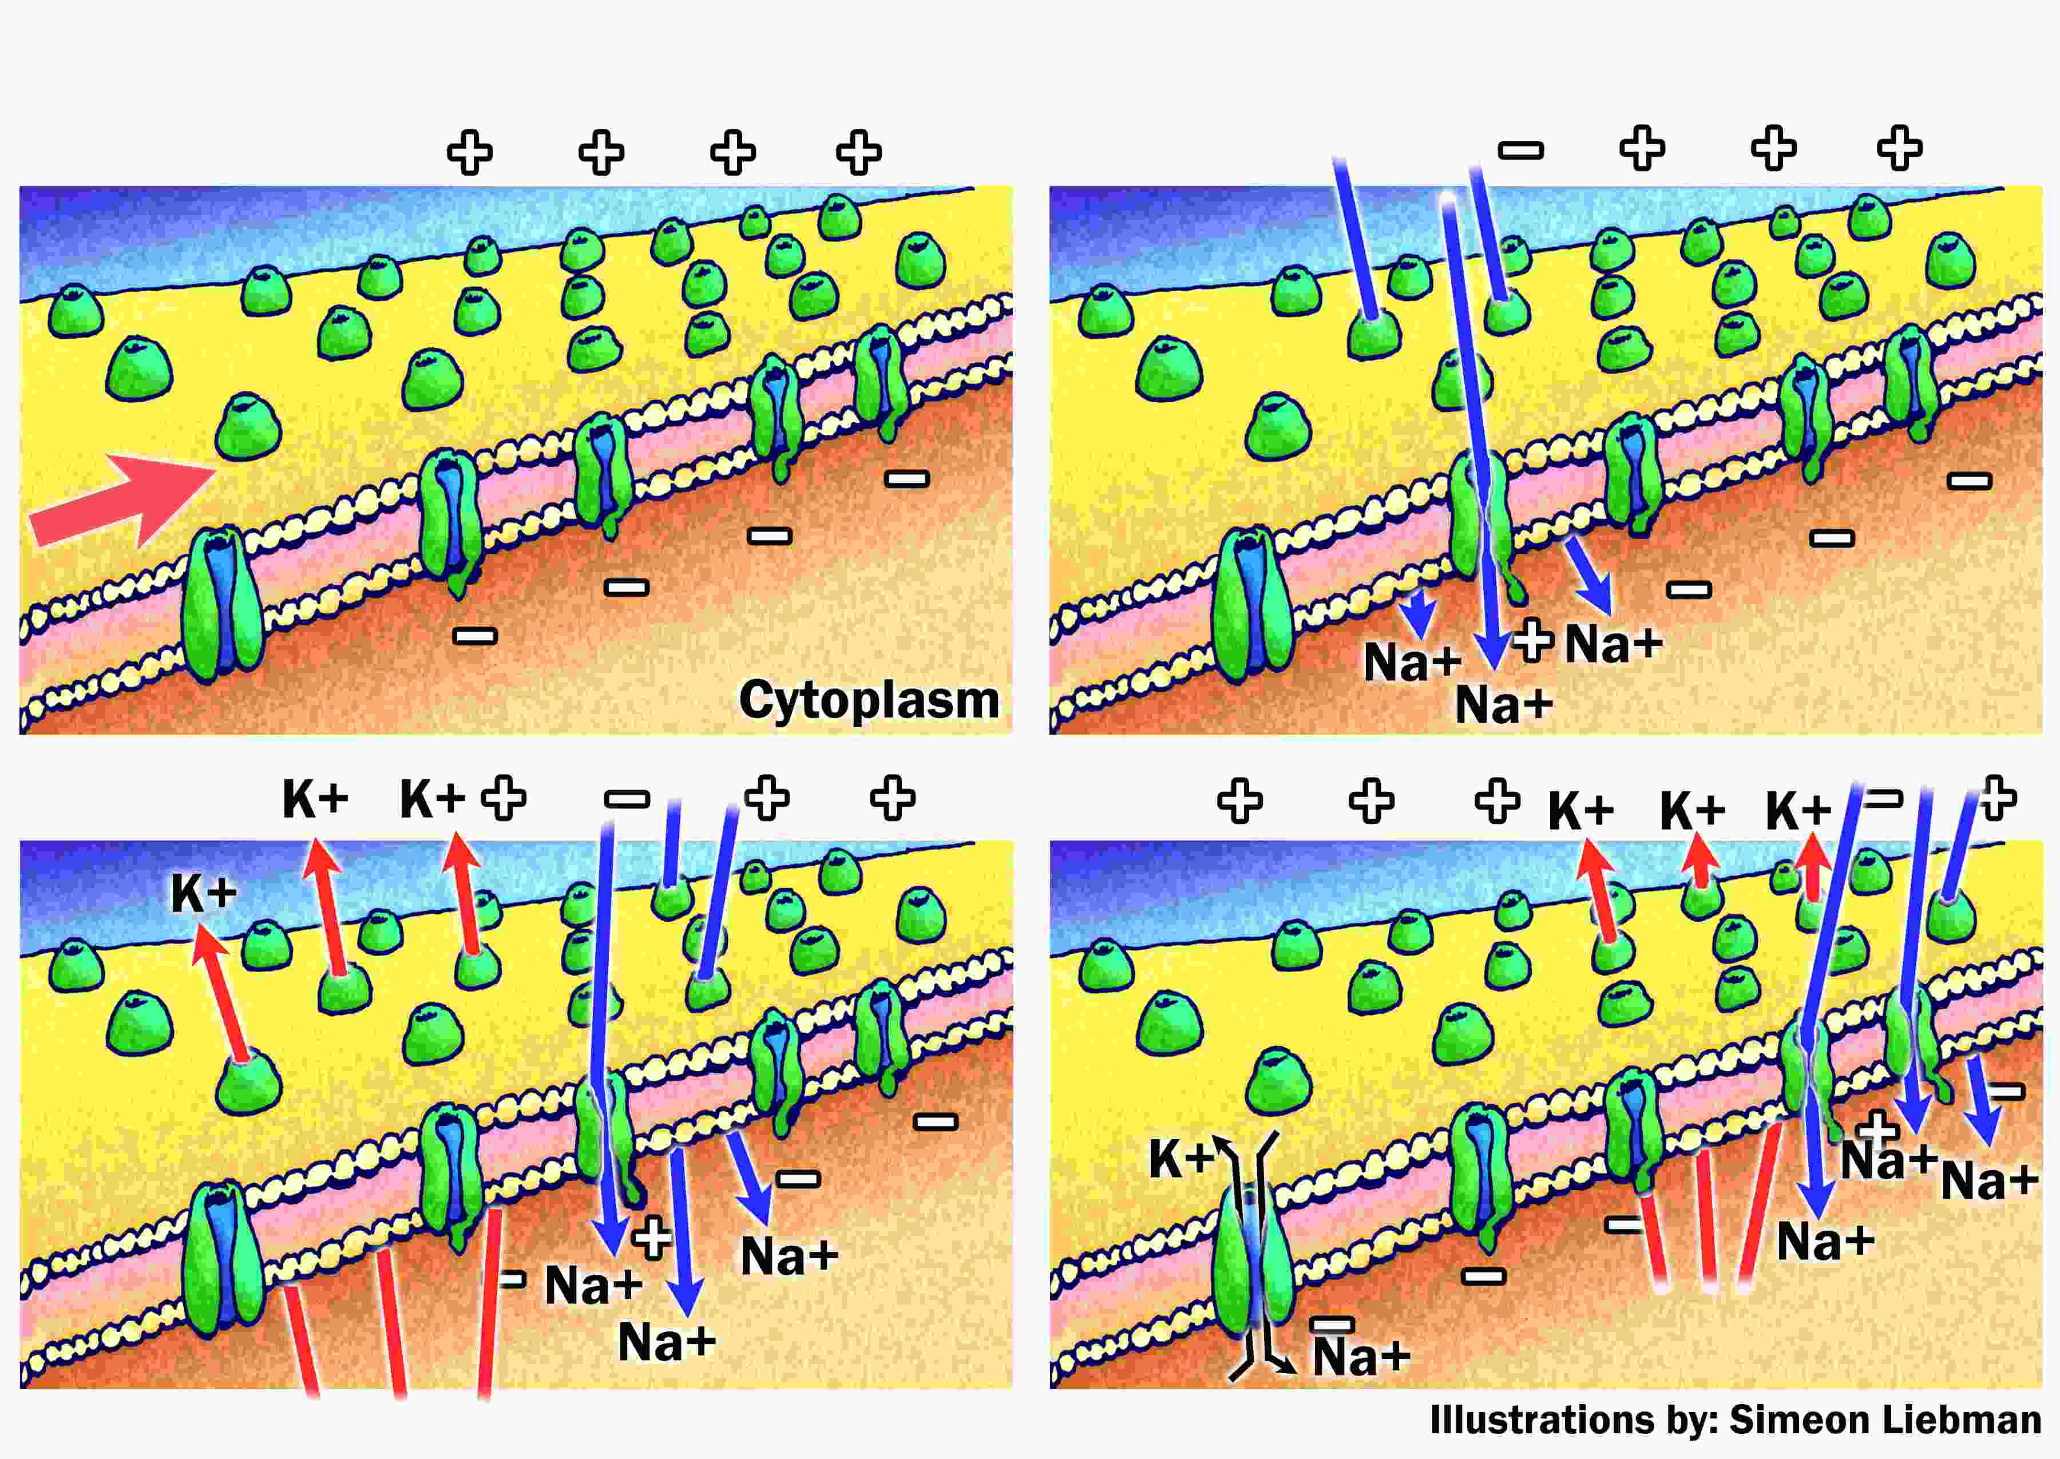
Depolarization and Repolarization
Based on: Starr, C., Biology: Concepts and Connections, Brooks/Cole
Notes:
Main Idea(s) of This Slide -
A depolarization wave is how the neuron carries a “message” from one part of the body to another. It is important ,however, to repolarize the membrane immediately after the impulse is sent. If the membrane is not repolarized, the impulse would not be short-term and precise. In order to repolarize the membrane, positively charged ions must be shipped back out of the cell. While it was sodium ions that entered the cell resulting in depolarization, it is potassium ions (K+, also with a positive charge) that are shipped out of the cell causing it to regain it’s polar nature. The repolarization “wave” follows behind the depolarization wave instantly resulting in extremely short-term stimulation of the effector (or adjacent neuron). To restore the original condition of the cell (with sodium ions on the outside and potassium ions on the inside), there are protein transporters that “pump” the ions back to their original positions.

Slide 9
Sodium Pump
Operates when neuron is at rest or
not transmitting nerve impulse
Pump is a membrane protein
The protein actively transports Na out
of the axon to re-establish polarity of
membrane
Notes:
Main Idea(s) of This Slide -
The sodium/potassium pump (or sodium pump) operates when the neuron is at rest (not transmitting an impulse). The pump is a protein molecule that is imbedded in the plasma membrane of the neuron. It actively transports the sodium ions back out of the cell and transports the potassium ions back into the cell to reestablish the original polarity of the neuron’s membrane.

Slide 10
Overview of Lesson
Nervous system
Synapses and neurohormones
Drug addiction
Notes:
Advance Organizer
This portion of the lesson will describe the function of neurotransmitters (neurotransmitters) and how they carry electrical signals from one neuron to another across synapses or carry impulses from a neuron to an effector of the body.

Slide 11
There are gaps or junctions between neurons called synapses
Based on: Mader, S., Inquiry Into Life, McGraw-Hill
Notes:
Main Idea(s) of This Slide -
Between two adjacent neurons which must communicate with each other (or between neurons and the effector it must stimulate) there exists a small gap called a synapse. In order to complete a nervous system pathway, the neurons must be able to pass the electrical signal from one neuron to the other (or from the neuron to the effector) across the synapse. neurotransmitters are responsible for transmitting the impulse across the synapse.

Slide 12
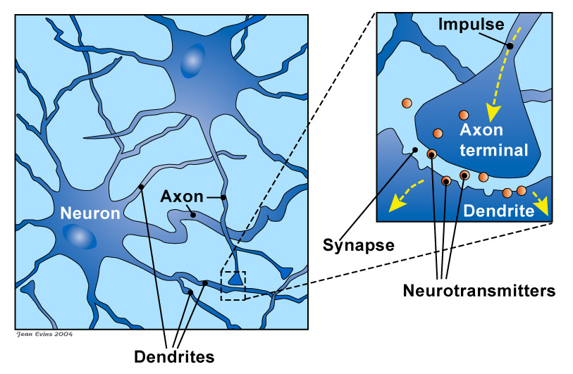
Synapses
Neurotransmitter being released into synapse and attaching to receptors on dendrite
Based on Harvard Medical School Family Health Guide
Notes:
Main Idea(s) of This Slide -
This slide depicts the synapses between the axon of one neuron and the dendrite of another.
Here is a close-up view of the synapse between two adjacent neurons. The axon of the neuron at the top of the slide terminates in what is called an axon bulb. Inside the axon bulb are synaptic vesicles that contain neurotransmitters. The neurotransmitters are responsible for exiting the axon bulb and entering into the synapse. Once inside the synapse (space between the neurons), the neurohormones bind to the adjacent neurons “postsynaptic membrane” and cause a new depolarization wave to begin.
This image on the right depicts the neurotransmitter (neurohormone) being released from the synaptic vesicle into the synapse where it can then bind to receptors on the adjacent neuron.

Slide 13
50 Known Neurotransmitters
Examples include:
Acetylcholine
Dopamine
Serotonin
Notes:
Main Idea(s) of This Slide -
There are over 50 known neurotransmitters today. This slide lists three commonly discussed neurotransmitters; acetylcholine, dopamine, and serotonin.
Acetylcholine is the neurotransmitter that is responsible for carrying a nerve impulse from a motor neuron, across a synapse, to a muscle cell (the effector) and causing the muscle to respond by contracting. Insufficient levels of acetylcholine or disruption in it’s ability to work can cause neuromuscular problems.
Seratonin is a neurotransmitter that is responsible for “filtering” sensory information coming into the brain. Some recreational drugs such as ecstasy create imbalances in the levels of serotonin resulting in hallucinations and mood changes. Other drugs called SSRI’s (selective serotonin re-uptake inhibitors) elevate serotonin levels in the brain resulting in mood elevation and are prescribed as anti-depressants.
Dopamine is considered the “master molecule” of addiction. It is a neurotransmitter that is released by brain cells that causes a feeling of “well being” in response to pleasurable activities such as sex and eating. Elevated levels of dopamine cause a euphoric high and are associated with many recreational drugs.

Slide 14
Why do we need a neurotransmitter like dopamine?
Notes:
Main Idea(s) of This Slide -
Here is a good time to generate some discussion with the students. Ask them to come up with ideas as to why neurotransmitters like dopamine are needed based upon their reading.

Slide 15
Importance of Dopamine
Human behavior is controlled by natural chemical reward systems in the body
For example, we like to eat fatty foods because it make us feel good
It is the release of dopamine that is the chemical reward system responsible for the good feeling
Dopamine “reinforces behaviors essential to our survival.”
Notes:
Main Idea(s) of This Slide -
Dopamine reinforces behaviors that are essential to human survival such as eating and procreating. When humans engage in these behaviors, some brain cells release dopamine resulting in “good” feelings.

Slide 16
Synapses must be cleaned up
After neurotransmitter stimulates the postsynaptic membrane, it is removed by an enzyme or transported out of synapse
For example, acetylcholine is removed from synapses by an enzyme called acetylcholinesterase
Notes:
Main Idea(s) of This Slide -
Neurotransmitters must be cleaned-up from the synapse to ensure that the response to them is short-lived and precise. Most neurotransmitters have enzymes which either break them down or cause them to be taken back into the neuron that released them.
Acetylcholine, for example, the neurotransmitter that causes muscle contraction is broken down by an enzyme called acetylcholinesterase. The presence of this enzyme ensures that when a neuron stimulates a muscle cell, the stimulus only lasts a second which allows the muscle to then relax immediately after it was stimulated. This allows precise, coordinated movements.
Other neurotransmitters have enzymes of their own that regulate their levels in the synaptic spaces.

Slide 17
Overview of Lesson
Nervous system
Synapses and neurohormones
Drug addiction
Notes:
Advance Organizer
This portion of the lesson will discuss how dopamine is considered the “master molecule” of addiction and how certain drugs can cause imbalances in dopamine levels resulting in dependency on the drug.

Slide 18
Price of Drug Addiction in U.S.
Cigarettes contribute to death rates from
cancer and heart disease
Alcohol is the leading cause of violence
Needles are spreading AIDS
Addiction to drugs, cigarettes and alcohol
account for a third of all hospital admissions,
and a majority of all crimes
Drug use costing us excess of 240 billion
dollars annually
Notes:
Main Idea(s) of This Slide -
Drug addiction has an enormous cost to the U.S. and to society in general. Dependency on cigarettes, alcohol, and illegal recreational drugs cause a major increase in death rates due to cancer, heart disease, HIV/AIDS, and other diseases and increases health care costs across the country. It is estimated that drug use is costing the U.S. over $240 billion dollars each year.

Slide 19
According to scientists, what is the master molecule of addiction and where is it produced?
Notes:
Main Idea(s) of This Slide -
Again, use this opportunity to generate discussion in order to see if students are comprehending the impact that dopamine has on the central nervous system.

Slide 20
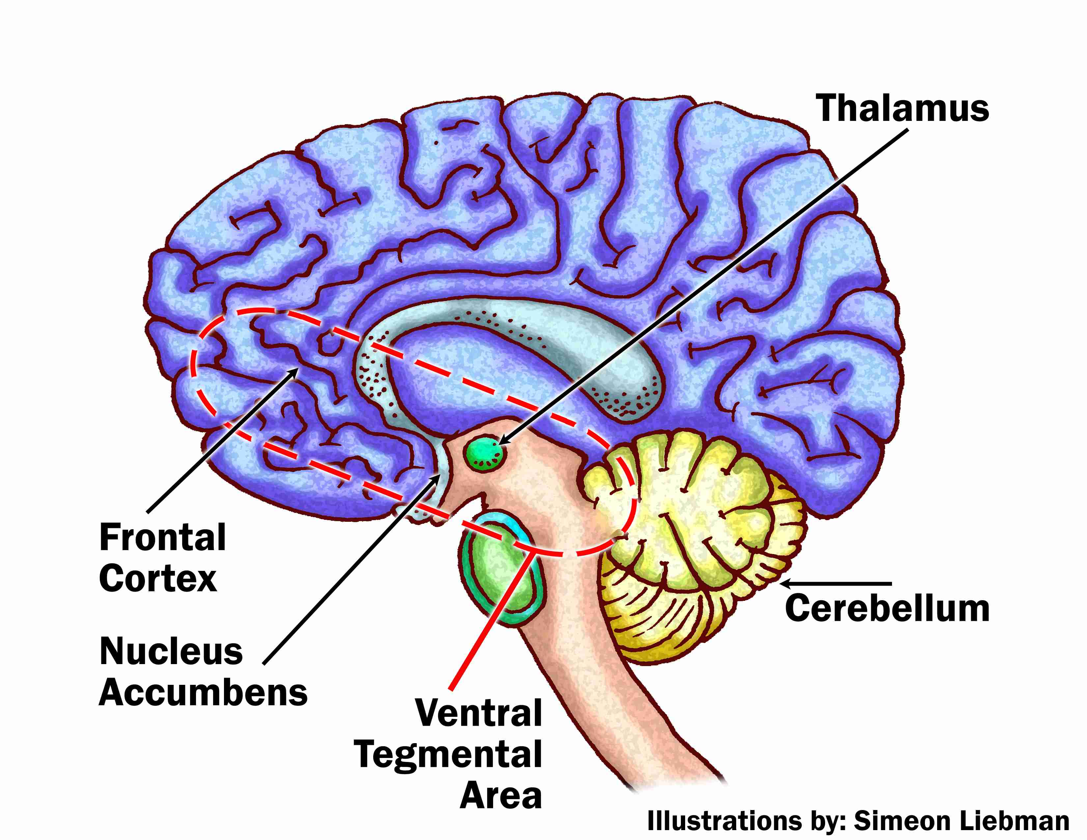
Dopamine is thought to be the master molecule of addiction
It is made in the brain and affects primitive parts of the brain
Based on Time, May 5, 1997
Notes:
Main Idea(s) of This Slide -
Dopamine is believed to be the primary neurotransmitter responsible for chemical dependency based upon it’s ability to reward behaviors with pleasurable feelings.

Slide 21
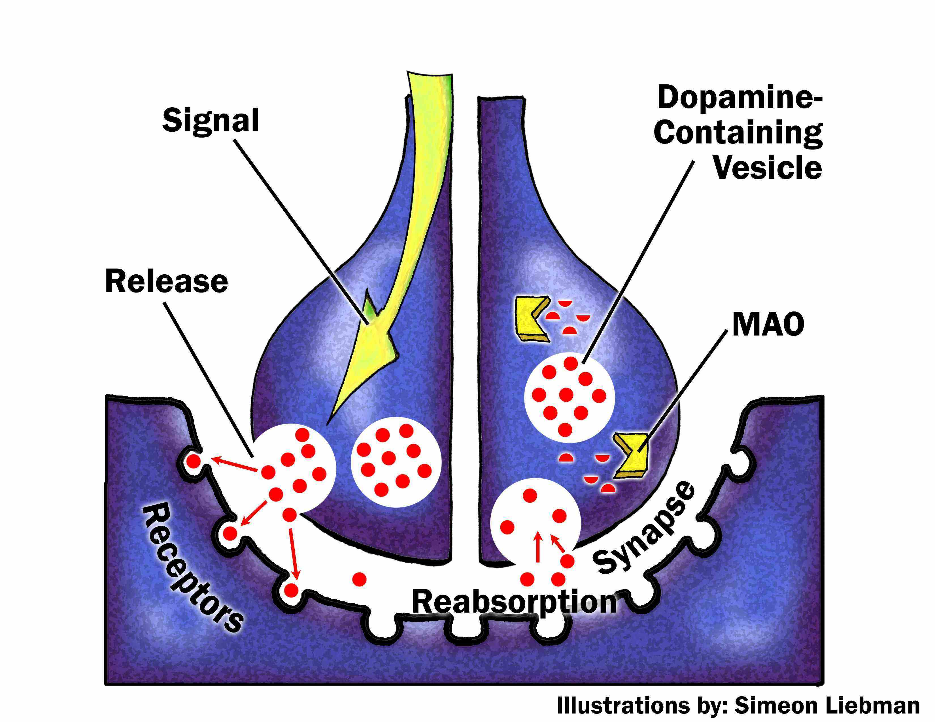
Dopamine’s Normal Action
Based on Time, May 5, 1997
After being released into the synapse (the gap between nerve endings and receiver cells), dopamine binds to receptors on the next neuron
The dopamine is either quickly reabsorbed or broken down by the enzyme monoamine oxidase (MAO)
Notes:
Main Idea(s) of This Slide -
The normal activity of dopamine is regulated by an enzyme called monoamine oxidase (MAO). When dopamine is released (after eating dessert, having sex, or other pleasurable activities), it is quickly reabsorbed back into the neuron that released it and/or broken down by MAO. This is why the euphoria felt after these pleasurable activities only lasts a short while.

Slide 22
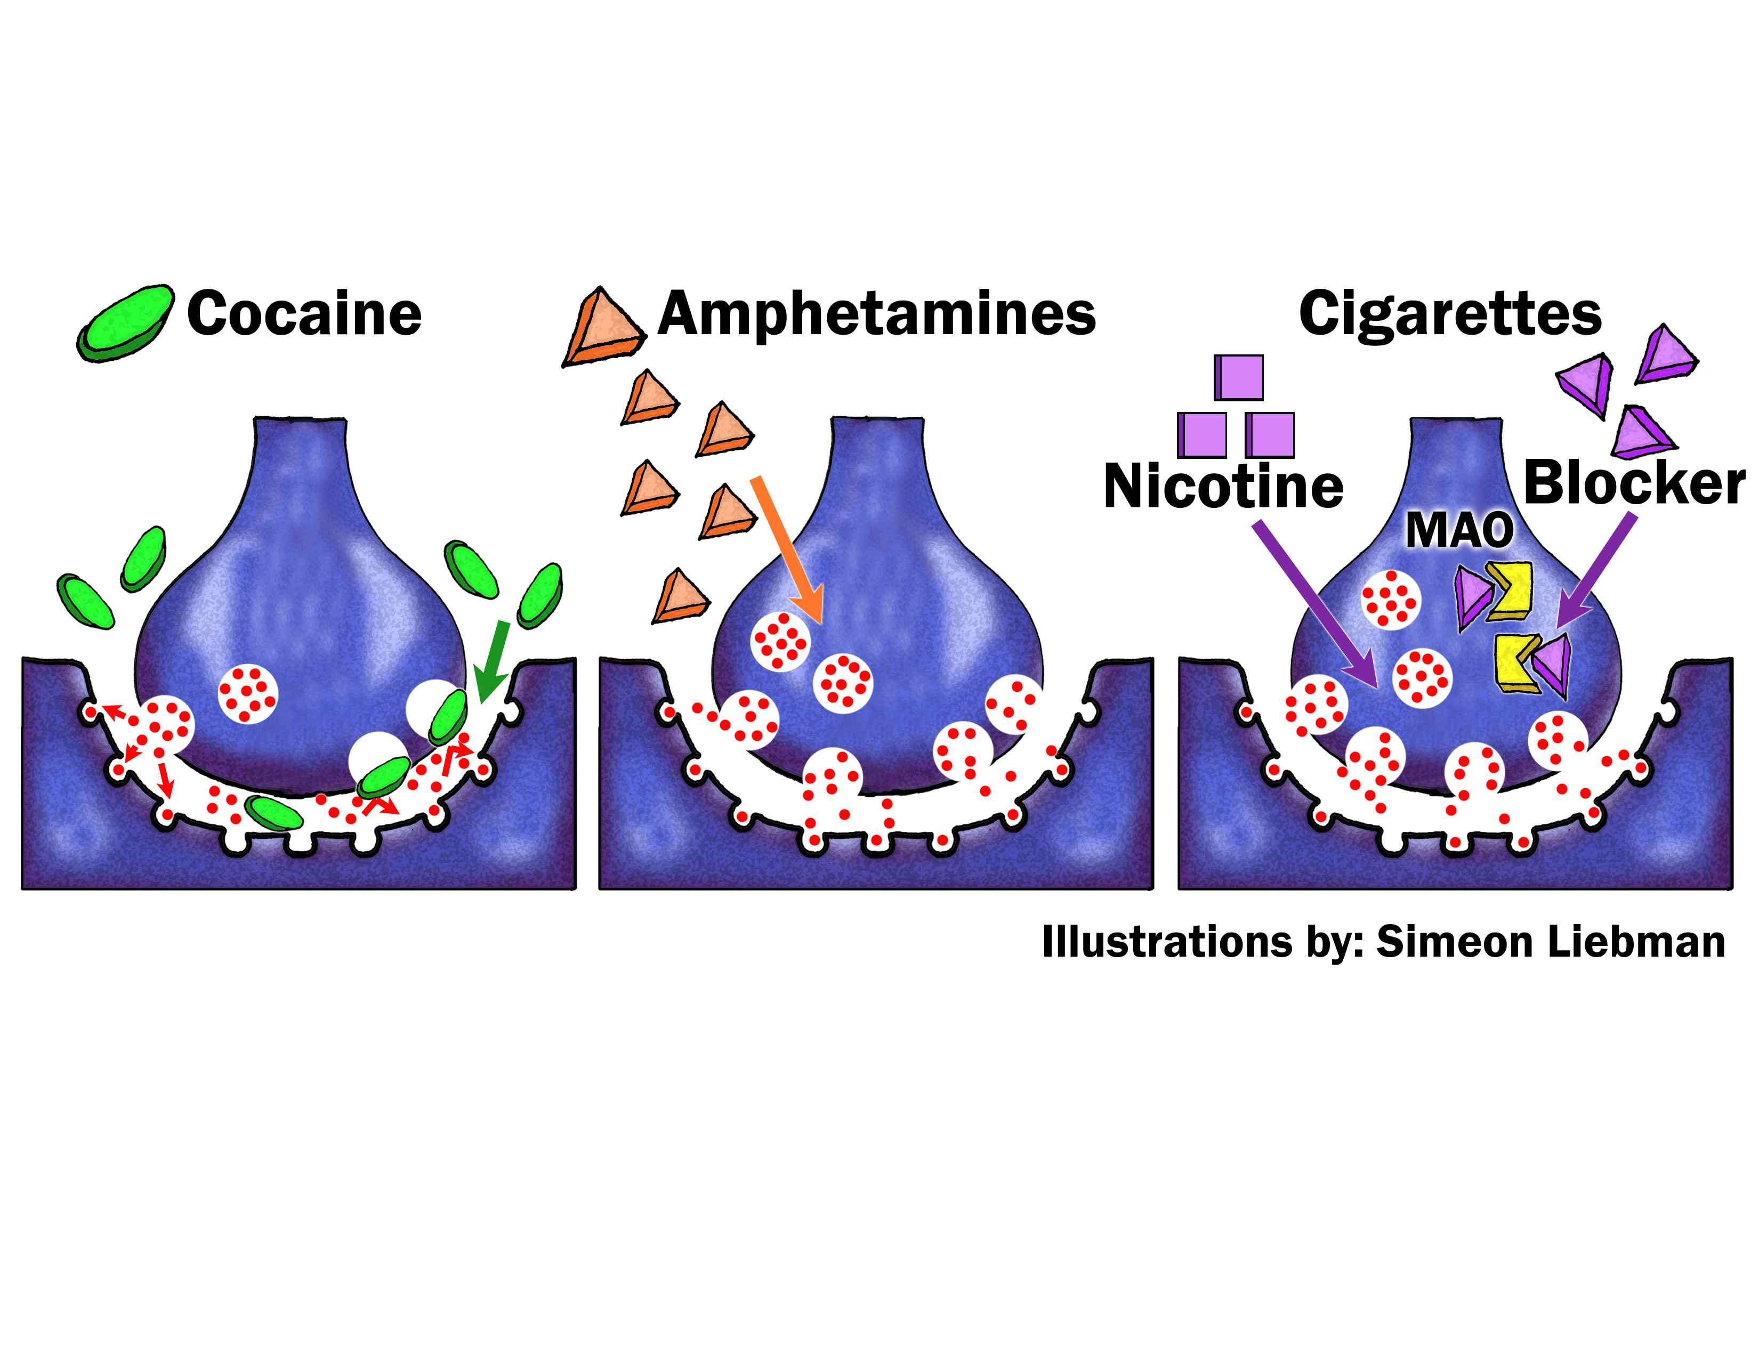
How Drug Affect Dopamine Levels
Based on Time, May 5, 1997
Cocaine blocks the normal absorption of dopamine. As a result, dopamine accumulates in the synapse, where is stimulates the receiver cell.
Amphetamines stimulate excess release of dopamine, overwhelming the processes of reuptake and enzyme breakdown.
Nicotine stimulates the release of dopamine, while another substance in cigarette smoke blocks the action of MAO.
Notes:
Main Idea(s) of This Slide -
Some recreational drugs interfere with the ability of the brain to regulate dopamine levels.
Cocaine blocks the reabsorption of dopamine back into the neuron that released it. This results in a build-up of dopamine causing a prolonged sense of euphoria.
Amphetamines stimulate excessive release of dopamine which overwhelms the ability of the neurons to reabsorb it quickly or MAO to break it down. The net result, again, is an elevated level of dopamine and a “high” feeling.
Nicotine stimulates excessive release of dopamine and blocks the ability of MAO to break it down. This leaves the neurons ability to reabsorb the dopamine as the only way to return levels to normal. Again, this results in a short term “high”.

Slide 23
Physiology of Addiction
Drug enhances amount of dopamine in the synapses
Increased dopamine results in increased feelings of pleasure
Nervous system responds by reducing the number of dopamine receptor sites
Addict must take more drug to produce the same “high”
“So while addicts begin by taking drugs to feel high, they end up taking them in order not to feel low.”
Notes:
Main Idea(s) of This Slide -
Because these drugs elevate the levels of dopamine, they result in increased feelings of pleasure. This reinforces the behavior of taking the drug. In response to continued elevated dopamine levels, the brain begins to reduce the number of dopamine receptors on it’s neurons (this is a kind of negative feedback mechanism where the brain is trying to keep things in balance). As a result of decreased numbers of dopamine receptors, the drug addict must take more and more of the drug and more often in order to maintain the same “high” feeling. This process continues, with number of receptors decreasing to the point that eventually, the drug addict must take high levels of the drug just to feel “O.K.” (in order to not feel bad).

Slide 24
Withdrawal
Physiological response to lack of drug effects, especially the drug’s substitution for naturally produced neurotransmitter
Withdrawal effects can be intense at first, especially if the drug addict quits abruptly
Eventually the body’s physiology returns to normal, and the person will stop craving the drug
Notes:
Main Idea(s) of This Slide -
Many people feel that drug addicts merely lack the willpower to do without their “high”. This slide points out the physiological withdrawal symptoms facing those who are dependent on drugs. It is these withdrawal symptoms that makes quitting so difficult for addicts.

Slide 25
Treatment for Heroin Addicts
Heroin addicts are put on methadone to wean them off of heroin
Methadone replaces the heroin without giving the “rush”
If the addict tries to take heroin, the methadone blocks the euphoric effects of it
Eventually the addict’s neurotransmitter production returns to normal if they can avoid taking heroin
Notes:
Main Idea(s) of This Slide -
Many students have heard of methadone or methadone clinics as a form of treatment for heroine addicts. This slide explains that methadone binds to the same receptors heroine does but does not make the patient feel the high of heroine. If the patient takes heroine while on methadone, they cannot get high. This helps prevent them from continuing it’s use and speeds their process of getting off the drug.

Slide 26
So how has the scientific view of the cause of drug addiction and treatment changed?
Notes:
Main Idea(s) of This Slide -
The view of addiction has changed dramatically since the discovery of neurotransmitters role in addiction.

Slide 27
Changing View of Drug Addiction
Drug addiction has been viewed as a failure of character and combated with criminal laws and imprisonment
Now some scientists feel drug addiction may be a disorder of the brain no different from other forms of mental illness
May be caused by deficiency in neurotransmitters
May be genetically based
Notes:
Main Idea(s) of This Slide -
With understanding of the physiology of addiction, it is now clear that drug addicts suffer from more than just “failure of character”. Instead, this new understanding is leading to new ways to deal with drug addiction.

Slide 28
This powerpoint was kindly donated to www.worldofteaching.com
http://www.worldofteaching.com is home to over a thousand powerpoints submitted by teachers. This is a completely free site and requires no registration. Please visit and I hope it will help in your teaching.

