Slide 1
Nervous System
By the end of the lesson you should be able to
Describe the transmission of impulses from senses to central nervous system and back to muscles.
Describe the reflex action and the pathway of the reflex arc.
Describe the function of reflex response.
Describe the role of the central nervous system.

Slide 2
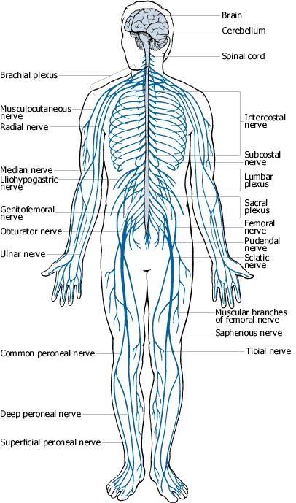
nervous system

Slide 3
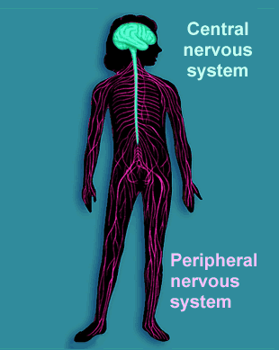

Slide 4
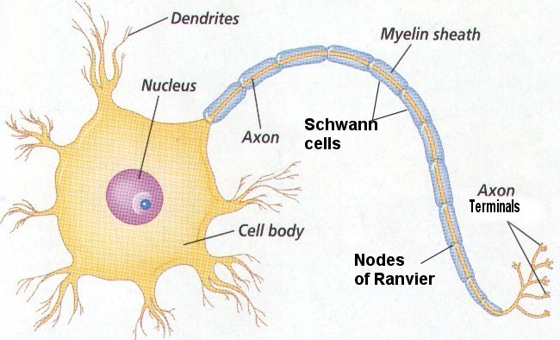

Basic nerve cell structure

Slide 5
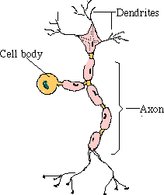
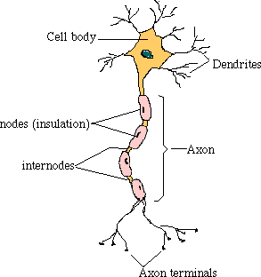
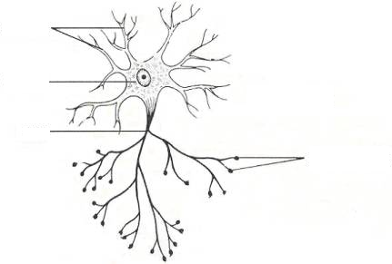
3 main types of nerve cells
sensory neurone
relay neurone
motor neurone

Slide 6
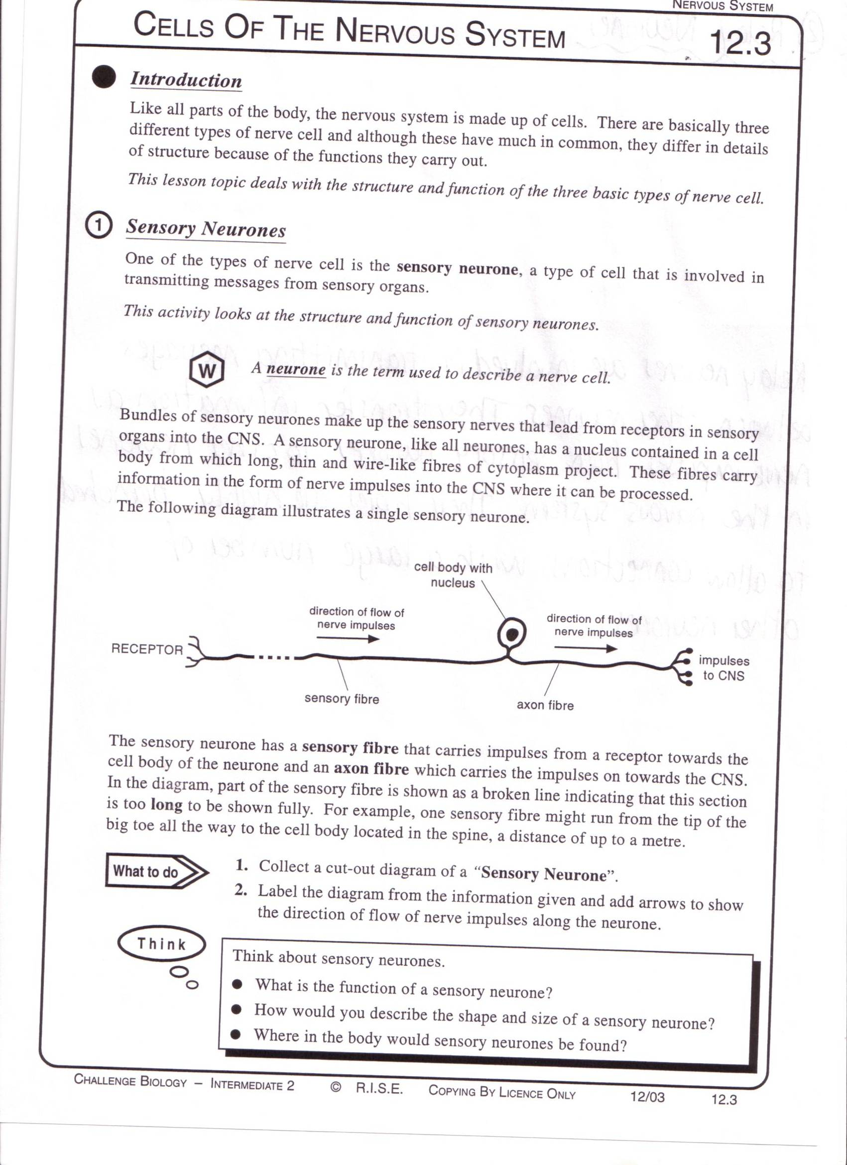
Sensory neurons
Carries impulses from receptors e.g pain receptors in skin to the CNS( brain or spinal cord)

Slide 7
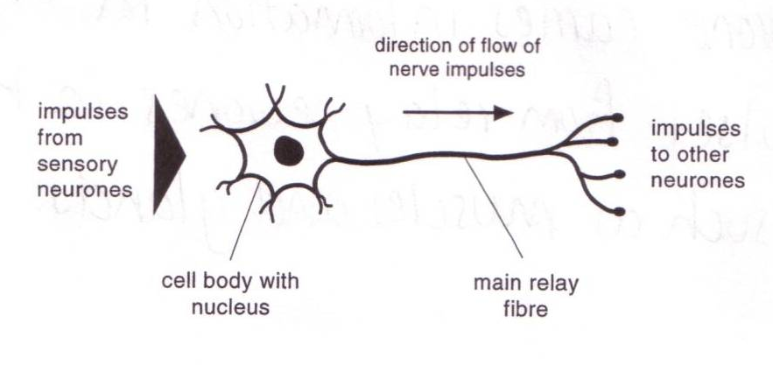
Relay neuron
Carries impulses from sensory nerves to motor nerves.

Slide 8
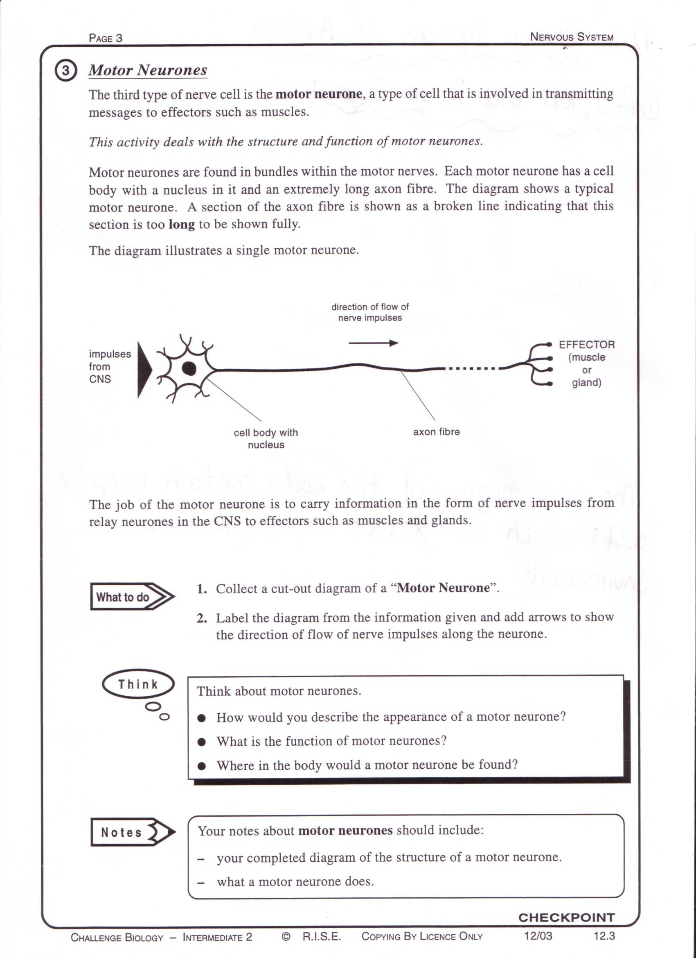
Motor neuron
Carries impulses from CNS to effector e.g. muscle to bring about movement or gland to bring about secretion of hormone e.g ADH

Slide 9
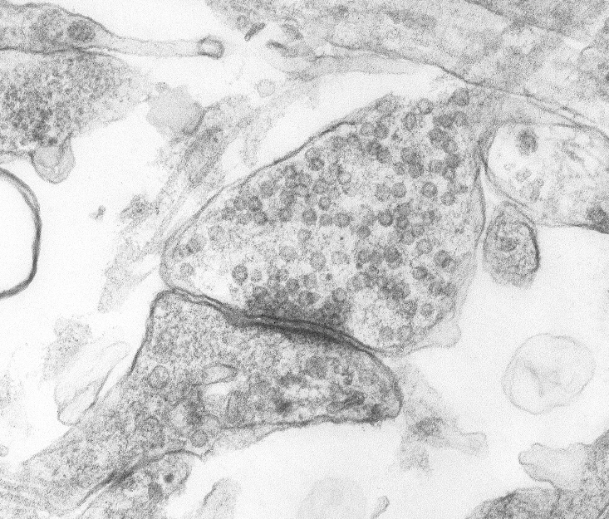
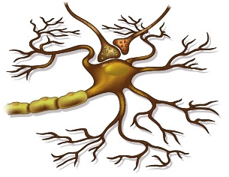
Transmission of signals

Slide 10
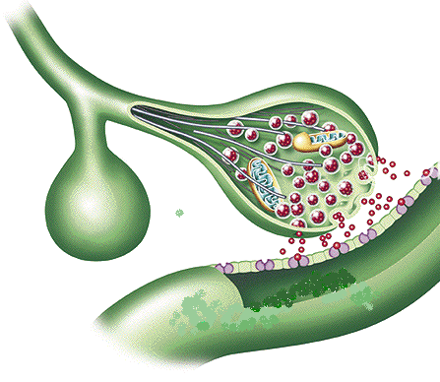
The Synapse
parkinson
parkinsons

Slide 11
This powerpoint was kindly donated to www.worldofteaching.com
http://www.worldofteaching.com is home to over a thousand powerpoints submitted by teachers. This is a completely free site and requires no registration. Please visit and I hope it will help in your teaching.

