Slide 1
Protein Synthesis
With thanks to Jenny P

Slide 3
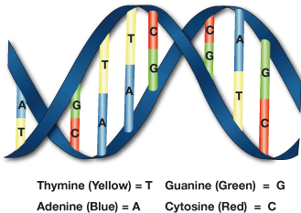
DNA is a very long molecule that looks like a twisted ladder.
It is made up of 4 different subunits called nucleotides which can be arranged in any order

Slide 4
The bases are complementary
DNA has two strands.
The strands are stuck together by the complementary bases.
Adenine to Thymine A-T
Cytosine to Guanine C-G

Slide 5
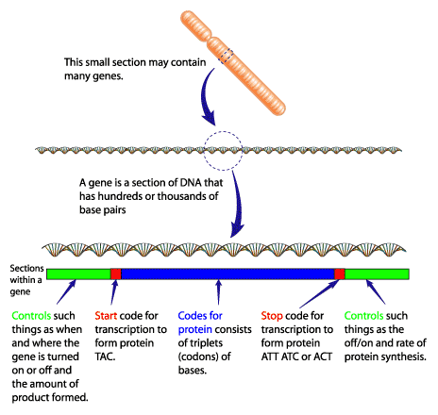

Slide 6
It is the Sequence of bases that act like a code
The sequence (order) of bases tells the cell what proteins to make.
The sequence of bases dictates the sequence of amino acids, which determines the shape of a protein.
If the protein is the wrong shape it will not work properly (it may work differently)
So if the sequence in the DNA is wrong it may result in a genetic disease

Slide 7
Sickle cell anaemia is caused by one change in the DNA base code

Slide 8
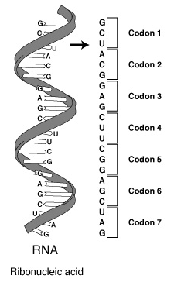
It is a triplet code.
It takes 3 bases to code for one amino acid

Slide 9
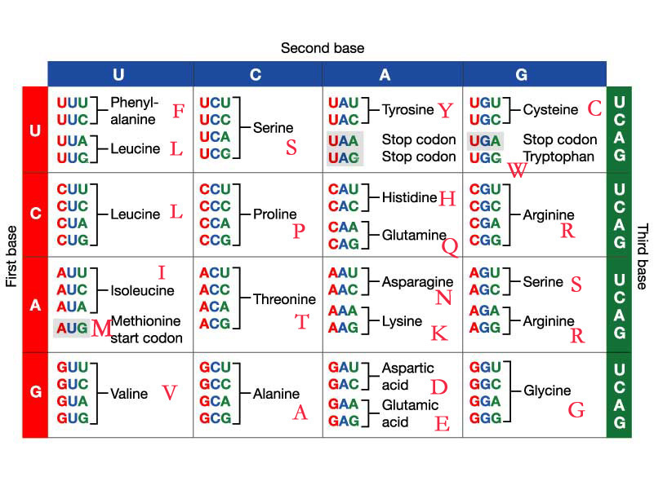
Each triplet codes for a different amino acid.

Slide 10
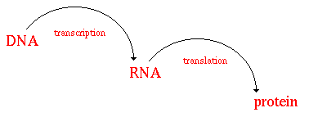
Protein Synthesis takes place in 2 stages
DNA carries the code for every protein that can be made by a cell.
A gene is a length of DNA which codes for a particular protein

Slide 11
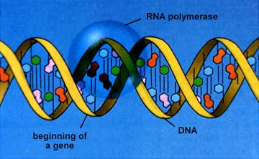
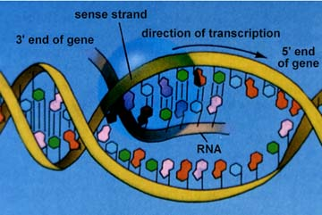
Transcription 1 (making a messenger RNA copy of DNA)
Part of the DNA molecule (the gene) unzips
An RNA copy is produced, by matching complementary bases

Slide 12
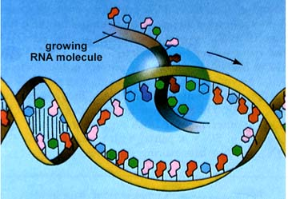
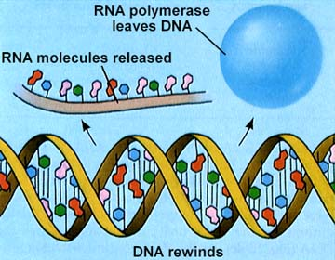
Transcription 2
The mRNA copy is made with the help of RNA polymerase.

Slide 13
Complementary base pairing
DNA Base | Complementary RNA Base
G
C
A
T
C
G
U
A

Slide 14
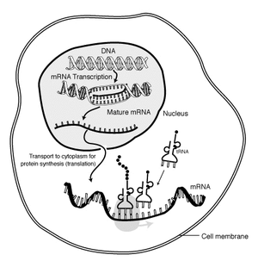
The m-RNA leaves the nucleus through a nuclear pore
Nuclear membrane
RNA leaving the nucleus
RNA in the cytoplasm

Slide 15
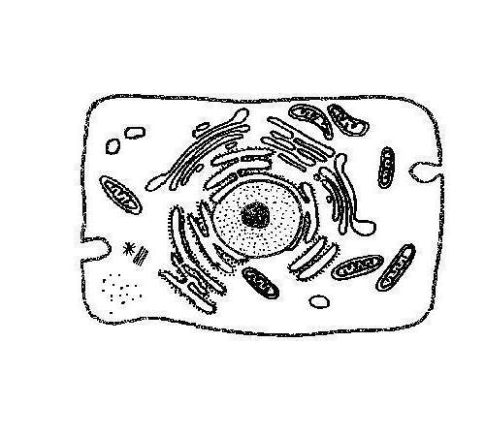
Translation
The m-RNA goes to the Ribosomes in the cytoplasm
F
E
A
B
D
C

Slide 16
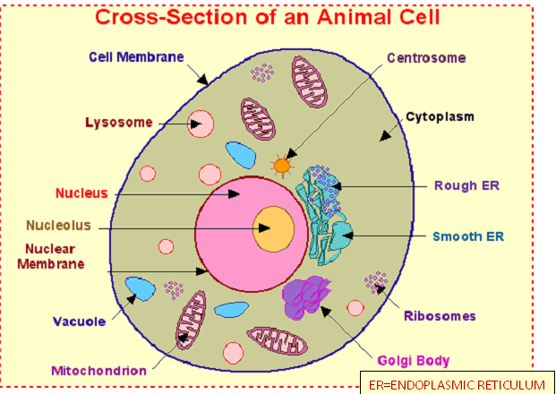

Slide 17
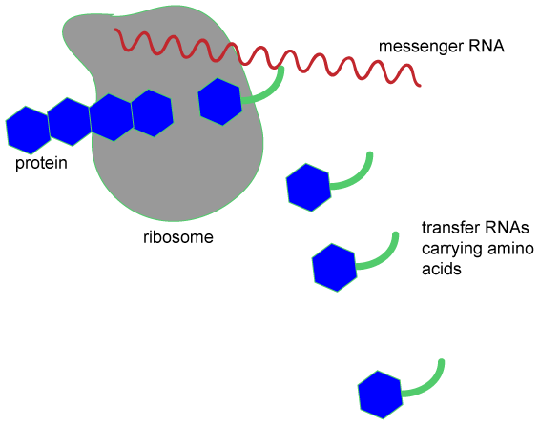
The ribosomes read the code and join the amino acids together

Slide 18
Transfer RNA brings the correct amino acid

Slide 19
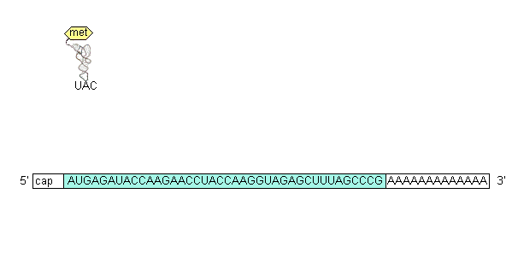
Translation - animation

Slide 20
This powerpoint was kindly donated to
www.worldofteaching.com
http://www.worldofteaching.com
Is home to well over a thousand powerpoints submitted by teachers. This a free site. Please visit and I hope it will help in your teaching
Notes:
20

