Slide 1
Kingdom Protista
The Catchall Kingdom

Slide 2
Algae

Slide 3
Characteristics of Algae
Autotrophic
Not plants – why?
Often contain pyrenoids

Slide 4
Structure of Algae
Thallus or body
Unicellular or multicellular
Colonial: Volvoz
Filamentous: Spirogyra
Multicellular: Ulva
Asexual and sexual reproduction

Slide 5
Phylums
Phylum Chlorophyta
Phylum Phaeophyta
Phylum Rhodophyta
Phylum Bacillariophyta
Phylum Dinoflagellata
Phylum Chrysophyta
Phyla Euglenohyta

Slide 6
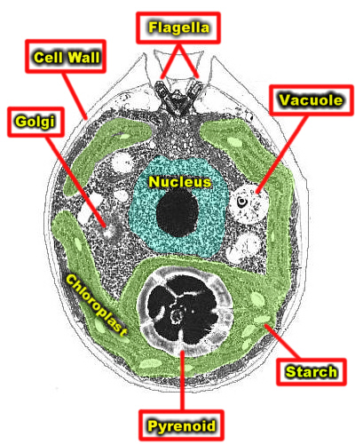
Phylum Chlorophyta
Look
familiar?

Slide 7
Continued…
Green algae
Many different forms
Gave rise to land plants – why?
Choroplasts that contain a and b cholorphyll
Have carotenoids
Cell walls of cellulose

Slide 8
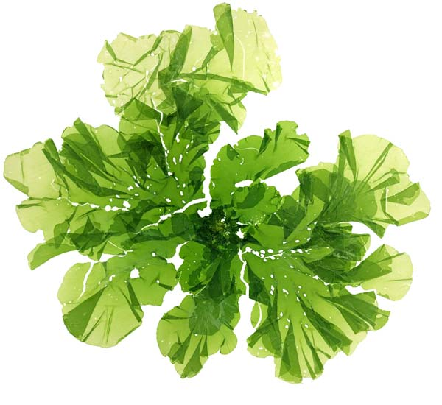
Ulva

Slide 9
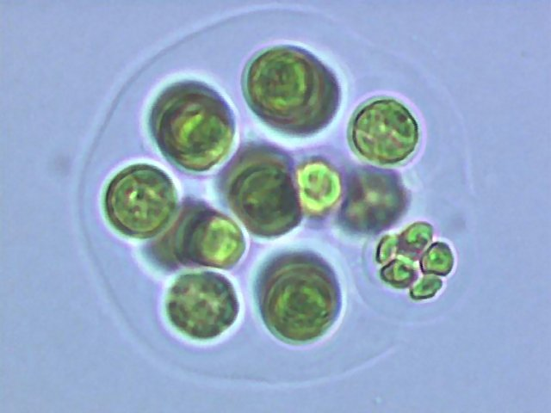
Colonial Chlorophyta

Slide 10
Phylum Phaeophyta
Brown algae
Marine
Seaweed and kelps
Cooler areas of ocean
Fucoxanthin pigment
Store food as laminarin
ALL multicellular
Stemlike stipe
Leaflike region called blade

Slide 11
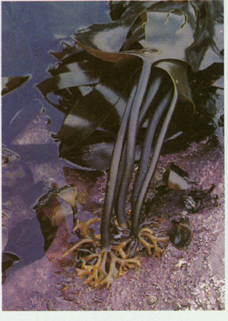

Slide 12
Phylum Rhodophyta
Red algae but colors vary
Marine seaweeds
Smaller than brown algae and live in deeper waters
Phycobilins – pigment for absorbing light
Some coated with polysaccharide carageenan – cosmetics, gel capsules, cheeses
Agar – extracted from cell walls of red algae

Slide 13
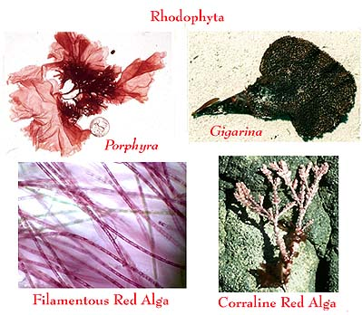

Slide 14
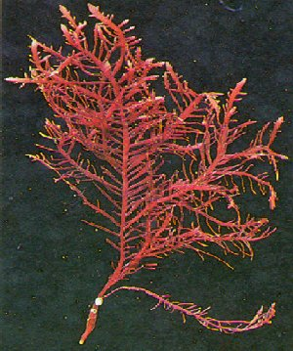

Slide 15
Phylum Bacillariophyta
Diatoms
Shells fit together like a box with a lid
Centric and pennate
Main component of phytoplankton
Diatomaceous earth

Slide 16
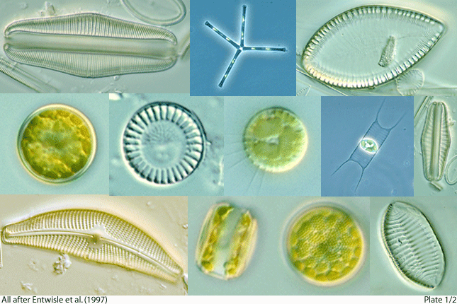

Slide 17
Phylum Dinoflagellata
Dinoflagellates
Small, unicellular
Most photosynthetic
Some bioluminescent
Red tide a problem

Slide 18
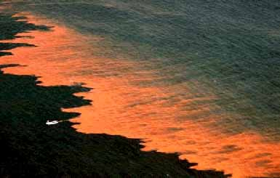

Slide 19
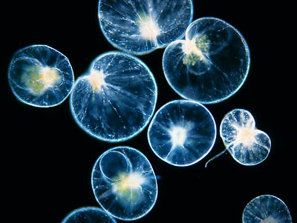

Slide 20
Phylum Chrysophyta
Golden algae
Most fresh water
Form cysts
2 flagella
Carotenoids give color
Important for formation of petroleum deposits

Slide 21
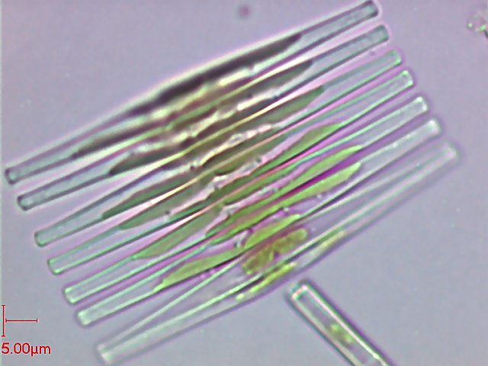

Slide 22
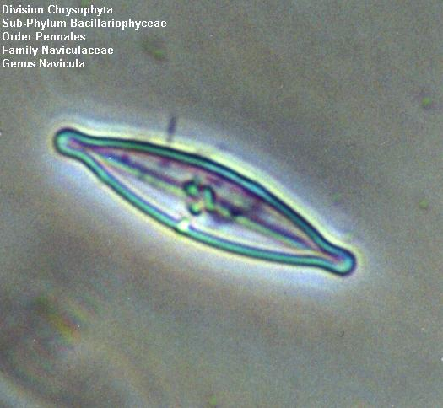

Slide 23
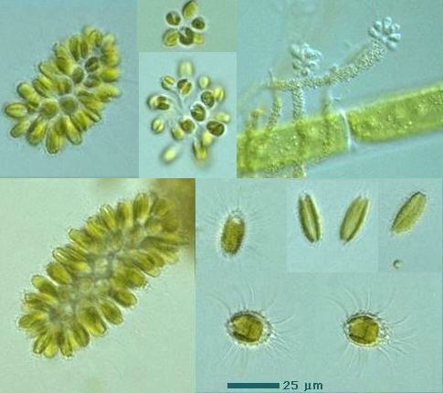

Slide 24
Phylum Euglenophyta
Euglenoids
Plant-like and animal-like characteristics
Many have cholorphyll and are photosynthetic
No cell wall, motile
Most live in fresh water
See picture on page 533

Slide 25
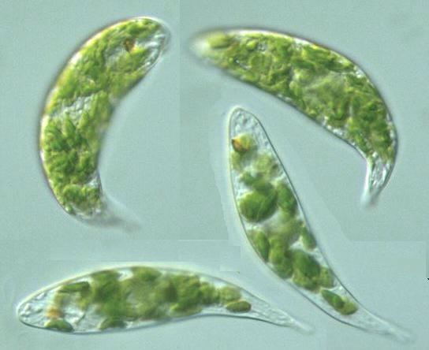

Slide 26
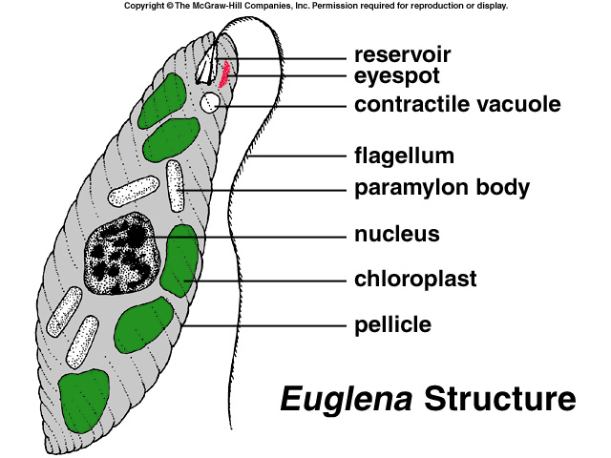

Slide 27
Fungus-like protists
Slime molds:
Phylum acrasiomycota
Cellular slime molds
Amoeboid movement
Phylum Myxomycota
Plasmodial slime molds
Mass of plasmodium
Water molds
Phylum Oomycota
Blight
Phylum Chytridiomycota
Chytrids
Zoospores with one flagellum
Maybe fungi?

Slide 28
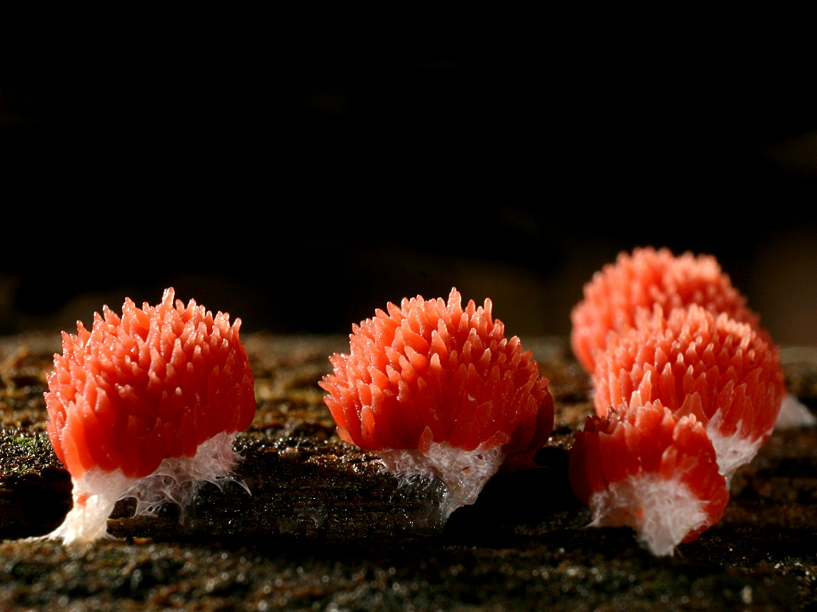
Slime molds

Slide 29
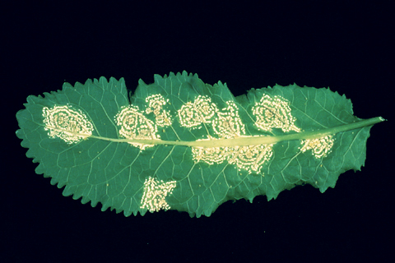
Water molds

Slide 30
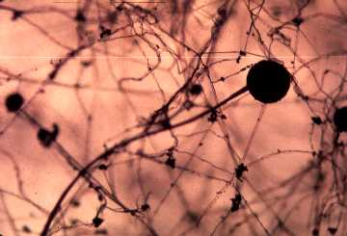
Chytrids

Slide 31
The END….

Slide 32
This powerpoint was kindly donated to www.worldofteaching.com
http://www.worldofteaching.com is home to over a thousand powerpoints submitted by teachers. This is a completely free site and requires no registration. Please visit and I hope it will help in your teaching.

