Slide 1
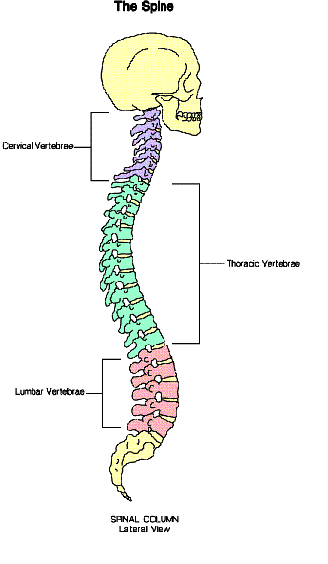
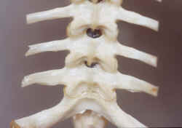
Vertebrates
Animals with backbones

Slide 2
There are 5 vertebrate groups
Starting letters are
A R F B M
Amphibians – (frogs and newts)
Reptiles - (lizards and snakes)
Fish
Birds
Mammals

Slide 3
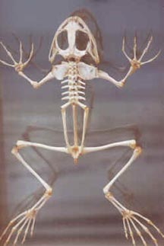
Frog - skeleton

Slide 4
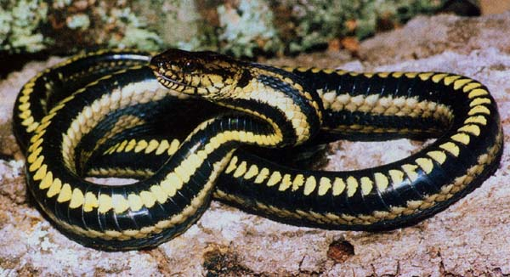
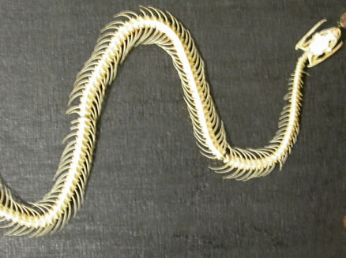
Snake - skeleton

Slide 5
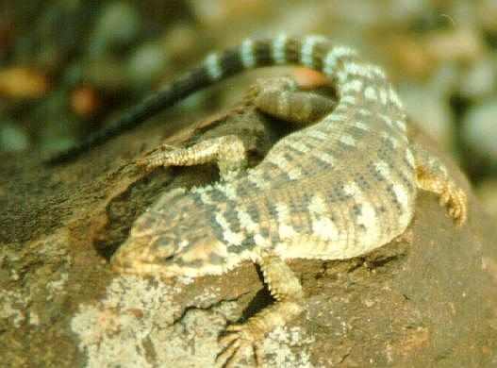
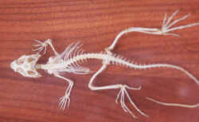
Lizard - skeleton

Slide 6
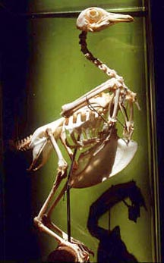
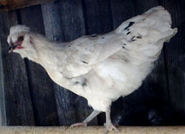
Bird - skeleton

Slide 7
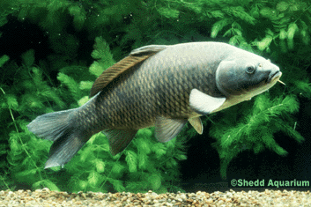
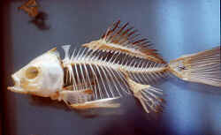
Fish - skeleton

Slide 8
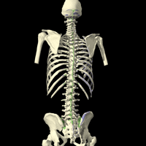
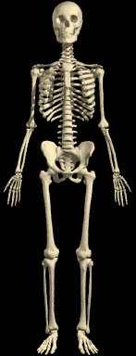
Human skeleton

Slide 9
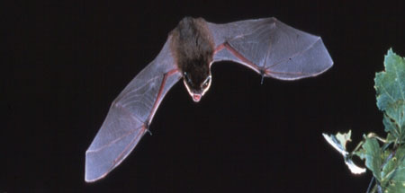
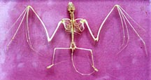
Bat - skeleton

Slide 10
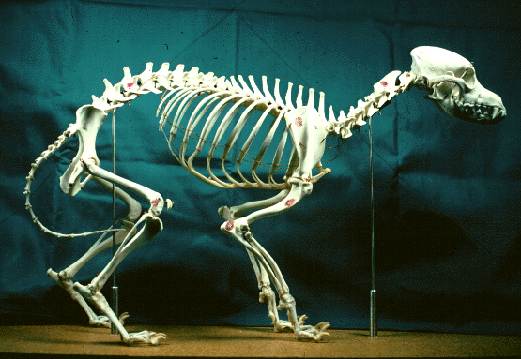
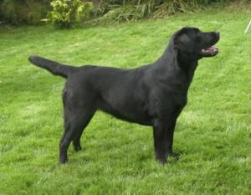
Dog - skeleton

Slide 11
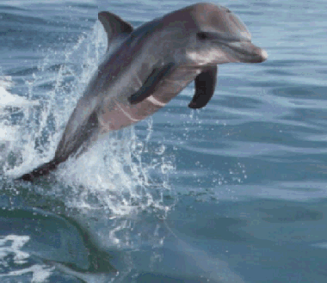
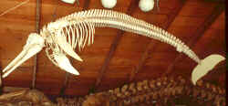
Dolphin - skeleton

Slide 12
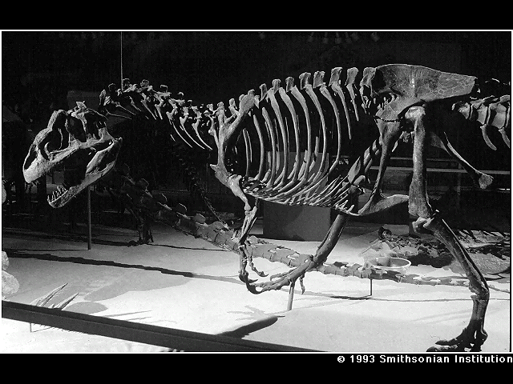
Dinosaur – fossil skeleton

Slide 13
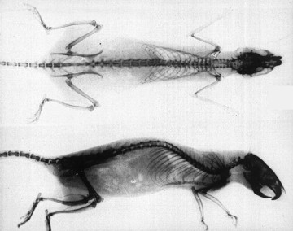
X – ray of rat

Slide 14
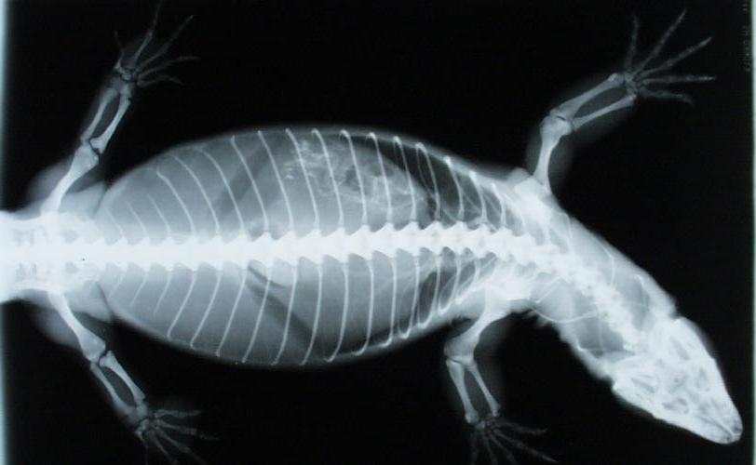
X-ray of lizard

Slide 15
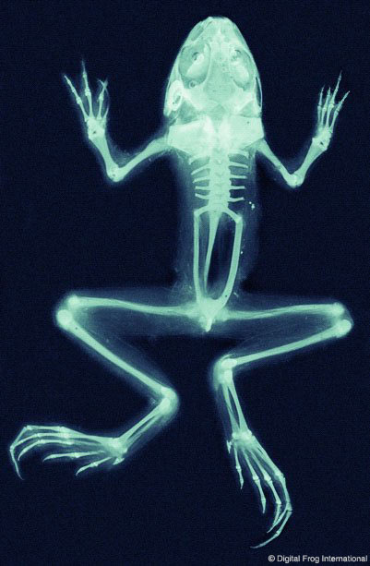
X-ray - Frog

Slide 16
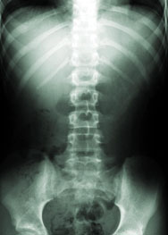
X-ray of human spine

Slide 17
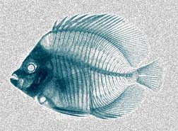
X-ray of fish

Slide 18
This powerpoint was kindly donated to www.worldofteaching.com
http://www.worldofteaching.com is home to over a thousand powerpoints submitted by teachers. This is a completely free site and requires no registration. Please visit and I hope it will help in your teaching.

