Slide 1
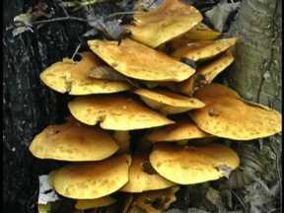
What is a Plant?
Hmmm…now there’s an interesting question.
Most schools used to lump the study of fungi (a science now called mycology) in with their botany departments, and some schools still do this.
Are fungi plants?

Slide 2
What is a Plant?
Surely, then we can say that anything that does photosynthesis
is a plant, right?
Nope. But I’m being pickier than
many people when I say that.
If you want to know much more
about it, take systematic botany;
but for now, to be a plant you
have to have chlorophylls a and b,
store sugar as starch, and have an ancestor that had two
anterior whiplash flagellae with star-shaped bases.
All of these, plus the euglenoids and golden algae, fall short of these criteria; though good arguments could be made for the inclusion of some of them (especially red algae.)

Slide 3
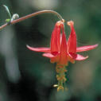
What is a Plant?
So what is a plant? My definition includes everything from “green algae” to flowering plants, which are considered the most advanced plants. Our focus will be on the land plants, like ferns, coniferous and deciduous trees, grasses, and wildflowers, to name a few.

Slide 4
Why Study Plants?
Atmospheric gas regulation
A. Production of oxygen gas as a by-product
of photosynthesis. The first oxygen
producers were thought to be bacteria
(like today’s cyanobacteria), which were
eventually incorporated as
endosymbionts into plant ancestors.
You can’t have eukaryotes without
oxygen (so aren’t we all glad it’s there!)
Maybe we’ll take a field trip
to an oxygen bar, like this one
in Seattle, where customers pay
$1/minute to breath 97% O₂.

Slide 5
Why Study Plants ?
Atmospheric gas regulation
B. Oxygen gas (O₂) in the atmosphere is converted to ozone (O₃)in the stratosphere, as it absorbs UV light. Ozone then absorbs more UV light and is eventually converted back into oxygen gas. This process blocks up to 99% of all the harmful UVB rays that would otherwise sterilize the surface of the earth impossible, by causing so many mutation in anything that ventured out of the shade.

Slide 6
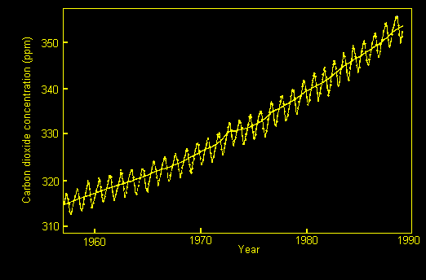
Why Study Plants?
C. Utilization of CO₂. Plants use carbon dioxide to build sugar via the Calvin cycle (a.k.a. “dark reactions”) of photosynthesis. Besides being
toxic to humans at elevated levels
(as the crew of Apollo 13 nearly
experienced), CO₂ is a “greenhouse gas,” meaning that it
absorbs infrared
radiation from earth,
keeping that energy
in the atmosphere longer and contributing to global
warming.

Slide 7
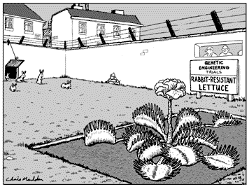
Why Study Plants?
Sugars and their polymers
A. “Carb’s are the enemy,” according to Dr. Atkins, right? I don’t buy it, but then again I’m not losing weight, either. Plants give us simple sugars as well as starches. Even if your on a low-carb diet, you can still thank plants for all the leafy greens you’re (hopefully) eating. And then there’s the fact that all the meat you eat was part of an animal that probably ate plants to live. So almost all our food comes
from plants.

Slide 8
Why Study Plants?
B. Fibers--
1. Cotton: As George
Costanza showed the
Yankees on Seinfeld,
cotton is king.
2. Paper: Average paper
use per person in North America is 2 kg/day.
3. Fibers such as nylon and
rayon are processed from
wood fibers.

Slide 9
Why Study Plants?
Other molecules
A. Medicines
Also noteworthy are aspirin, ephedra (banned),
quinine, ginkgolides, and others.
Foxglove produces digitalis, which treats heart disease.
Taxol from the bark of the pacific yew tree is one of the most promising anti-cancer drugs.
Rosy periwinkle from Madagascar treats two cancers: juvenile leukemia and Hodgkin’s disease. Threatened by increasing population.

Slide 10
Why Study Plants?
B. Spices
C. Oils
D. Essential amino acids--There are 8 amino acids that we need in our cells, but we don’t have the ability to produce them ourselves.
We can most easily get them
from plants. To get the complete
set of essential amino acids,
a combination of
legumes and cereals is best.
What does that mean?
E. Fossil fuels like coal, crude oil, and natural gas are the products of plants that died a long time ago.

Slide 11
Why Study Plants?
F. I would be remiss not to mention one of the most economically and culturally important “other molecules” that is
made from
plants…
alcohol.

Slide 12
This powerpoint was kindly donated to www.worldofteaching.com
http://www.worldofteaching.com is home to over a thousand powerpoints submitted by teachers. This is a completely free site and requires no registration. Please visit and I hope it will help in your teaching.

