Slide 1
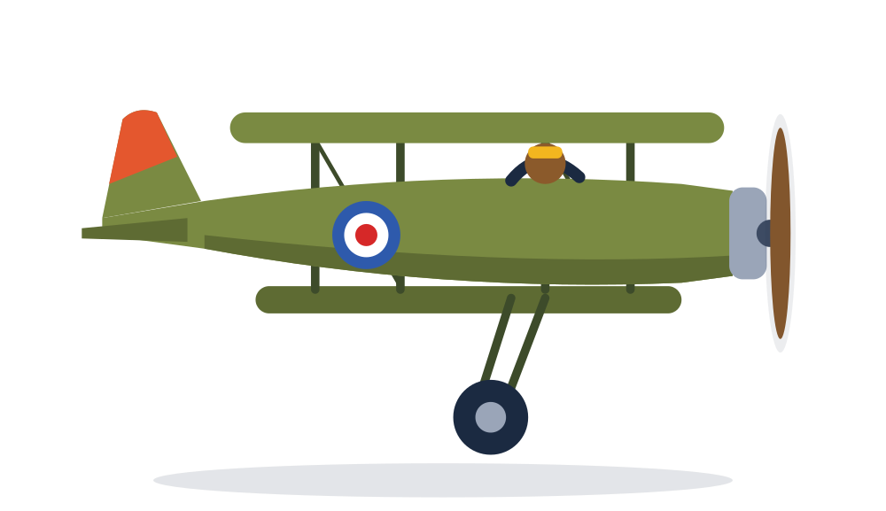
Causes of the First World War
Why did an assassination in Sarajevo lead to a world war?
GCSE History | Conflict and tension, 1894 to 1918
Notes:
Premium lesson pack, about 60 to 70 minutes. Colour code used throughout: coral for militarism, teal for alliances, purple for imperialism and gold for nationalism. Suits the AQA Conflict and tension 1894 to 1918 option and any KS3 or GCSE unit on the origins of the war. Taught in the week of 11 November, it links naturally to Remembrance Day.

Slide 2
Learning objectives
M
S
C
Must
Should
Could
Describe the four long term causes of the war and the assassination that triggered it
Explain how the July Crisis turned a local conflict into a European war
Judge which cause was most important and support that judgement with evidence
Notes:
Share the three levels. The 'Could' objective is the sustained judgement that the 16 mark question rewards at Level 4.

Slide 3
Warm up: what do you already know?
1
In which year did the First World War begin?
2
Who ruled Germany in 1914?
3
Which two countries were Britain's main partners?
4
Which city did Archduke Franz Ferdinand visit in June 1914?
5
When did the fighting end?
6
What do people wear a red poppy to remember?
Notes:
Five minutes in pairs. Nobody is expected to know everything yet: this shows what the class already knows.

Slide 4
Warm up: answers
1
In which year did the First World War begin?
2
Who ruled Germany in 1914?
3
Which two countries were Britain's main partners?
1914
Kaiser Wilhelm II
France and Russia
4
Which city did Archduke Franz Ferdinand visit in June 1914?
5
When did the fighting end?
6
What do people wear a red poppy to remember?
Sarajevo, in Bosnia
11am on 11 November 1918
Those who died in war, starting with the First World War
Notes:
Use question 6 to link to Remembrance Day. Questions 3 and 4 are the two halves of today's lesson: the alliances that divided Europe, and the event that set them off.

Slide 5
Key words
Militarism
Alliance
Imperialism
Nationalism
Building up armed forces and believing in using them
An agreement between countries to support each other
Building an empire by taking control of other lands
Strong pride in your nation, or a wish for your people to rule themselves
Entente
Mobilise
Ultimatum
Neutral
A friendly understanding between countries, weaker than a full alliance
To get an army ready for war
A final demand, with a threat if it is refused
Not taking sides in a war
Notes:
The top row spells MAIN, the four long term causes. Students could copy these into the back of their books as a glossary.

Slide 6

Long term causes: MAIN
Why was Europe ready to go to war?
Notes:
Long term causes built up tension over 20 or 30 years. They explain why Europe was like a powder keg; the assassination was the spark.

Slide 7
Four long term causes
M
A
I
N
Militarism
Alliances
Imperialism
Nationalism
An arms race, especially at sea, and war plans ready to go
Europe split into two armed camps that promised to help each other
Rivalry over empires and colonies in Africa and Asia
National pride and the demands of Slav peoples in the Balkans
Notes:
MAIN is a memory aid, not an explanation. The skill examiners reward is explaining how each cause made war more likely, and how the causes connect.

Slide 8

Militarism: the naval race
29
British dreadnoughts by 1914
17
German dreadnoughts by 1914
In 1906 Britain launched HMS Dreadnought, a battleship so powerful that every older warship looked out of date.
Germany's Kaiser wanted a navy to match Britain's, and both sides raced to build more.
Armies grew too, and every Great Power had detailed war plans ready.
The Schlieffen Plan: Germany's plan to beat France in about six weeks by marching through Belgium, then turn to fight Russia.
Notes:
Figures for dreadnoughts vary slightly between textbooks depending on whether battlecruisers are counted; 29 to 17 is the figure most often used. The Schlieffen Plan matters later: it is why Germany invaded Belgium, and that brought Britain into the war.

Slide 9
Alliances: two armed camps
Triple Alliance, 1882
Triple Entente, 1907
Germany
Austria Hungary
Italy (but it stayed neutral in 1914)
Britain
France
Russia
Also: Russia promised to protect Serbia, and under the Treaty of London (1839) Britain had promised to protect Belgium.
Notes:
The alliances were meant to keep the peace by making war too risky. Ask: how could an agreement meant to prevent war end up spreading one? The Entente was looser than the Alliance: Britain was not formally bound to fight.

Slide 10
Imperialism: a race for empire
1
Britain's huge empire
2
Germany wanted more
By 1914 Britain ruled about a quarter of the world's land and people, protected by its navy.
Germany wanted 'a place in the sun': colonies, trade and respect to match its new power.
3
The Moroccan Crises
4
The result
In 1905 and 1911 Germany challenged France over Morocco. Both times Britain backed France.
Each crisis pushed Britain and France closer together and left Germany feeling surrounded.
Notes:
The Moroccan Crises are the best example of imperial rivalry for exam answers. They backfired on Germany: instead of splitting Britain and France, they strengthened the Entente.

Slide 11
Nationalism: trouble in the Balkans
1
Serbian nationalism
2
The Bosnian Crisis, 1908
Serbia wanted to unite all Slav peoples, including the Serbs living in Austria Hungary.
Austria Hungary took over Bosnia, angering Serbia and its protector, Russia.
3
The Balkan Wars, 1912 to 1913
4
French revenge
Serbia grew stronger, and Austria Hungary saw it as a real threat.
France wanted back Alsace and Lorraine, the provinces it lost to Germany in 1871.
Notes:
The Balkans were called 'the powder keg of Europe'. Austria Hungary was an empire of many nationalities, so Slav nationalism threatened to break it apart. This is why it reacted so strongly in 1914.

Slide 12
Your turn: which cause is it?
The naval race between Britain and Germany
Britain, France and Russia agree to support each other
1
2
The Moroccan Crises of 1905 and 1911
Serbia wants to unite all Slav peoples
3
4
The Schlieffen Plan
The Treaty of London protecting Belgium
5
6
Germany wants 'a place in the sun'
France wants Alsace and Lorraine back
7
8
Notes:
Students write M, A, I or N next to each number. About 4 minutes, then compare with a partner.

Slide 13
Which cause? Answers
The naval race between Britain and Germany
Britain, France and Russia agree to support each other
1
M
2
A
The Moroccan Crises of 1905 and 1911
Serbia wants to unite all Slav peoples
3
I
4
N
The Schlieffen Plan
The Treaty of London protecting Belgium
5
M
6
A
Germany wants 'a place in the sun'
France wants Alsace and Lorraine back
7
I
8
N
Notes:
Some examples fit more than one cause: the naval race also fed imperial rivalry, and the Schlieffen Plan only mattered because of the alliances. Students who spot this are already linking causes, which is what Level 4 needs.

Slide 14

The spark: Sarajevo, 28 June 1914
How one wrong turn changed history
Notes:
The short term cause, or trigger. Tell the story dramatically: students remember it, and the details are useful in 'write an account' questions.

Slide 15
The assassination of Franz Ferdinand
The visit
Archduke Franz Ferdinand, heir to the throne of Austria Hungary, and his wife Sophie visited Sarajevo, the capital of Bosnia.
1
The plot
A group of young Bosnian Serbs, armed by a Serbian secret society called the Black Hand, planned to kill him.
2
The bomb
In the morning a bomb bounced off the Archduke's car and injured people in the car behind.
3
Austria Hungary blamed Serbia, and wanted to crush it.
The wrong turn
Later his driver took a wrong turn and stopped right beside Gavrilo Princip, who was 19.
4
The shots
Princip fired twice, killing both Franz Ferdinand and Sophie.
5
Notes:
Princip was too young for the death penalty and was sentenced to 20 years; he died of tuberculosis in prison in 1918. Ask: was the war caused by bad luck? Lead students to see that the long term causes explain why a murder in Bosnia led to a world war.

Slide 16
The July Crisis
Five weeks from assassination to world war
Notes:
This section shows the alliances in action, one domino falling after another.

Slide 17
From murder to world war
Franz Ferdinand assassinated
Austria's ultimatum to Serbia
Russia mobilises to help Serbia
Germany declares war on France
28 Jun
23 Jul
30 Jul
3 Aug
5 Jul
28 Jul
1 Aug
4 Aug
Germany's 'blank cheque' to Austria
Austria declares war on Serbia
Germany declares war on Russia
Germany invades Belgium; Britain declares war
Notes:
The 'blank cheque' was Germany's promise to support Austria Hungary whatever happened. Serbia accepted almost all of the ultimatum, but not all, and Austria declared war anyway. Note how each step was linked to an alliance or a war plan.

Slide 18
Why did Britain join the war?
1
Belgium
2
The Entente
Germany invaded neutral Belgium as part of the Schlieffen Plan. Britain had promised to protect it in 1839.
Britain had grown close to France and Russia and could not let them be defeated.
3
The navy
4
The balance of power
A German controlled coast across the Channel would threaten Britain's navy and trade.
Britain did not want any one country to dominate Europe.
Notes:
Britain sent Germany an ultimatum to leave Belgium by 11pm on 4 August. When it expired, Britain was at war. The German Chancellor called the treaty 'a scrap of paper'.

Slide 19
Your turn: put them in order
Germany declares war on Russia
Archduke Franz Ferdinand is shot
A
B
Britain declares war on Germany
Austria sends Serbia an ultimatum
C
D
Russia mobilises its army
Germany promises Austria its support
E
F
Austria declares war on Serbia
Germany declares war on France
G
H
Notes:
Students write the letters A to H in the order the events happened. Allow about 4 minutes, then check in pairs.

Slide 20
Put them in order: answers
B: Archduke Franz Ferdinand is shot
28 June
F: Germany promises Austria its support
5 July
1
2
D: Austria sends Serbia an ultimatum
23 July
G: Austria declares war on Serbia
28 July
3
4
E: Russia mobilises its army
30 July
A: Germany declares war on Russia
1 August
5
6
H: Germany declares war on France
3 August
C: Britain declares war on Germany
4 August
7
8
Notes:
Answers read across each row, left to right. The common slip is putting Russia's mobilisation before Austria's declaration of war: Russia mobilised in response.

Slide 21
Exam practice
Explain, link and judge
Notes:
Exam practice: a 16 mark 'how far do you agree' question in the style of AQA Paper 1.

Slide 22
Exam style question
'The main cause of the First World War was the alliance system.' How far do you agree with this statement?
(16 marks)
+4 SPaG
Explain your answer. You may use:
Plan in 3 minutes
the alliance system
the assassination at Sarajevo
You must also use information of your own.
One paragraph on alliances
Two on other causes, such as militarism and the assassination
A conclusion that makes a clear judgement
Notes:
Students should spend about 20 minutes writing. Good 'own knowledge' points include the naval race, the Schlieffen Plan, the Moroccan Crises and the invasion of Belgium.

Slide 23
Mark scheme
1 to 4 marks
Basic explanation of one or more factors, with some knowledge
L1
5 to 8 marks
Simple explanation of the stated factor or other factors
L2
9 to 12 marks
Developed explanation of the stated factor and other factors
L3
13 to 16 marks
Complex explanation of several factors, linked, with a sustained judgement
L4
Notes:
Simplified from the style of AQA's levels. A further 4 marks are given for spelling, punctuation, grammar and use of specialist terms. To reach Level 4 students must reach a clear judgement and explain how the causes link together.

Slide 24
What a strong paragraph looks like
Point: The alliance system was an important cause because it turned a local quarrel in the Balkans into a European war.
Evidence: After Austria Hungary declared war on Serbia on 28 July 1914, Russia mobilised to protect Serbia, and within a week Germany had declared war on Russia and France.
Explain: Because each country had promised to support its partners, none could stay out without abandoning an ally.
Judge: However, alliances did not make war certain: Italy broke its alliance and stayed neutral, which suggests the Schlieffen Plan, which forced Germany to attack through Belgium, mattered just as much.
Notes:
Model the structure, then ask students to write a second paragraph on militarism using the same pattern. The 'judge' sentence is what lifts an answer towards Level 4.

Slide 25
Common mistakes
1
'Britain joined because of the assassination'
2
'Italy fought alongside Germany'
Britain joined because Germany invaded Belgium, not because of events in Sarajevo.
Italy stayed neutral in 1914 and joined the Allies in 1915.
3
Just describing MAIN
4
Calling the assassination the main cause
Listing the four causes is not enough. Explain how each one led to war.
It was the trigger. The long term causes explain why it led to a world war.
Notes:
The first two are the most common factual errors on this topic. The last two are the most common reasons answers stay in Level 2.

Slide 26
Exit ticket
What do the letters MAIN stand for?
1
What was Germany's 'blank cheque'?
2
Which invasion brought Britain into the war?
3
Notes:
Independent, about 3 minutes.

Slide 27
Exit ticket: answers
What do the letters MAIN stand for?
Militarism, Alliances, Imperialism, Nationalism
1
What was Germany's 'blank cheque'?
Its promise to support Austria Hungary
2
Which invasion brought Britain into the war?
Germany's invasion of Belgium
3
Notes:
Next lesson: the Schlieffen Plan in action and the start of trench warfare on the Western Front.

Slide 28

Key points
Long term causes: militarism, alliances, imperialism, nationalism
28 June 1914: Franz Ferdinand assassinated in Sarajevo
July 1914: the alliances pulled the Great Powers in
4 August 1914: Britain declared war after Germany invaded Belgium
We will remember them
11 November
Notes:
Remembrance Day, 11 November, marks the armistice that ended the fighting at 11am on 11 November 1918. If this lesson falls in Remembrance week, finish with the two minute silence or a short discussion of why we still remember the war.

