Slide 1
Water on Mars
Geological Evidence for Water on Mars**
- gullies, erosion channels
- layers/sedimentary features
The Physics of Water on Mars
  polar ice caps – seasonal variation
  atmosphere - history
Chemical Evidence for Water on Mars
Theories for Water on Mars – debates!
The Martian Meteorites

Slide 2
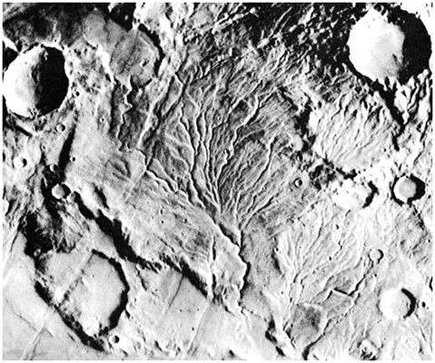
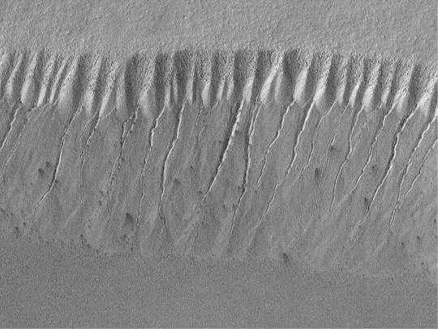
Water on Mars
One of the most natural human curiosities – related to the ultimate question of LIFE on Mars
MGS
Viking 1 Orbiter
although many images suggest SIGNS of water,
NO LIQUID WATER or RAIN has ever been observed!

Slide 3
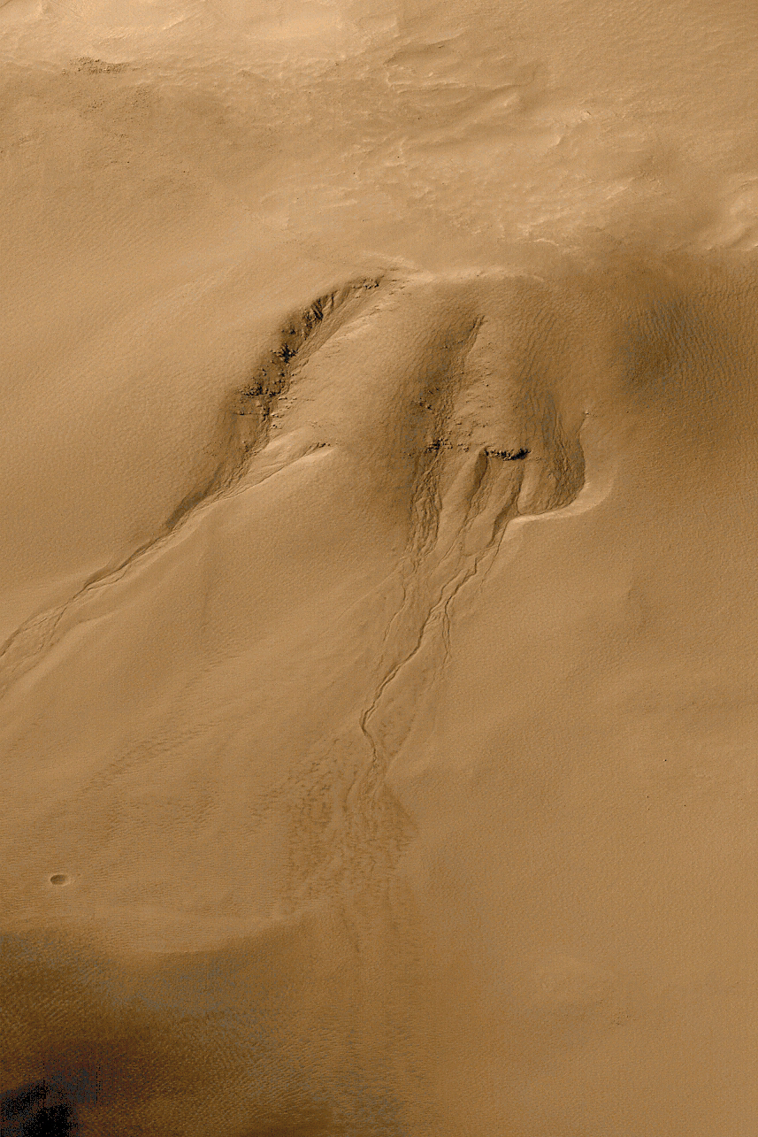
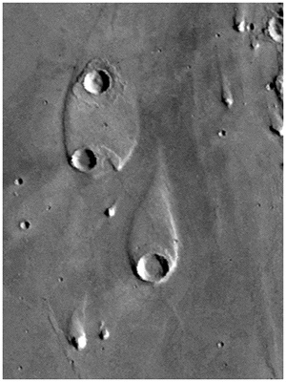
Geological Evidence: Outflow Channels
Ares Valles
MGS data
Outflow channels suggest that massive floods happened:
- water discharge rates ~10,000 times Mississippi River flood
- did these floods form into a massive ocean?

Slide 4
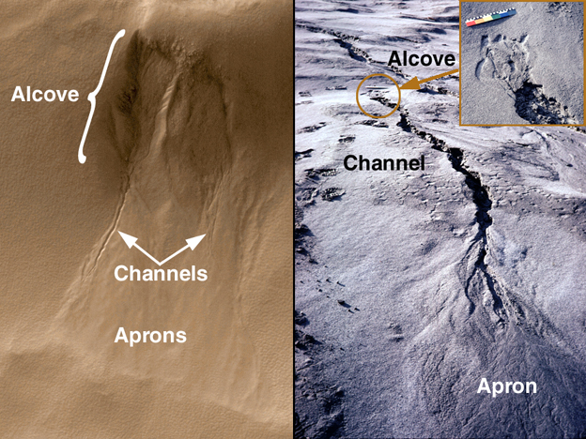
Geological Evidence: Martian Channels
Martian Gullies: left (Mars) and right (Earth).
In the Earth picture, rain water flowing under and seeping along the base of a recently-deposited volcanic ash layer has created the gully.
For Mars, water is not actually seen but is inferred from the landforms and their similarity to examples on Earth.
Mars Global Surveyor Image (June 2000) Earth (Mt. St. Helens)

Slide 5
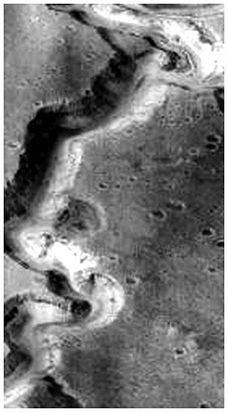
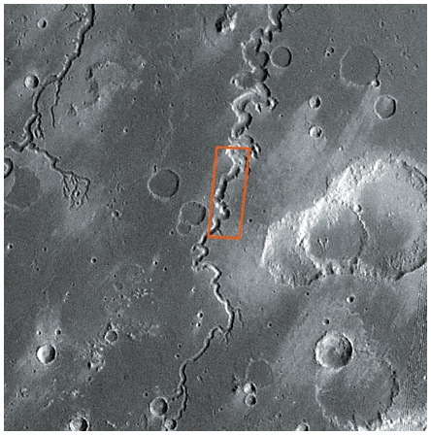
Geological Evidence: Sustained Water Flow

Slide 6
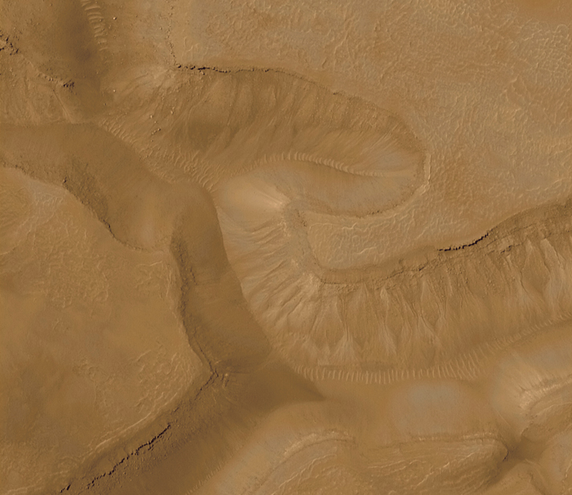
MGS

Slide 7
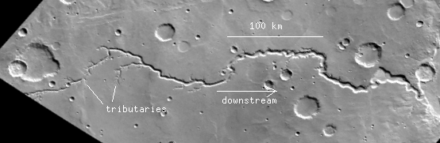
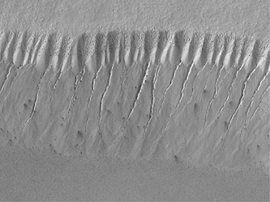
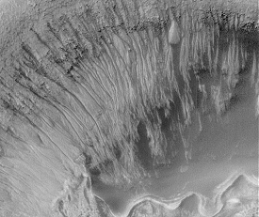
Geological Evidence:
Possible Ancient Streambeds and Erosion Channels

Slide 8
Summers in the Martian southern hemisphere are
shorter than summers in the northern hemisphere.
Why?
The northern hemisphere is chilled by a larger polar cap
There are more volcanoes in the southern hemisphere
(3) The southern hemisphere is at much lower elevation on average the Martian equatorial bulge makes the sun shine more directly on the Southern hemisphere
(4)This is a consequence of Mars’ elliptical orbit.

Slide 9
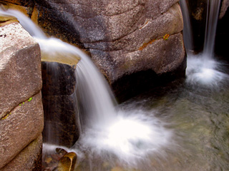
The physics of finding water on Mars
When/how does water (H₂0) exist in its liquid state?
LIQUID water exists over a very NARROW range in TEMPERATURE
- if T is too high → gas
- if T is too low → solid (ice)
The TEMPERATURE of water will depend on the ATMOSPHERIC PRESSURE
- if Pressure is too low – water will vaporize (evaporate)
- if Pressure is too high – water will stay liquid!
Mars’ atmospheric pressure is ~1% of Earth’s
- LOW pressure
- LOW temperature ➔ FROZEN WATER (ice!)

Slide 10
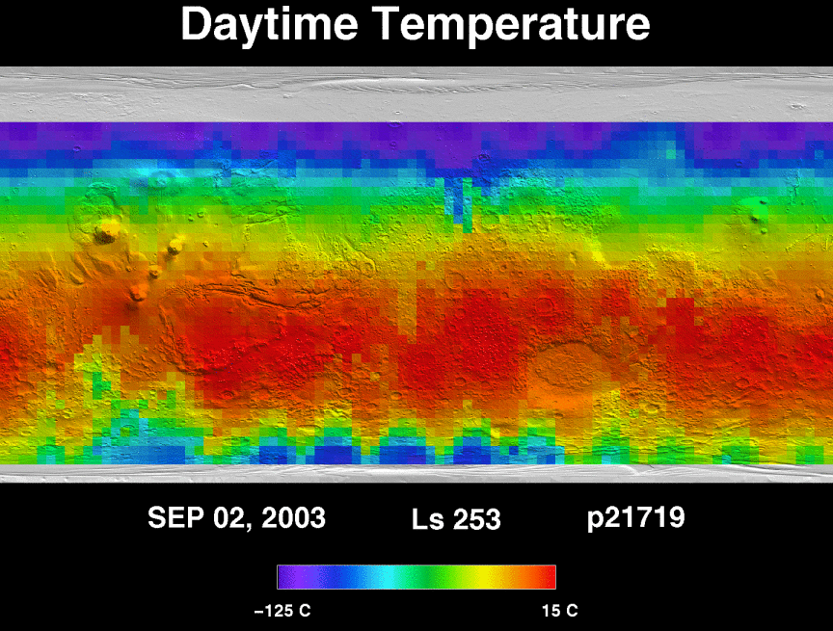
Mars Global Surveyor
TES instrument

Slide 11
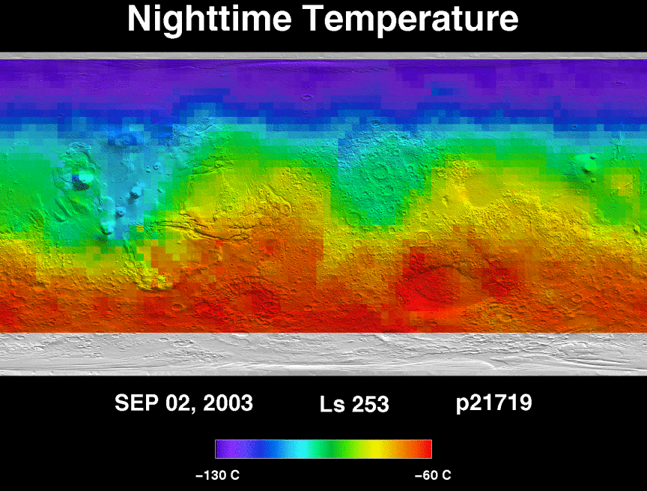
Mars Global Surveyor
TES instrument

Slide 12
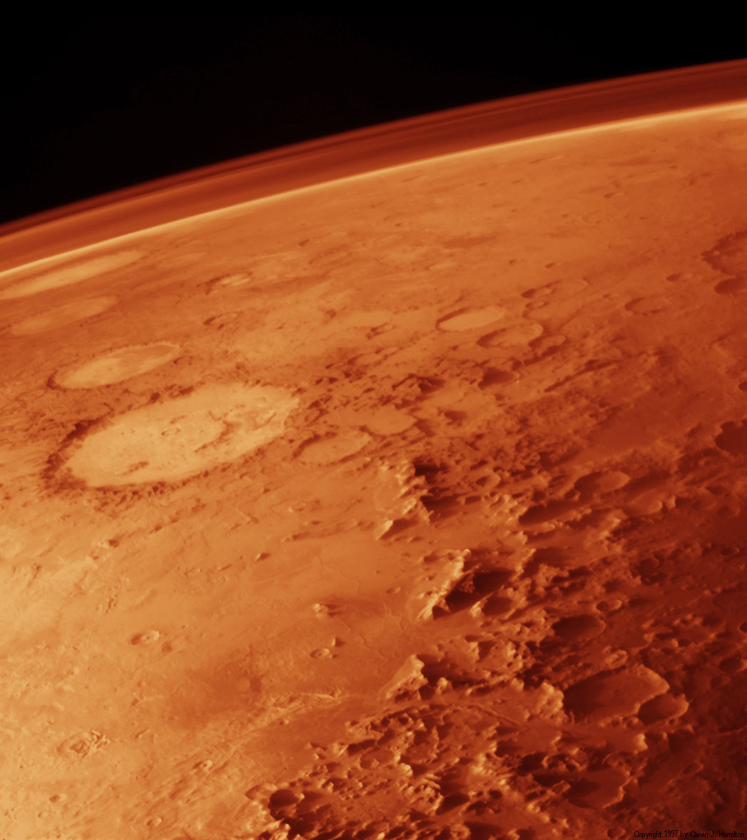
Martian Atmosphere
Carbon Dioxide (CO₂): 95.32%
Nitrogen (N2): 2.7%
Argon (Ar): 1.6%
Oxygen (O₂): 0.13%
Water (H₂O): 0.03%
Neon (Ne): 0.00025 %
1/1,000 as much water as our air
only enough to cover the surface
of the planet with 0.4 inches if
melted out of the atmosphere!!
Martian atmosphere does not
regulate the surface temperature
on the planet as Earth’s

Slide 13
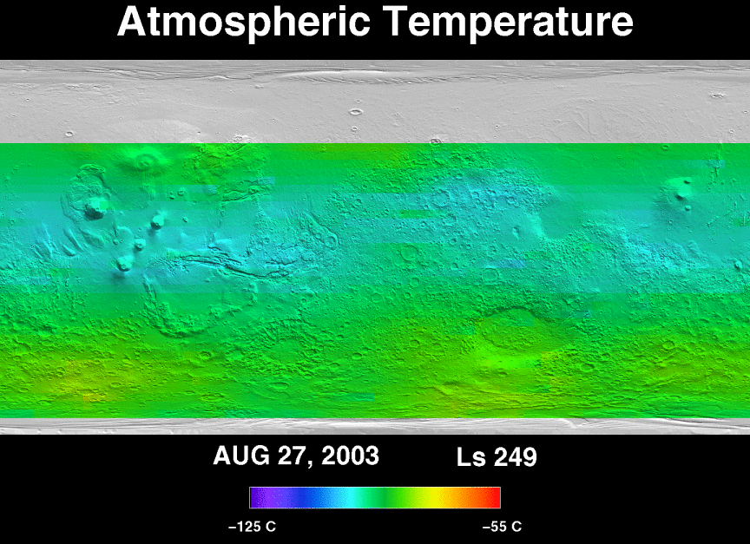
Mars Global Surveyor
TES instrument

Slide 14
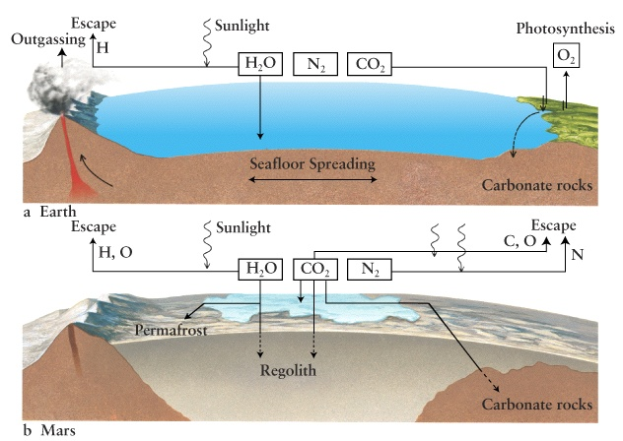
History of Mars’ atmosphere: first like Earth’s
Atmospheres of terrestrial planets created by out-gassing of volcanoes
- ~4 Billion years ago (Mars/Earth = same atmosphere)
- volcanic gasses: nitrogen, CO2, water vapor
H₂O in atmospheres condensed to create oceans on Earth
CO₂ cycles through our atmosphere: volcanoes/carbonate rocks

Slide 15
What happened to the atmosphere on Mars?
CO₂ and H₂O may have condensed out and onto the surface
  – got so cold, that the water froze into permafrost
End of volcanic activity, however, would stop the cycle
Strong UV light from the Sun will break up chemicals on surface
and cause them to evaporate

Slide 16
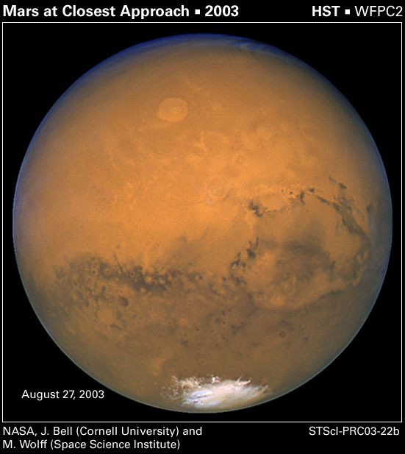
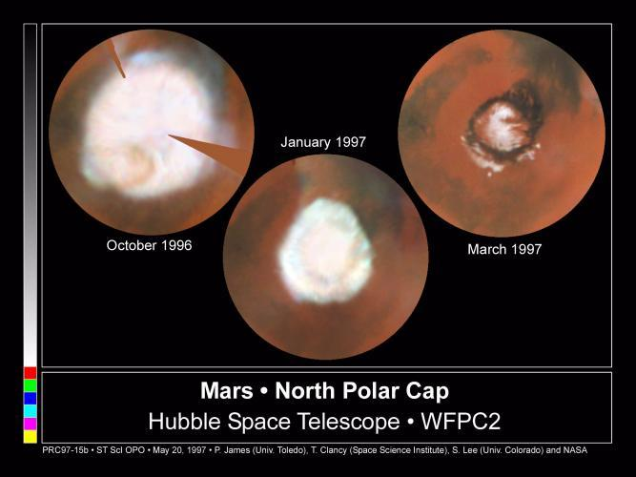
Storage place for Water: some in N Polar Cap!
Caps are frozen carbon dioxide CO₂ (‘dry ice’) and some frozen water
notes on frozen CO₂
- CO₂ freezes at T~150 K (~ -200 F)
- block of ‘dry ice’ T~ -110 F
- sublimes directly ice to gas
Southern residual cap is ~300 km across, T ~150 K.
Northern cap is ~1,000 km, T~200K (implies mostly water ice b/c CO₂ ice would be sublimating)

Slide 17
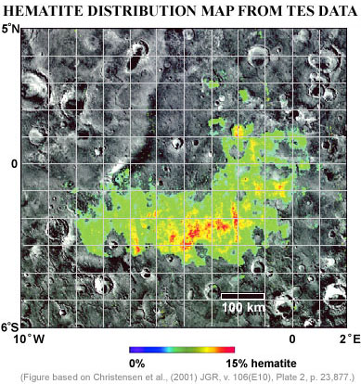
Chemical Evidence:
Looking for presence of minerals which suggest water
Small amounts of water vapor in the atmosphere indicated
that much of the planet’s water lost to space – evaporated
Recent Mars missions have looked for evidence of carbonates
  large seafloor beds resulting from consumption of atmospheric CO₂
  finding little or none – this is problematic, controversial
Recent Mars missions have found
Hematite – a signature of dried-up
lakes on a few places on the planet
from TES instrument on MGS

Slide 18
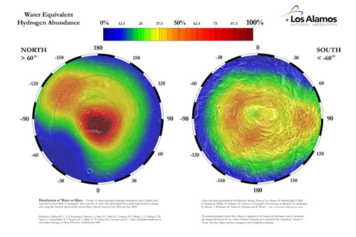
Recent Chemical Evidence for water on Mars:
Detection of Hydrogen (Mars Odyssey - 2003)

Slide 19
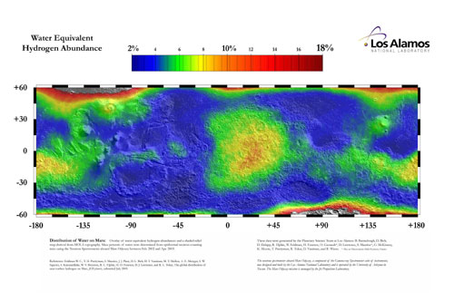
Recent chemical Evidence for water on Mars:
Detection of Hydrogen (Mars Odyssey - 2003)

Slide 20
Theories for Water on Mars: WET, WARM MARS
early atmosphere was dense
  - could support water in liquid form
  - could “rain” out the CO₂ onto the surface
large beds of carbonate form in standing water like on Earth (Oceans)
water would be plentiful on Mars, could generate the observed features
Theories for Water on Mars: COLD, DESERT MARS
Never right conditions for water to condense and to create erosions
Have to rely on other eroding agents:
- wind?
- dust?
- liquid carbon dioxide?

Slide 21
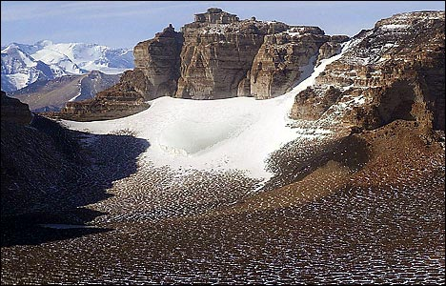
Theories for Water on Mars: Current Data & Ideas…
Mars probably did have a “warmer, wetter” past, but not extreme
- studies show water can exist in ice-covered lakes
- as long as temperatures get above freezing for a few days
- clues from glacial regions on Earth have helped
Geological Evidence:
Use Ancient Lakebeds/Glacial Lakes
as analogy

Slide 22
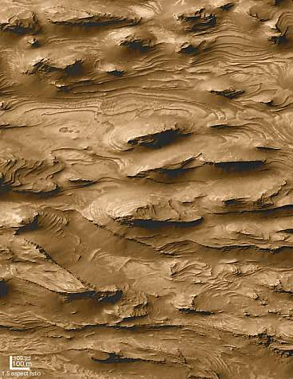
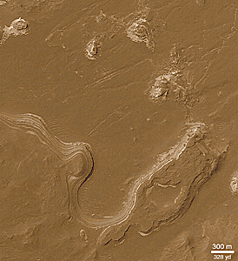
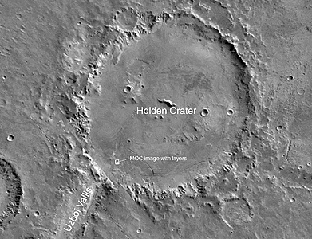
Geological Evidence:
Layered Sedimentary Features
141 km (88 miles)
Holden Crater

Slide 23
Theories for Water on Mars: Current Data & Ideas…
Also can invoke CYCLES of warm, wet climates
- volcanic activity generates atmosphere for short periods
- water starts flowing again (unfreeze it)
- create the observed layers of water erosion features
- water freezes into permafrost under Mars surface
Also can invoke an active underground system of water
- water lower down may be able to be liquid
(warmer near Mars’ core)
- volcanic soils (megaregolith) are incredibly porous
The final word… keep watching the skies (NASA)
Monday: review of current/future Mars Exploration
New results in every day!

Slide 24
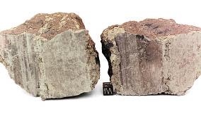
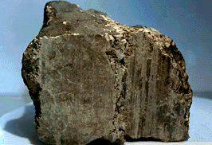
Martian Meteorites
Martian data
without going
there!
What are these “meteorites”?
Unusual rocks found in Antarctica
How did they get to Earth?
An impact on Mars (crater size: 10-100 km) ejected
part of the Martian surface
How do we know these meteorites are from Mars?
Chemical composition does not match usual meteorites
Only 1.3 billion yrs old (most asteroid-type meteorites
MUCH older); Higher content of volatile substances
Why aren’t they orange – the color of Mars surface?
Has to do with how the rocks weathered

Slide 25
What DO they tell us?
Physical processes on Mars
    Crust/core developed early in Solar System
Volcanism until < 1 Billion Years ago
Chemical composition
    Interaction with water
    Martian atmosphere composition
What DON’T they tell us?
Location of origin
Enough about Mars’ water & atmosphere
Need to RETURN ROCKS from Mars!!
Case Study: Martian Rock ALH84001
Mass = 1.9 kg
Igneous Rock
Discovered in Antarctica (easier to find) 1984
Formed on Mars 4.5 Billion yr ago
Ejected ~16 Million yr ago
Landed ~13,000 yr ago

Slide 26
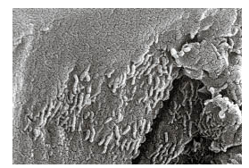
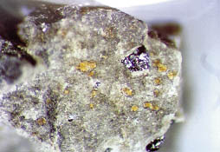
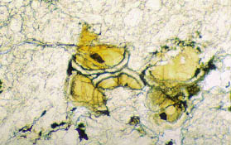
Controversial – microbial presence in meteorites??
Globules of carbonate minerals (the yellow-orange grains) are scattered along cracks in this small chip of ALH 84001.
The rims contain iron oxides (including magnetite) and iron sulfides--incompatible minerals that on Earth would suggest microbial action
Close up views reveal structure similar to Earth microbes!

Slide 27
Mars has a very thin atmosphere and no magnetosphere.
If humans populated the Martian surface, what environmental
problems will they be concerned about?
Global Warming
(2) Solar flare particles and ultraviolet radiation
(3) Nitrogen poisoning
(4) Lead contamination from volcanoes
(5) Magnetic anomalies in the interior causing brain disorders

Slide 28
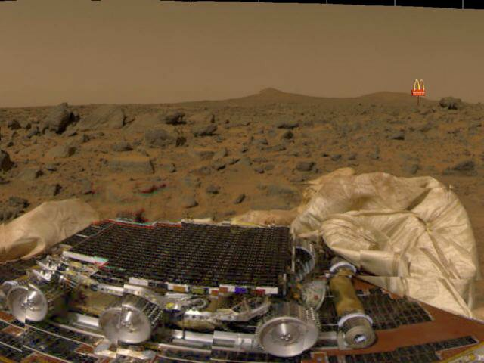
Monday: Mars Surface Exploration

Slide 29
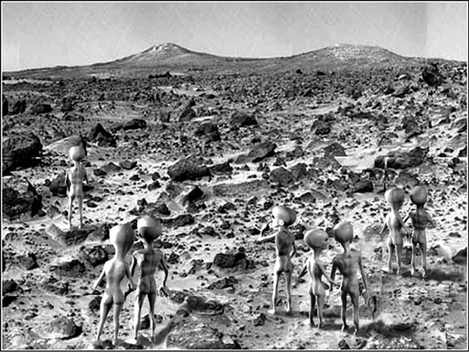
Monday: Mars Surface Exploration

Slide 30
This powerpoint was kindly donated to www.worldofteaching.com
http://www.worldofteaching.com is home to over a thousand powerpoints submitted by teachers. This is a completely free site and requires no registration. Please visit and I hope it will help in your teaching.

